Slide 1
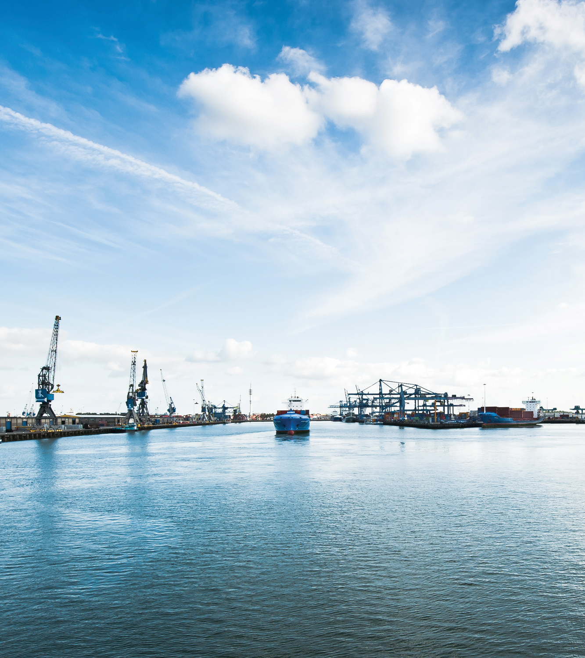
ZERO BRINE
Final Forum
De Oude Bibilotheek, Delft,
The Netherlands
4 November 2021 (10:00-16:30 CET)

Slide 2
IMPACT OF ZERO BRINE
CLOSING SESSION

Slide 3
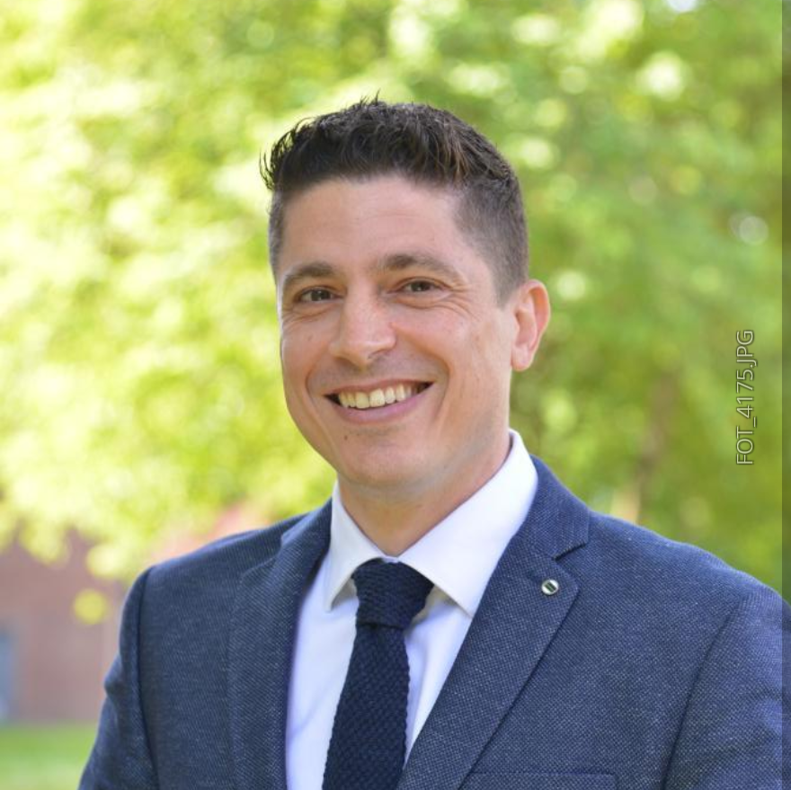
Dr. Dimitris Xevgenos
Innovation Manager
ZERO BRINE
Dr. Dimitris XEVGENOS is Senior Researcher at Applied Sciences faculty at TU Delft. During the past 10 years of his research career, he has designed and developed cutting-edge technology on circular economy (CE) and resource recovery solutions and delivering them to the market. Dimitris has a strong interdisciplinary engineering background, covering the fields of mechanical engineering (BSc), electrical engineering (MSc), chemical engineering (PhD) and civil engineering (Post Doc). He is the Executive Coordinator of the WATER-MINING project. Dimitris has initiated and prepared several research proposals, raising approx. 40 million EUR through highly competitive LIFE and H2020 calls.
BUSINESS CASES AND CIRCULAR ECONOMY

Slide 4

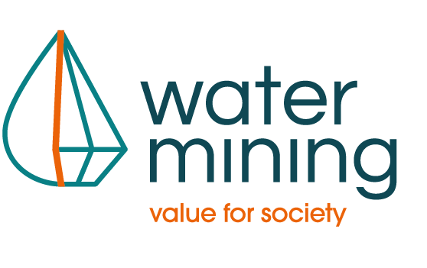
ZERO BRINE & Market implementation
ZERO BRINE Final Forum
Delft, Thursday, 4 November 2021
Dr. Dimitris Xevgenos,
Innovation Manager, ZERO BRINE
Exec. Project Coordinator, WATER-MINING

Slide 5
Outline
Introduction
ZERO BRINE Task Force
WATER-MINING & a new initiative
Chlorine recycling demo

Slide 6

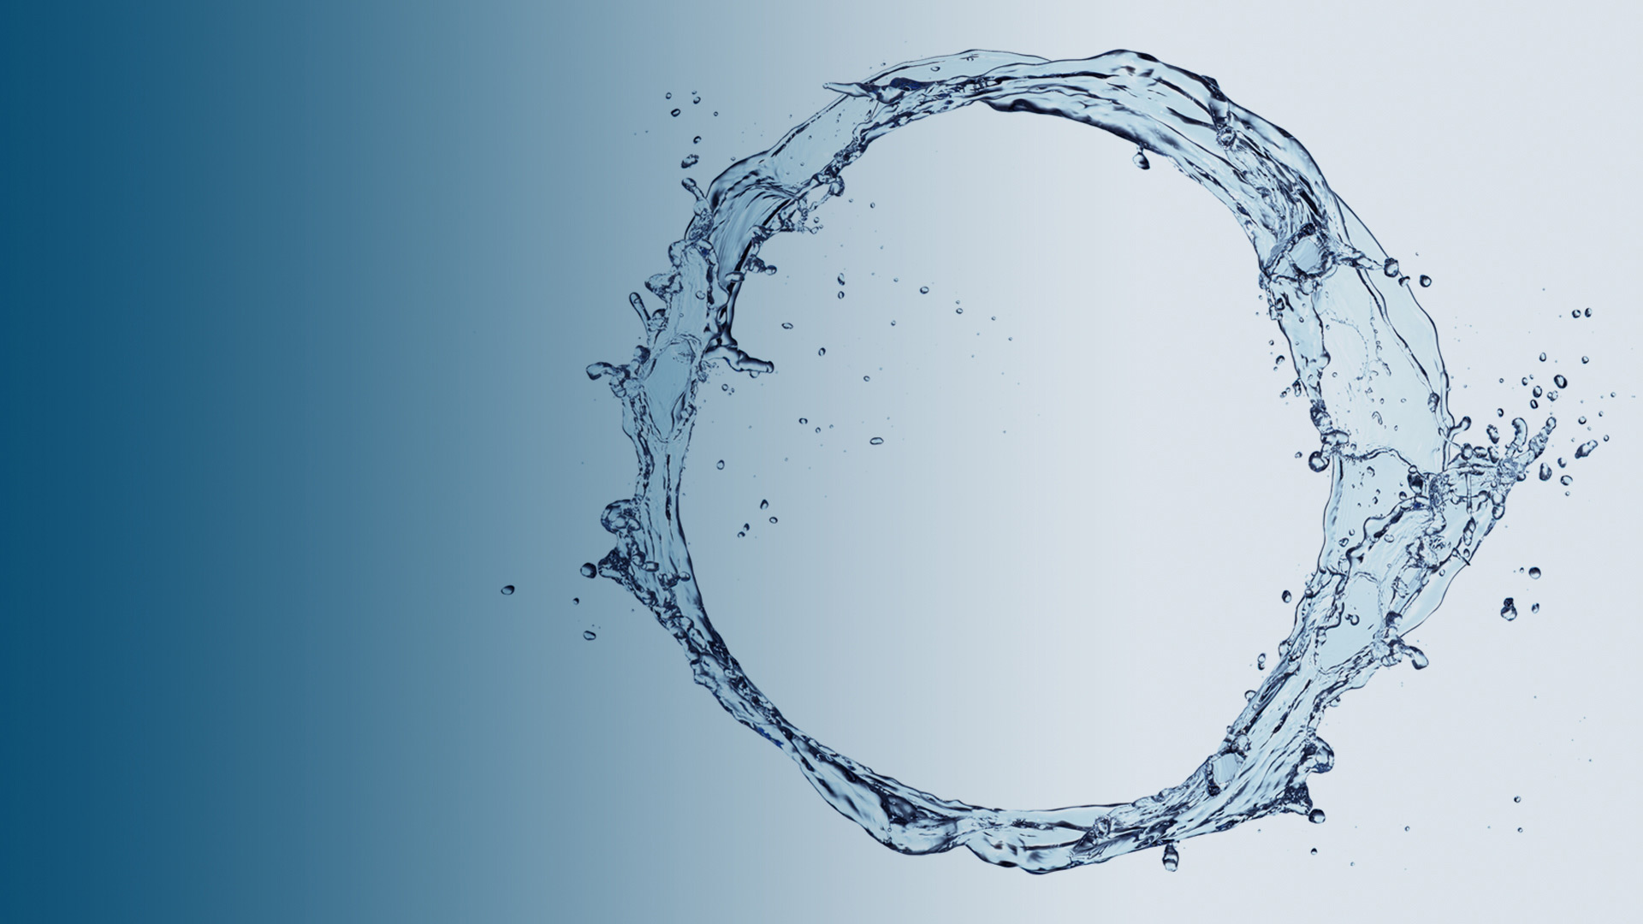
Industries are looking for ways to close the loop and move to a circular economy

Slide 7
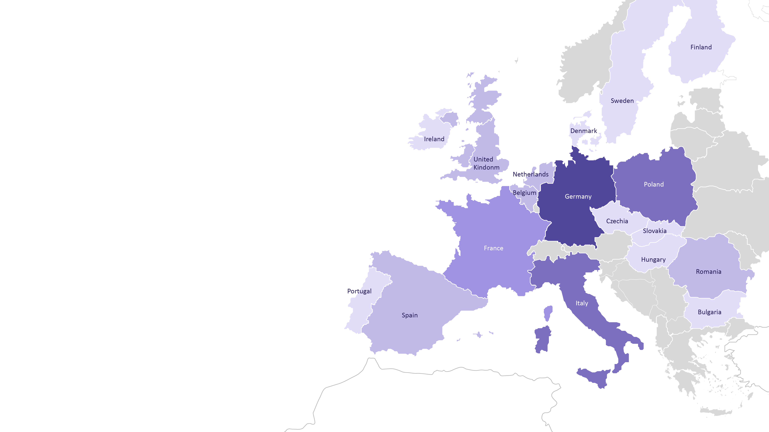
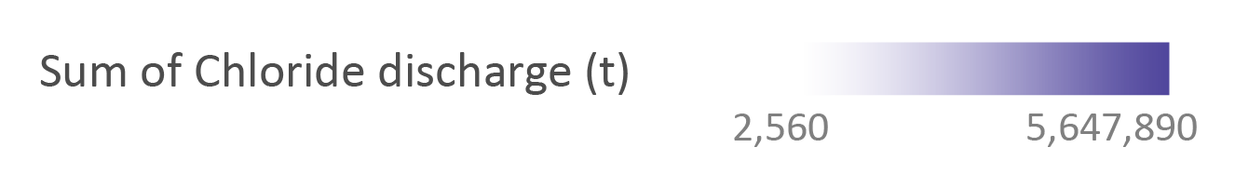
Brines: a shared problem
18Mt
Chloride releases (2017)
713
facilities

Slide 8
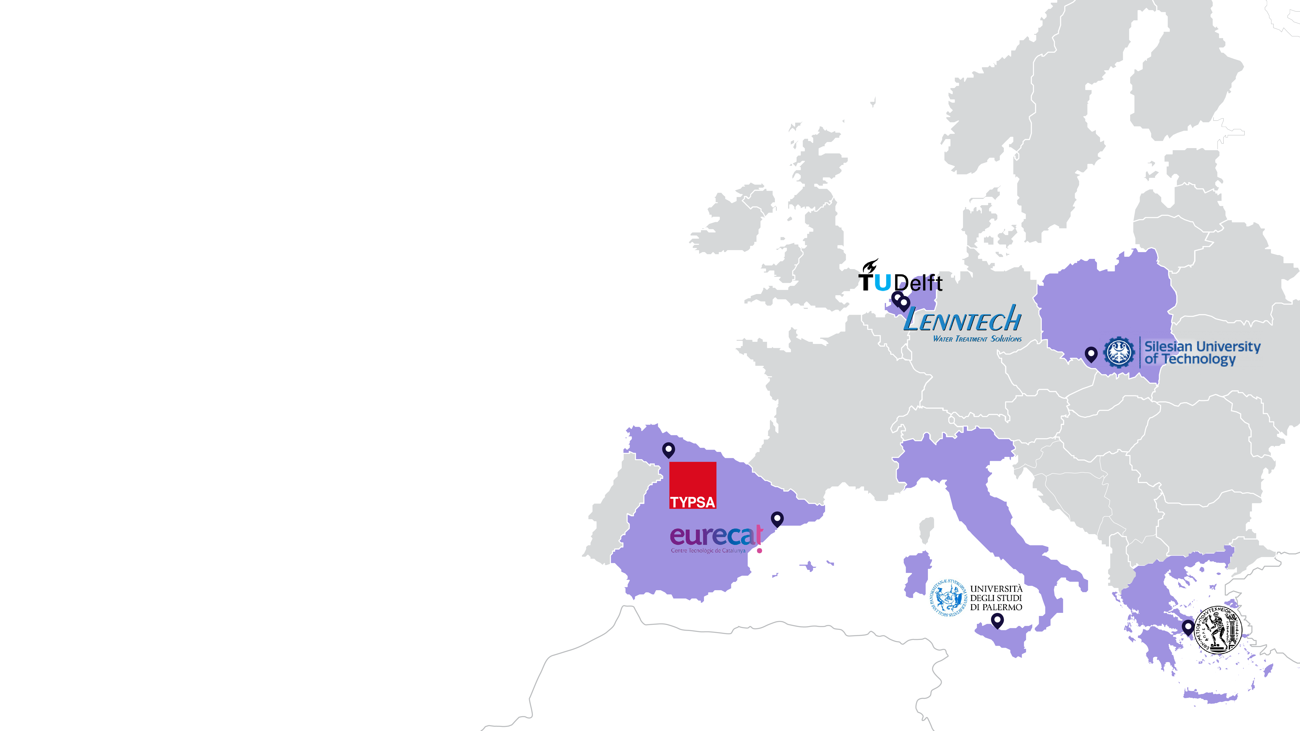
Disruptive brine treatment technologies
In five EU Countries, 10 organizations have been developing leading & disruptive technology on brine treatment
Challenge/Research question:
How can the interests of water innovators be aligned into joint exploitation pathways towards circular economy implementation (sustainable development)?
Notes:
Sustainable business models are rarely implemented in the market and when they do they fail.

Slide 9
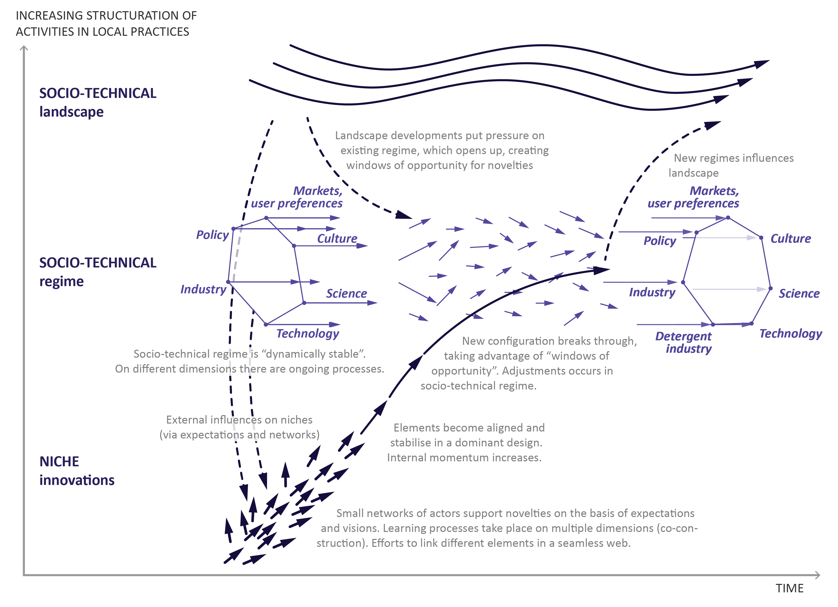
Dynamic multi-level perspective on system innovations
How to align interests of individual technology innovators into joint exploitation pathways towards CE implementation?
1
How to design a circular economy solution based on systemic innovation that will be taken up by the market (mainstreamed in the regime)?
Other
industry
2
2
1

Slide 10
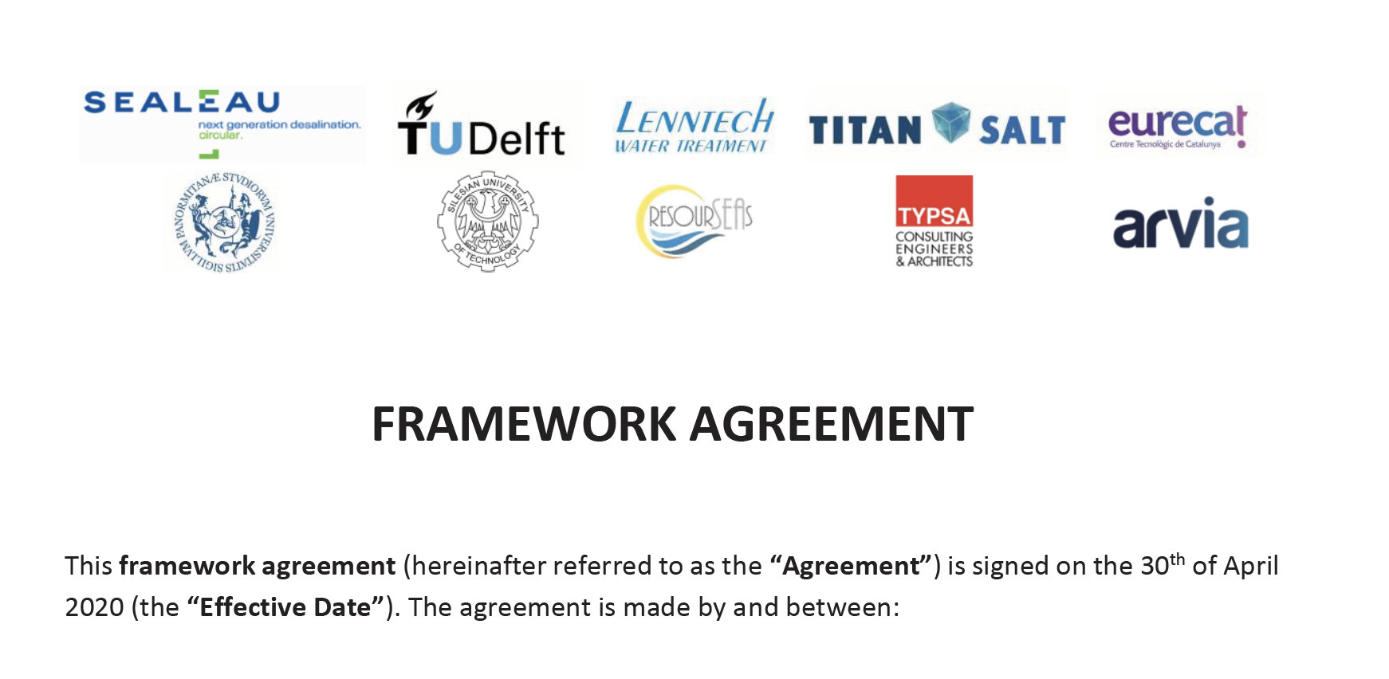
Establishing the ZERO BRINE Task Force

Slide 11


Slide 12
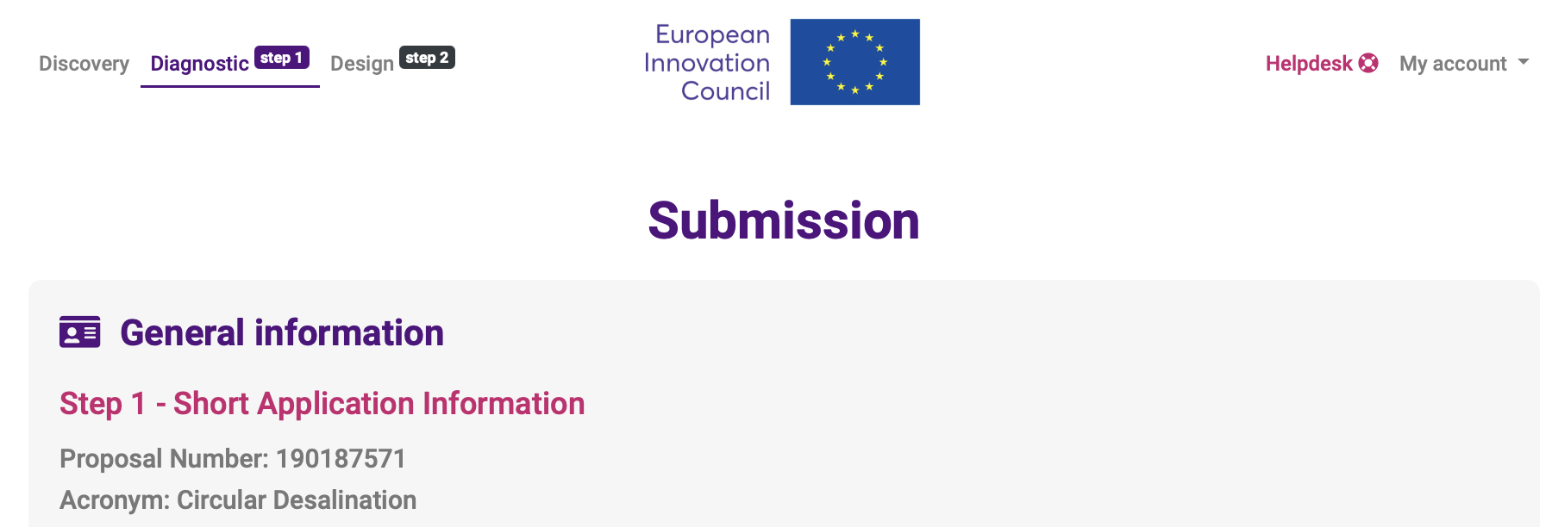
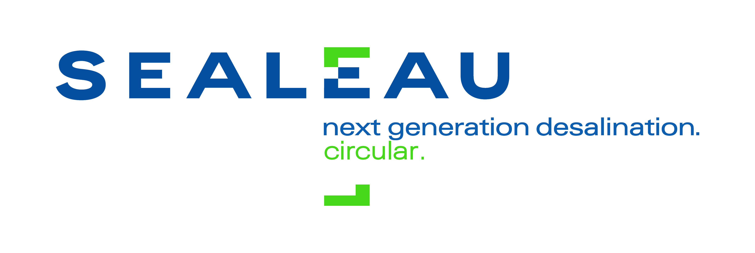
“Demonstrating the first of its kind circular and decarbonised desalination technology to enable wide deployment and transformation of the desalination sector by 2030”
€17M
CIRCULAR
DESALINATION

Slide 13


Slide 14
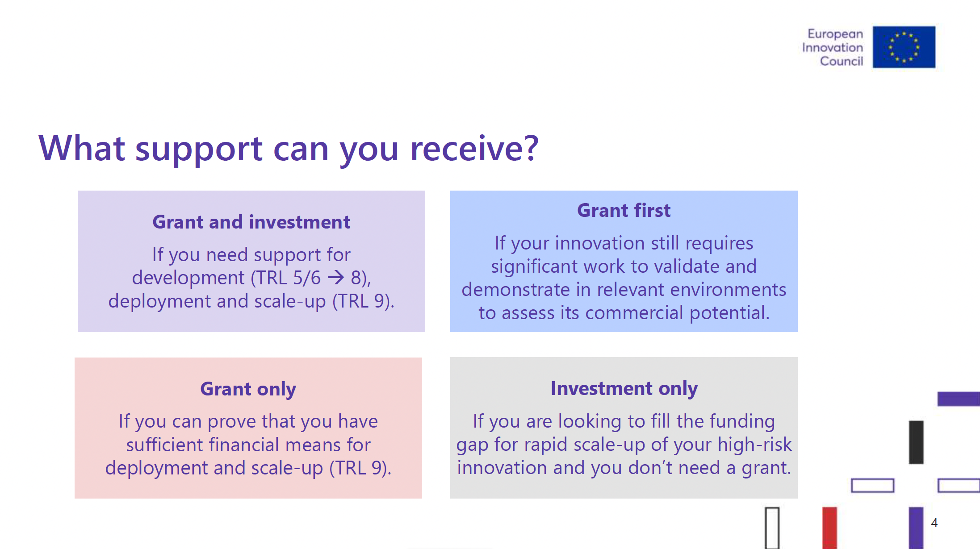

Slide 15
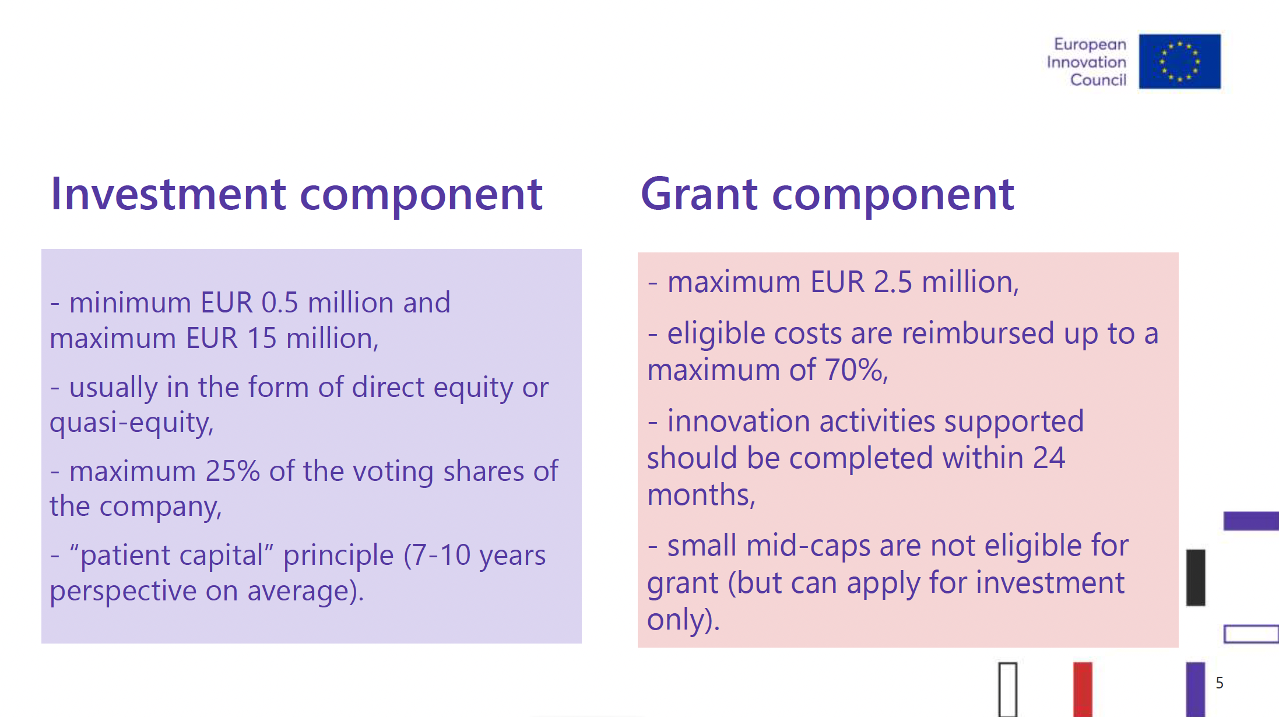

Slide 16
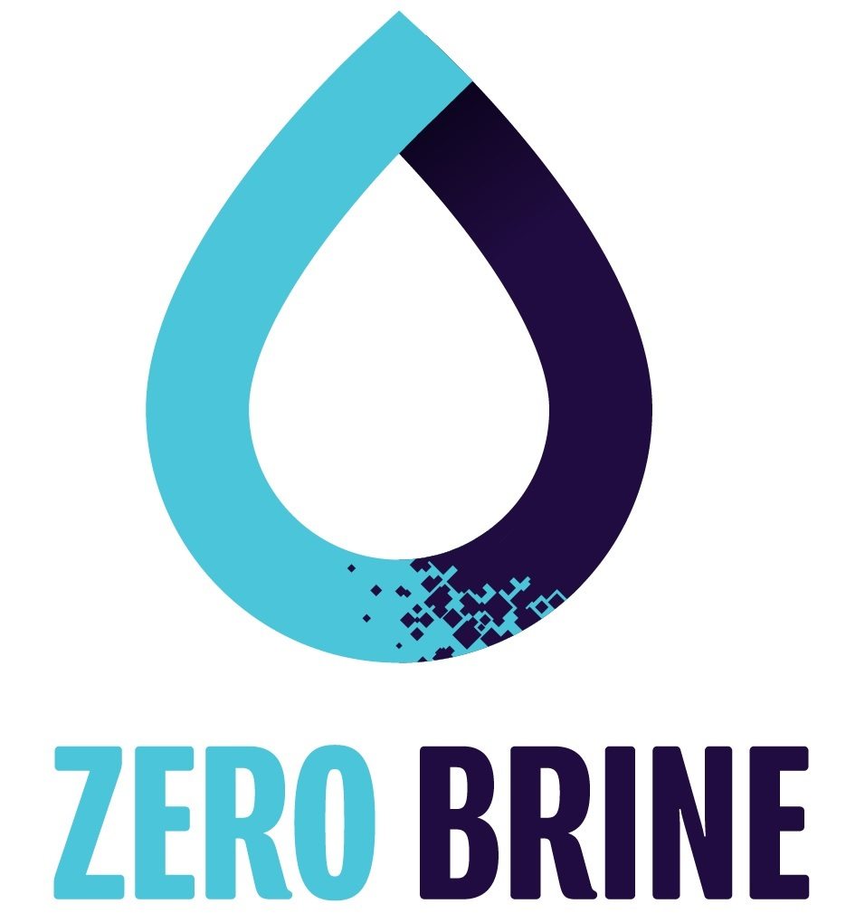
“Next generation water-smart management systems: large scale demonstrations for
a circular economy and society"
“Re-designing the value and supply chain
of water and minerals:
a circular economy approach for the recovery of resources from saline impaired effluent (brine) generated by
process industries”
€10M
BUDGET
€19M
BUDGET

Slide 17
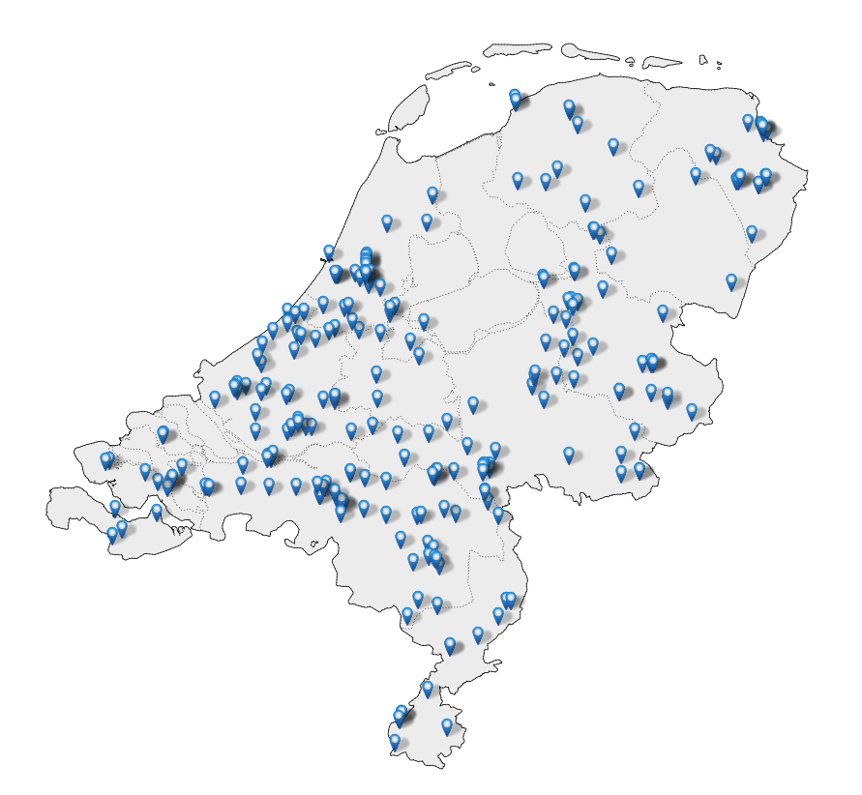
Emissieregistratie: Chloride releases
277
FACILITIES
870
KT CHLORIDES/YEAR

Slide 18
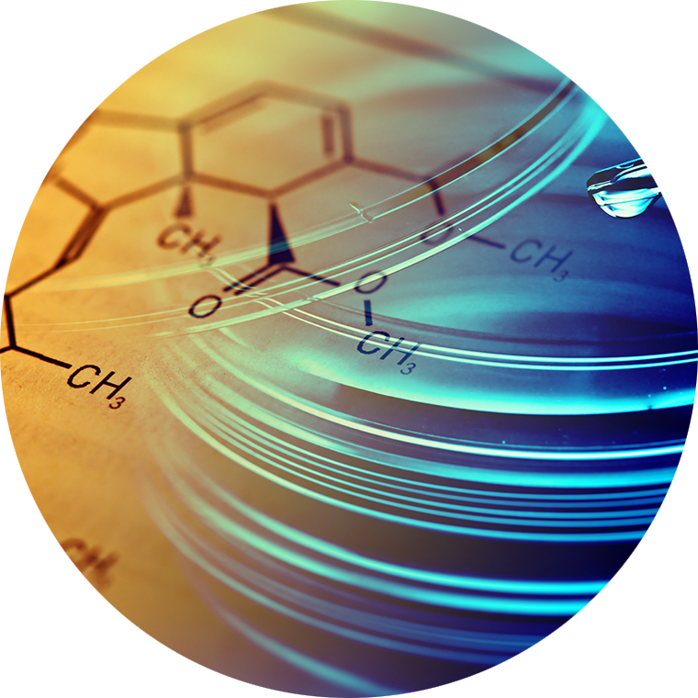
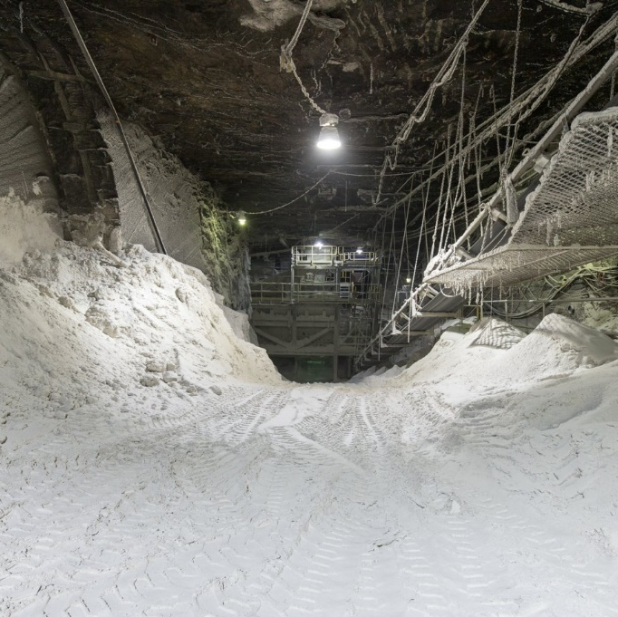

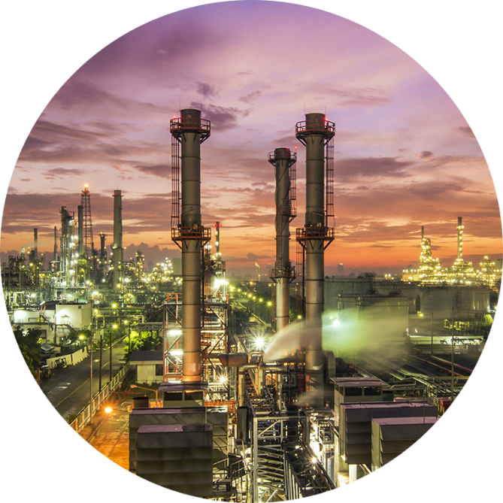
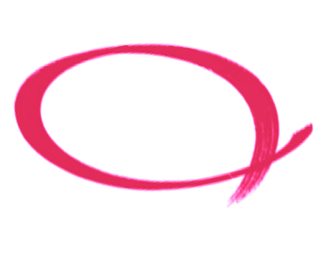
Chloride releases by main sectors
CHEMICAL INDUSTRY
SALT MINING INDUSTRY
FOOD SECTOR
OTHER INDUSTRIES
61%
29%
5%
5%

Slide 19
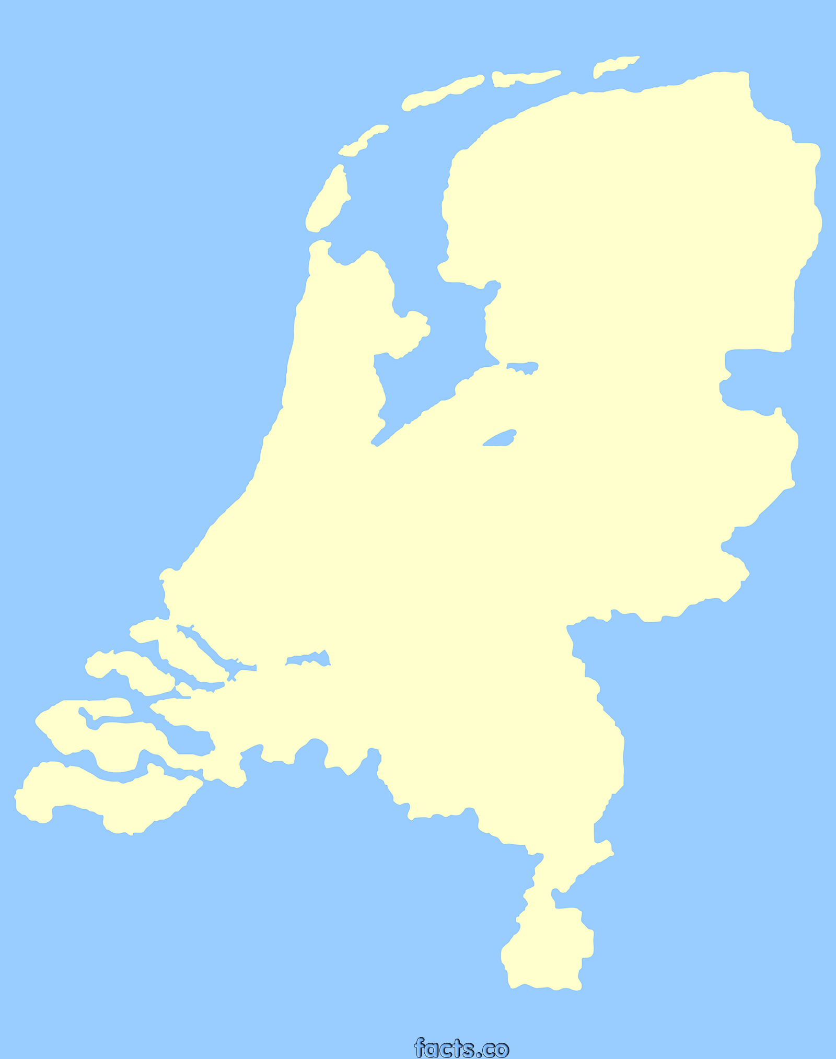
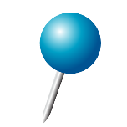
Delfzijl
The Netherlands is the 3rd largest producer of salt in Europe
Market share: NOBIAN: 84.2%, Frisa Zout: 11.4% and Nedmag: 4.4%
Salt production: 6.6 Mt (2013)
43% (2.9Mt) is exported (mainly to Germany, Belgium and Scandinavia),
47% (3.7Mt) domestic consumption
  the largest part is used in the chlor-alkali industry e.g. Chlor-alkali plant in the Botlek area (NOBIAN) uses 27% (or 1,000kt) of the total domestic salt consumption
Botlek

Slide 20
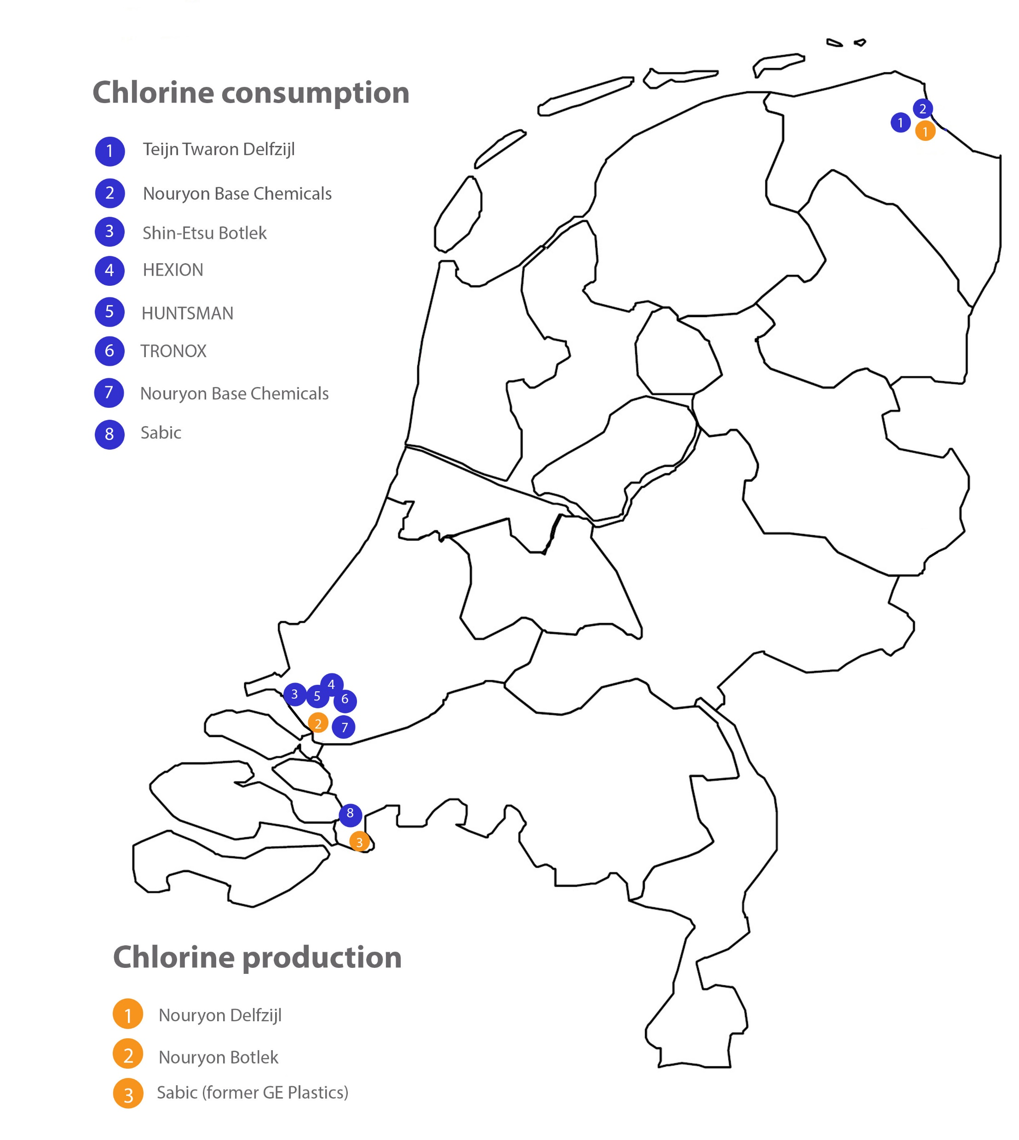
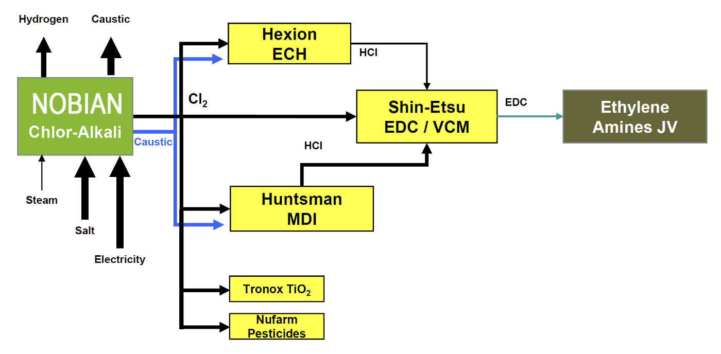
Chlorine cluster in
Rotterdam

Slide 21
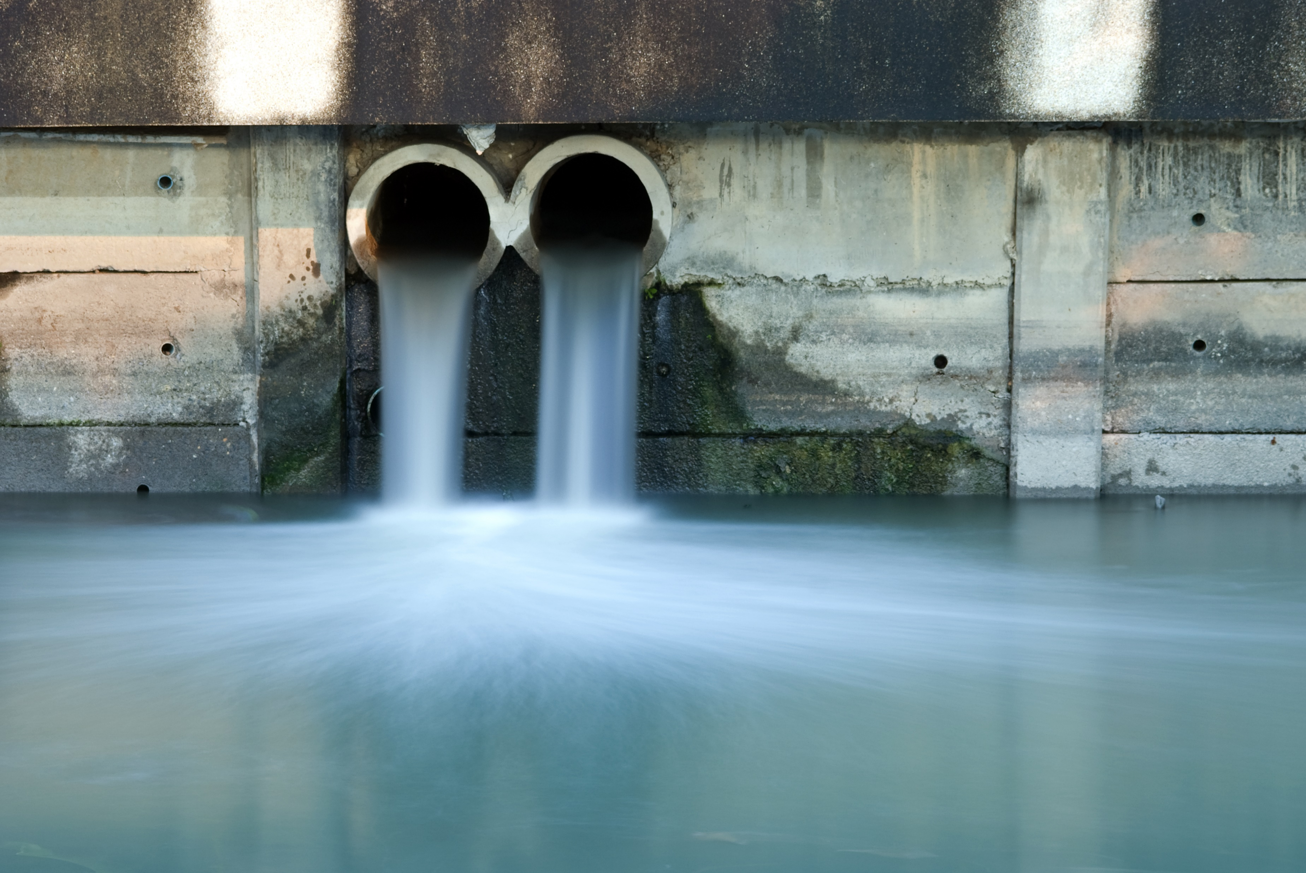
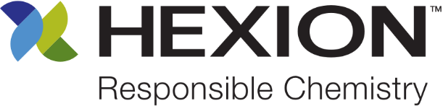
But how to reuse 3,000,000 m³ of wastewater, containing salts and organics?
50 kt NaCl salt
100 kt CaCl₂ salt
Notes:
Formulate the problem or change: Objective/Statement of the Problem or Research Question(s)
Provide end-use application/process overview
Describe the problem
Define terms and labeling to enable everyone to understand the topic, give a brief background of the topic you are discussing/presenting
Get your viewer interested in the issue or question

Slide 22
Current situation: linear production process
Linear business: salt → chlorine → product + brine (salt) waste treatment
Bringing salt from sedimentary deposits underground to the sea

Slide 23
Optimized treatment train
LER Plant
Wastewater Vessel
V2020/33
Wastewater ~ 12% NaCl 2000 ppm TOC
Shell Biotreater
O2
Water, Solvent
HCl
Catalyst
CO2, CO, O2
NaOH, Filter Aid
Conc. with MED
1-2 m3/h
Brine conditioning
High Pressure Oxidation
Catalyst recovery/ polishing
Nobian
Heat Recovery
Purified Brine
< 5 ppm TOC
12-23% NaCl
Waste heat
Energy
KVT: HPO
0.1 m3/h

Slide 24
Envisioned situation: circular salt
Sustainable solution: recycling of salt
Waste brine produced in epoxy production process has relatively high salt content and no inorganic impurities
Innovative business model : Chemical leasing

Slide 25
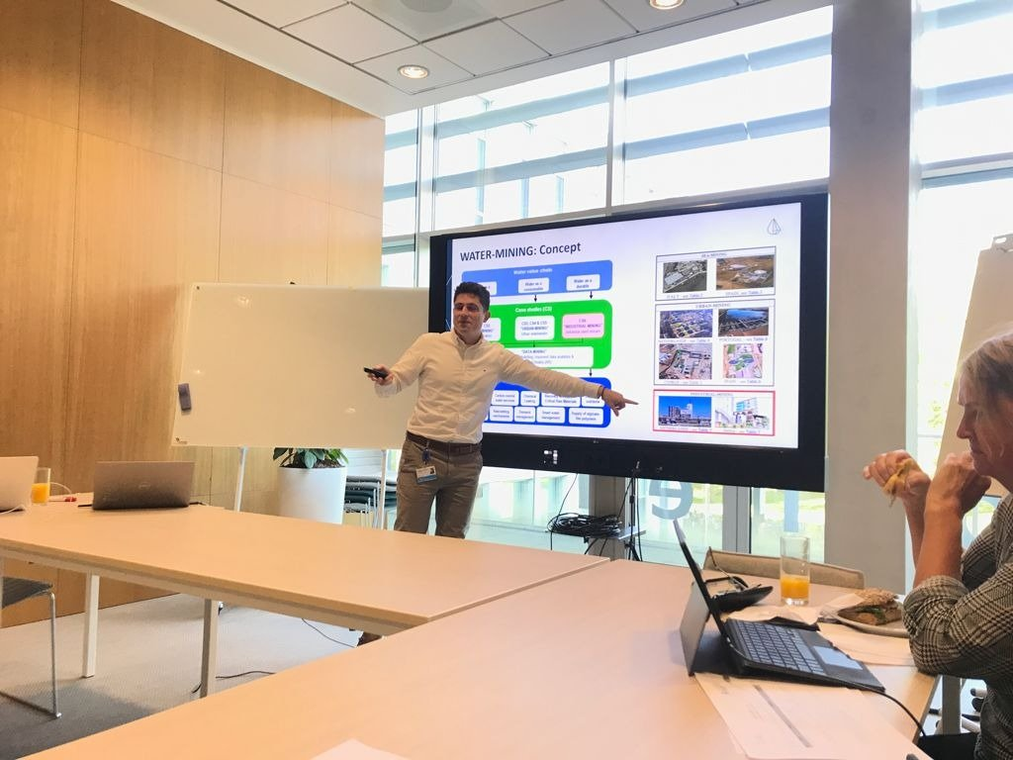
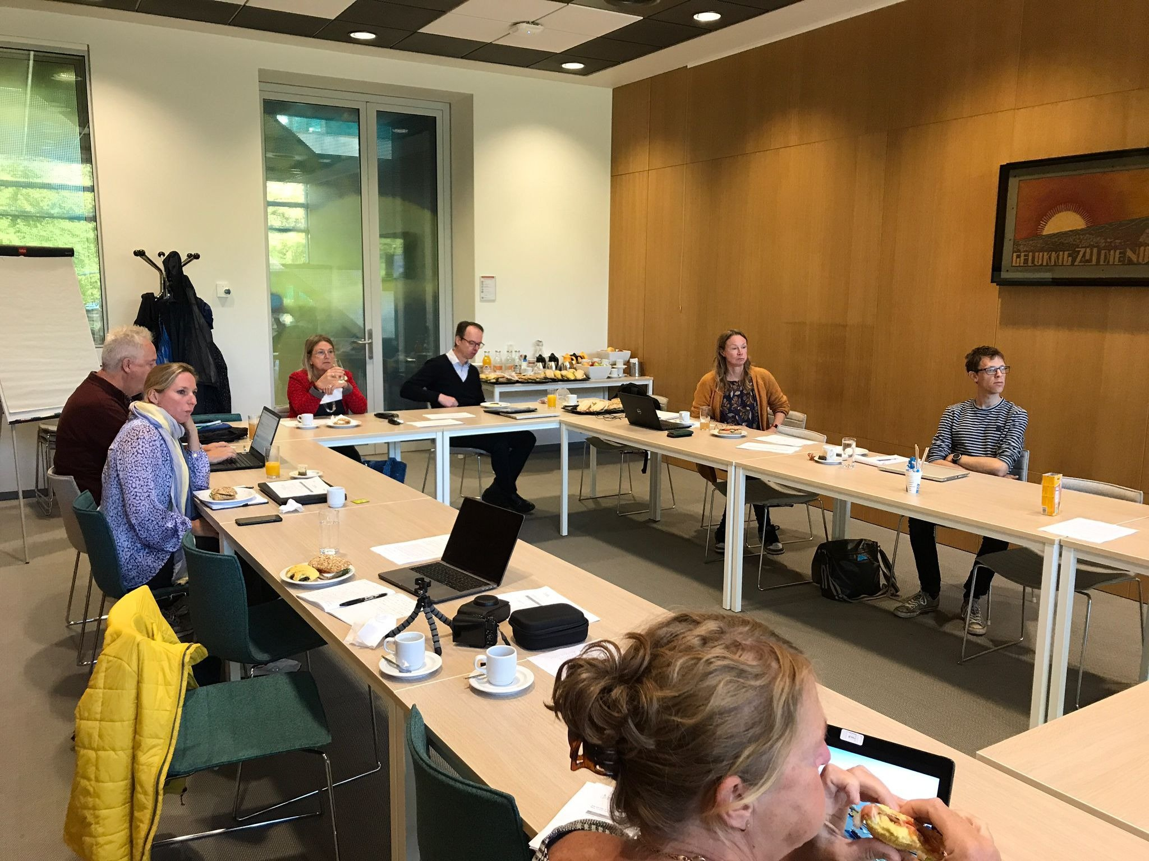
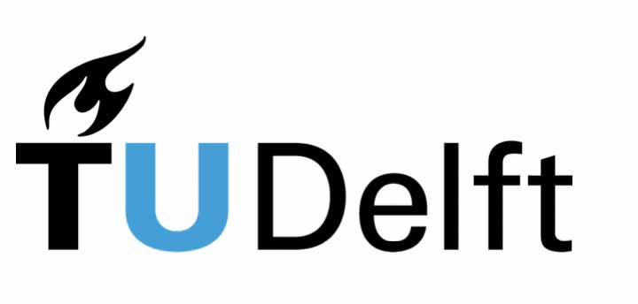
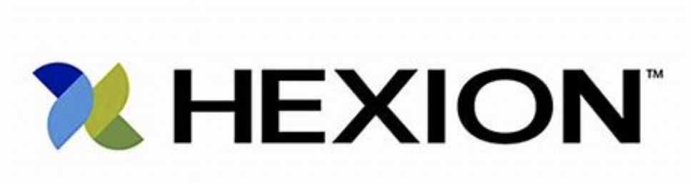
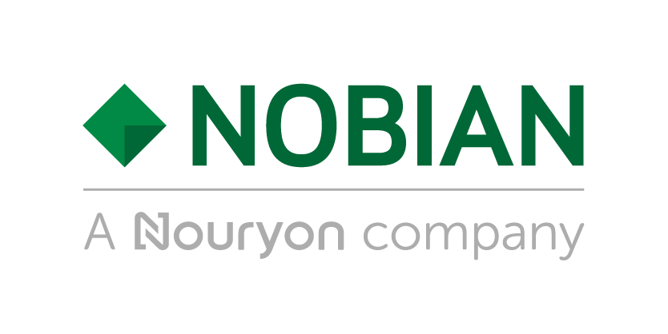
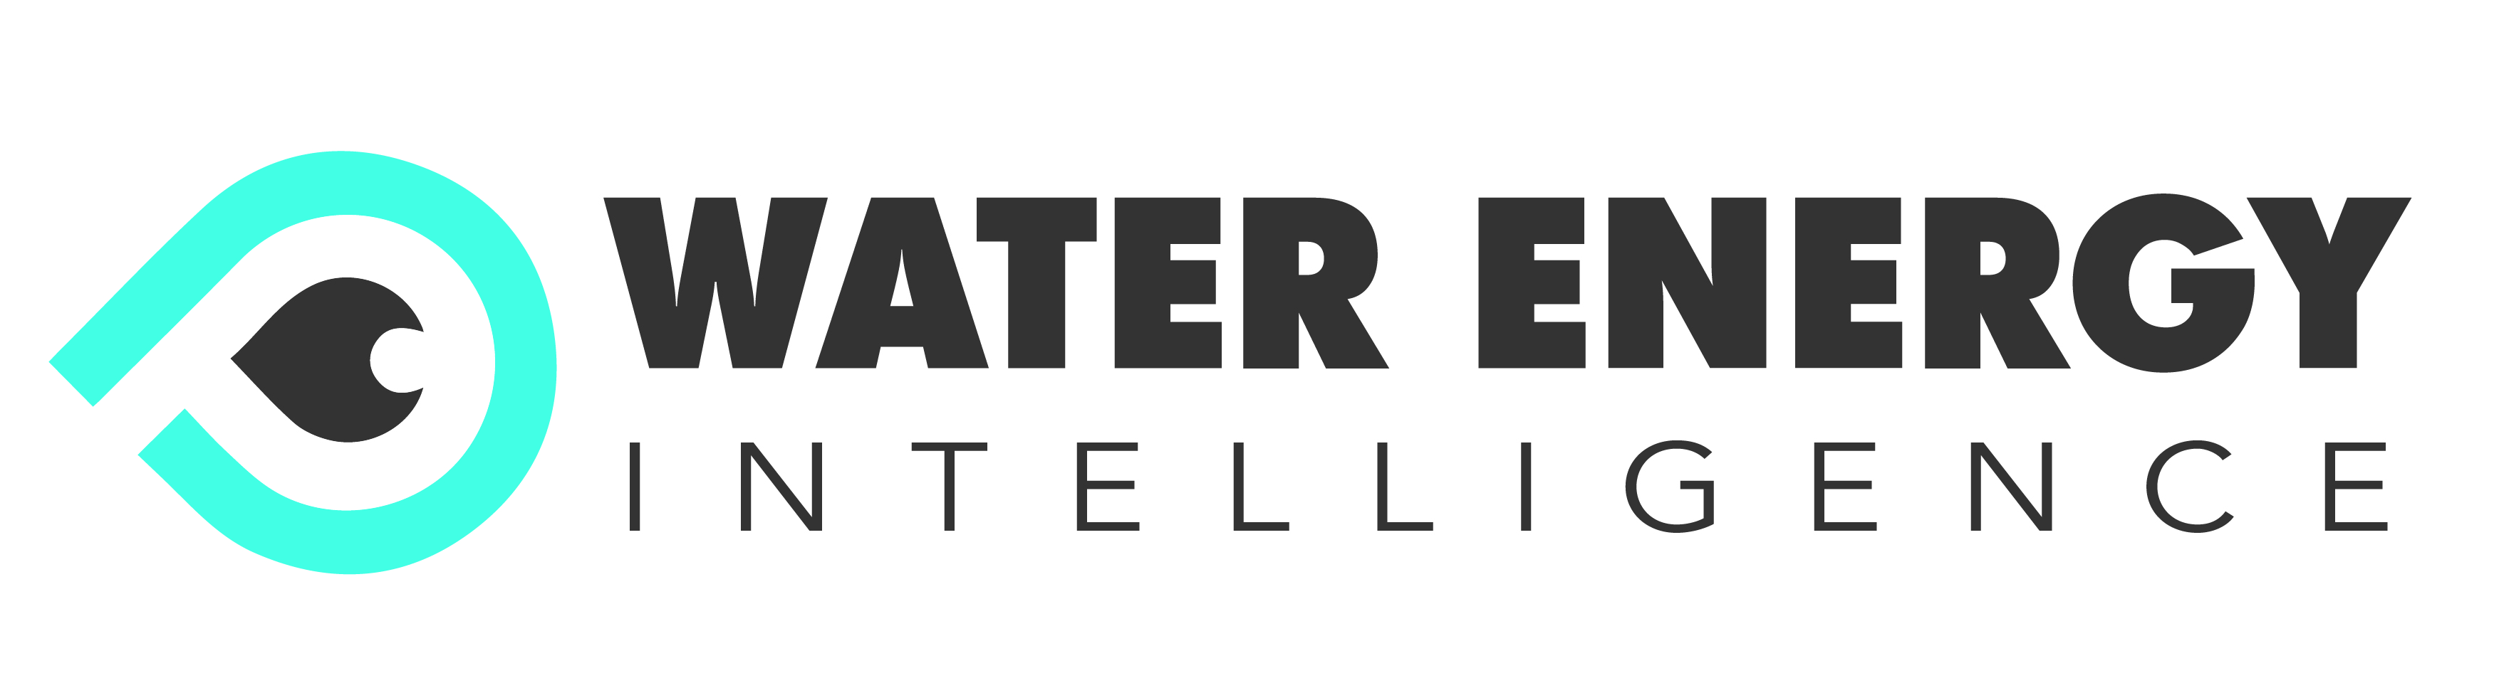
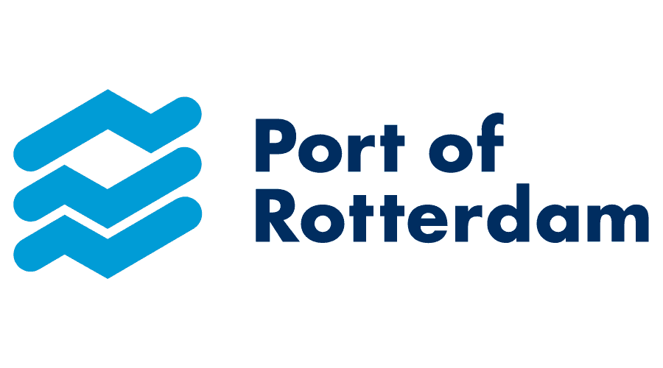
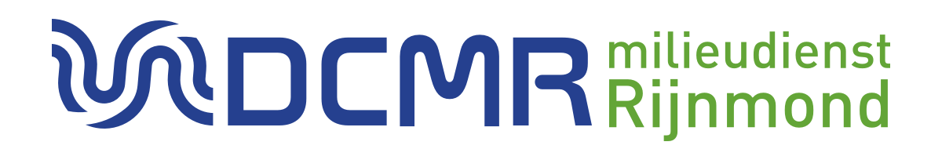
1st CoP meeting: 4 October 2021

Slide 26
Thank you!
Dr. Dimitris Xevgenos,
Executive Project Coordinator, WATER-MINING
Senior Scientific Coordinator,
DELFT University of Technology
Email: d.xevgenos@tudelft.nl
www.watermining.eu

Slide 27
Zero Brine
Policy Review
Dr Maria Kyriazi
National Technical University of Athens
makyriazi@gmail.com

Slide 28
Policy review and assessment
WFD
REACH
Industrial Emissions Directive
Policy review and assessment
WFD + EoW

Slide 29
REACH (1907/2006)-Steps need to be followed
REACH: Registration, Evaluation, Authorization and Restriction of Chemicals
Valorization of recovered salts is strongly taken into consideration.
Market of chemicals is subjected to legislation to ensure safety.
REACH is the regulation for improving protection of human health and environment from risks caused by chemicals.
NaCl, CaSO₄, Mg(OH)₂, Ca(OH)₂, NaHCO_{3,} Na₂SO_{4,}
are recovered from brines

Slide 30
REACH and recovered materials in ZeroBrine
Registration: According to REACH for the commercialization of a chemical, upload of safety and toxicological data folder to the platform of ECHA (European Chemical Agency) is necessary.
All recovered salts in ZB have been already registered.
According to REACH if an industry wants to commercialize a chemical, already registered, need to send an access letter to ECHA and pay the relevant fee for taking access to the folder with the safety and toxicological data.
Industries using recovered salts for their own processes do not need to follow this procedure.

Slide 31
REACH and recovered materials in ZeroBrine
The procedure needed to be followed is clearly described in ECHA-REACH sites.
All ZB operators have been informed adequately about the procedure.
No obstacles exist for salt commerciali-zation and the application of REACH.

Slide 32
Water Framework Directive (WFD 2000/60/EC)
Aim: Good qualitative and quantitative status of water bodies and their dependent wildlife/habitats.
Water recovery and reuse are encouraged and shown as alternative water source.
This philosophy is mainly referred to urban and not industrial wastewaters.
The WFD is mainly oriented to the use of recovered water in agriculture and not in industrial sector
Gaps in National legislations on the use of recovered water in industrial sector.

Slide 33
Water Framework Directive (2000/60/EC) and recovery of water in ZeroBrine
Zero Brine is in full agreement with WFD as:
The systems design takes into consideration the relevant EU and local policy legislation.
Achieve appropriate quality level of treated water.
Take into consideration human health, environmental risks and carbon footprint
Provide treated water to industry or agriculture. This way the use of treated industrial wastewater substitutes the use of drinking, surface or underground water.

Slide 34
Waste Framework Directive (2008/98/EC) and ZeroBrine
WFD mainly focuses on the fundamental terms of recycling, recovering and by-products.
Aiming to the prevention of municipal waste, increasing recycling, phasing out land filling practices.

Slide 35
WFD and EoW criteria-the four conditions
The Waste Framework Directive (WFD) incorporates the concept of end-of-waste (EoW) by setting out conditions whereby substances or objects which meet the waste definition can achieve, after undergoing a recovery operation (including recycling), a non-waste status and thus fall outside the scope of waste legislation.
The substance or object is commonly used for specific purposes;
A market or demand exists for such a substance or object;
Substance or object fulfils the technical requirements for the specific purposes and meets the existing legislation and standards applicable to products;
Use of substance or object will not lead to overall adverse environmental or human health impacts.

Slide 36
Industrial Emissions Directive (IED 2010/75/EU)-BREFs
IED is one of the main legislative tools for controlling and mitigating industrial impacts on human health and environment.
IED does not refer to specific standards for water emissions.
However, it is clearly mentioned that an industry should be based on BATs (Best Available Techniques) as these referred to BREFs (Best Available Techniques Reference Documents) and national legislation about emission levels, in order to obtain operation permission from the EU Members authorities.
IED covers all the categories of industries participating in ZeroBrine (extractive industry, textile industry, silica industry and water industry).

Slide 37

BREFs (Best Available Technique (BAT) Reference Documents)
2/2
a publication resulting from information exchange between stakeholders
What is BREF?
applied techniques, emissions and consumption levels, techniques considered for the determination of best available techniques and conclusions and any new/innovative technique
What does a BREF describe?
Which is the most important part of a BREF?
Conclusions are the final evaluations of BAT and one of the most important part of BREFs

Slide 38
Why must we review BREFs?
New installations must achieve the BAT standard required before startup.
Existing installations responsible to reconsider everything in production procedure for meeting the BREF’s required standards.
In case of BAT conclusions absence, operators should continue to ensure that their installations meet the highest standards of environmental control.
As science and technologies are continuously developed, new methods and techniques are introduced into the industries. These changes must be included to BREFs. As a result, BREFs must be periodically reviewed and updated.
Notes:
Any new installations must achieve the standard required as this is referred to BAT conclusions before the operation start. The operators of existing installations are responsible for reconsidering everything in production procedure for meeting the BREF’s required standards. In case of BAT conclusions absence, operators should continue ensure that their installations meet the highest standards of environmental control.
As science and technologies are continuously developed, new methods and techniques are introduced into the industries. These changes must be included to BREFs. As a result, BREFs must be periodically reviewed and updated.

Slide 39
What could ZeroBrine offer to IED and BREFs?
1/2
ZeroBrine suggests that IED should be more oriented to circular economy and reuse of water within industrial facilities.
ZeroBrine proposed solutions/systems, for the treatment of wastewater, do not have the perspective of pollutants removal from brines in order to discharge treated water to the receiving water bodies.
ZeroBrine suggests systems which have as target the recovering of valuable salts for the European and International market and clean water production that could be used by the same or another industrial sector.
Concluding: ZeroBrine proposed systems are based on Circular Economy Strategy, Industrial Symbiosis and Zero Pollution Ambition and they embed the main principles of Water Framework Directive and Industrial Emissions Directive.

Slide 40
Thank you for your attention

Slide 41
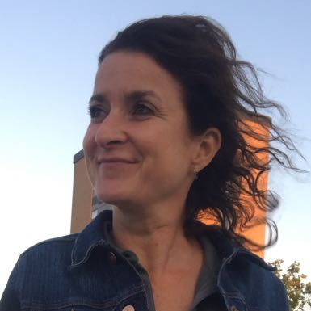
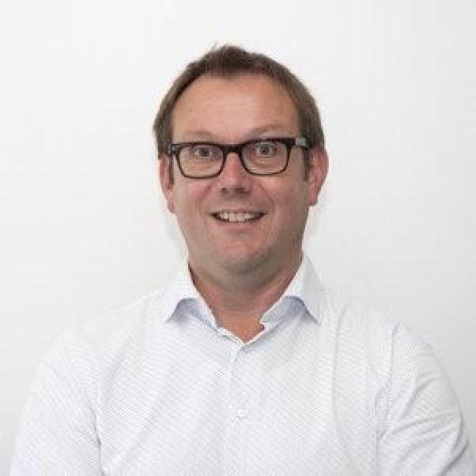
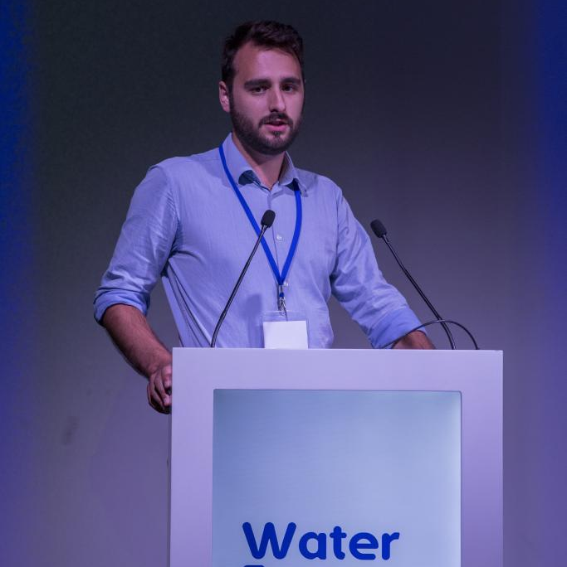
Corinne van Voorden
Advisory Board Member
ZERO BRINE
Gijsbert Korevaar
Assistant Prof Policy Management Studies
TU Delft
Loïc Charpentier
Water Innovation Policy Officer
Water Europe
EU POLICY PANEL – HOW CAN ZERO BRINE SUPPORT CIRCULAR ECONOMY IN EU POLICIES?

Slide 42
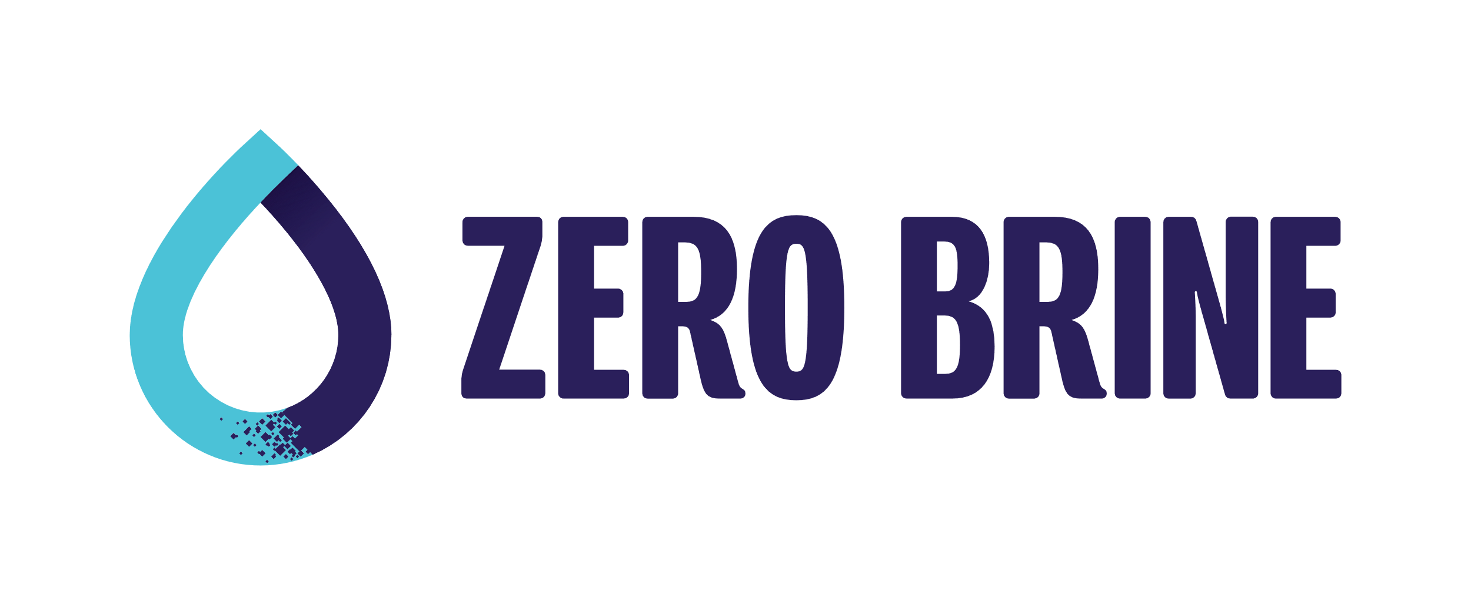



Key aspects for the development of sustainability indicators
Dr. Gijsbert Korevaar
This project has received funding from the European Union’s Horizon 2020 Research and Innovation Programme under grant agreement No 893924.
42

Slide 43
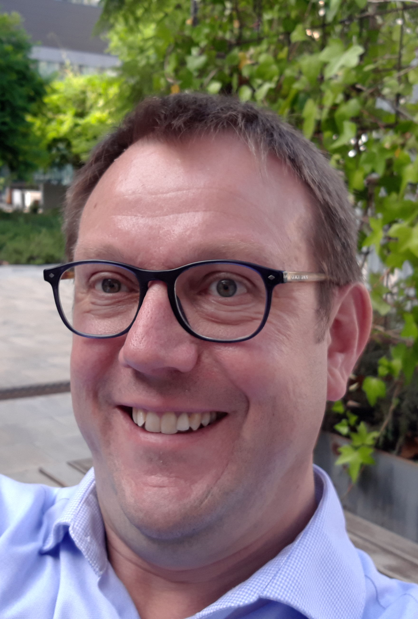
My background
Chemical Engineering design research
Industrial Ecology education development
Industrial Symbiosis projects and research
Circular Economy education and research
Faculty of Technology, Policy and Management
Department of Engineering Services and Systems
Energy and Industry section

Slide 44
Key Aspects of Industrial Symbiosis
Industrial Symbiosis
Reduced Environmental Impact
Improved Resource Efficiency
Reduced Energy Loss
Shared Sustainability Vision and Strategy
Integrated Corporate Social Responsibility
Notes:
[Slide 6]

Slide 45
Industrial Symbiosis – needs
Industrial - resources, production, transport, waste treatment
- Symbiosis … linked together with a mutual benefit
What is needed:
Process Intensification
Innovative (Bio)-Chemical Routes
Design Value Chains and Supply Chains as Closed Loops
Smart Infrastructures
Sufficient Diversity
Organisational Embedding
Evaluation and Management of Sustainability Performance

Slide 46
System change improvements
From Fet, A.M.; Knudson, H. An Approach to Sustainability Management across Systemic Levels: The Capacity-Building in Sustainability and Environmental Management Model (CapSEM-Model). Sustainability 2021, 13, 4910. https://doi.org/10.3390/su13094910
Notes:
[Slide 1]

Slide 47
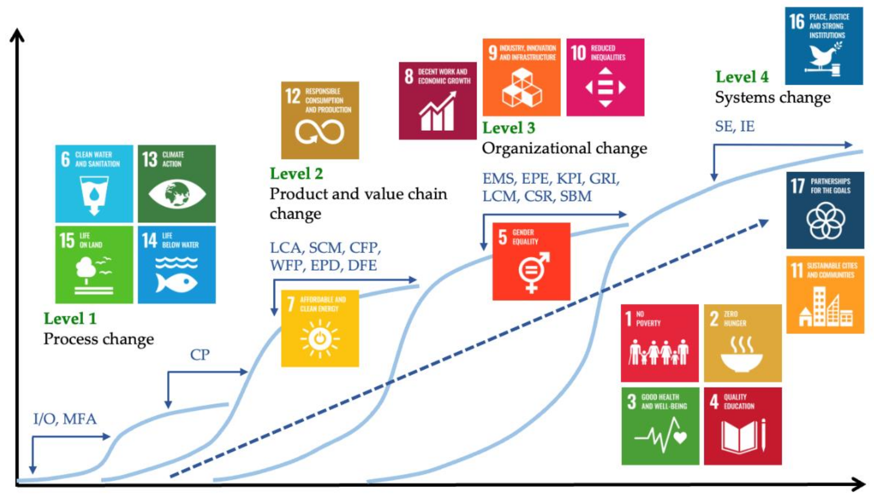
From Fet, A.M.; Knudson, H. An Approach to Sustainability Management across Systemic Levels: The Capacity-Building in Sustainability and Environmental Management Model (CapSEM-Model). Sustainability 2021, 13, 4910. https://doi.org/10.3390/su13094910

Slide 48
Key aspects for the development of sustainability indicators
Environmental and economic assessments
Life Cycle Sustainability Assessment
Ecological impacts from brine discharge
Policy review and assessment

Slide 49
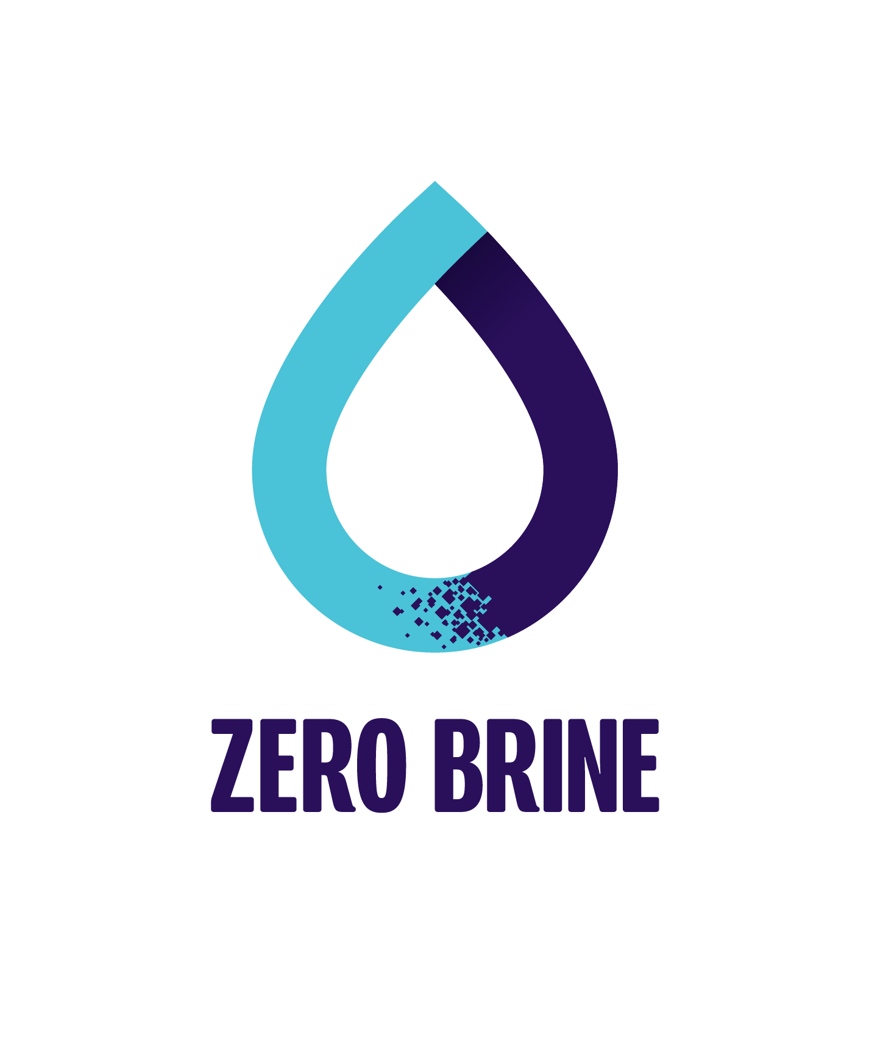
Keep in touch
Dr. G. (Gijsbert) Korevaar (PhD, MSc)
Assistant Professor Industrial Symbiosis
Faculty of Technology, Policy and Management
Delft University of Technology
Jaffalaan 5
2628 BX Delft
g.korevaar@tudelft.nl
+31 15 278 3659
LinkedIn: http://nl.linkedin.com/in/gijsbertkorevaar

Slide 50
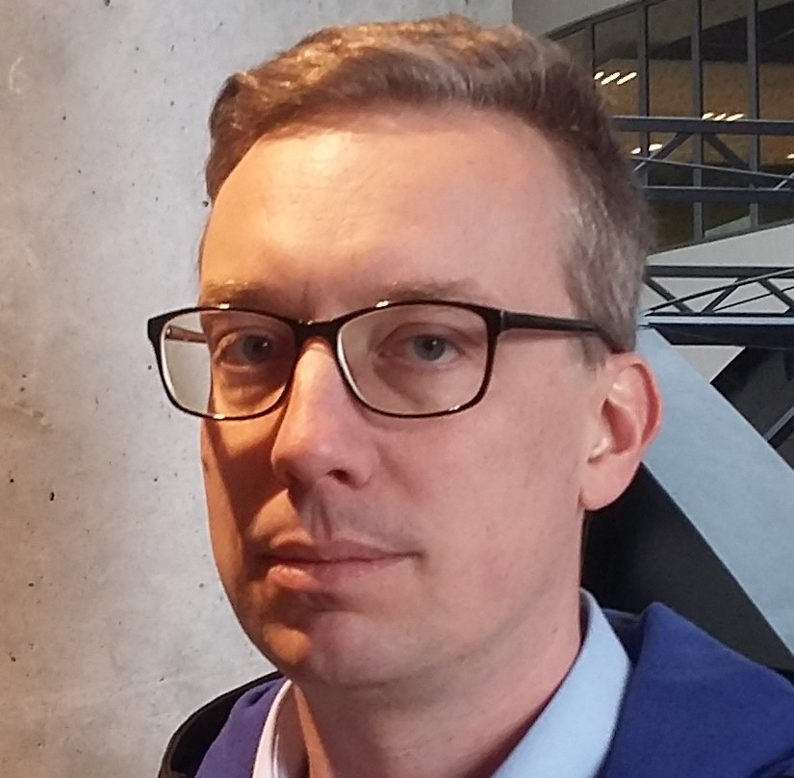
Grzegorz Gzyl
Assistant Professor
Główny Instytut Górnictwa (GIG)
Grzegorz Gzyl (PhD Eng.) is an Assistant Professor at GIG, specialist in the field of hydrogeology, geology and water protection. He is a successful coordinator and project manager in several finished and on-going international projects (MAGIC, FOKS,AMIIGA, LoCAL, FLOMINET, LINDANET, LIFEPOPWAT, LIFE Brine-Mining) with a focus on groundwater contamination assessment and treatment, mine water assessment, management and treatment, recovery of energy and chemicals from mine water. He has co-authored several scientific publications in international journals.
STAKEHOLDER PERSPECTIVES / FOLLOW-UP PROJECTS– DESALINATION IN POLISH COAL MINE WATERS

Slide 51
Environmental impact of brines discharged from coal mining industry in Poland
Grzegorz Gzyl
Central Mining Institute, Katowice, Poland
Zero Brine Final Forum, Delft, 4th Nov 2021

Slide 52
FACTS ABOUT BRINES FROM COAL MINING INDUSTRY IN POLAND
Deep coal mines need to pump huge amounts of water, so that the coal extraction is possible.
The deeper the mines operate - the more saline is mine water.
In Upper Silesian Coal Basin in Poland there are many mines that pump and discharge brines that are extremely saline.
In many cases the discharge of saline mine water is done into small rivers and therefore mine water dominates the flow of these rivers.
For such rivers it is impossible to reach the goals set by National and EU regulations - such as Water Framework Directive.
The ZERO BRINE project (www.zerobrine.eu) has received funding from the European Union’s Horizon 2020
research and innovation programme under grant agreement No 730390.

Slide 53
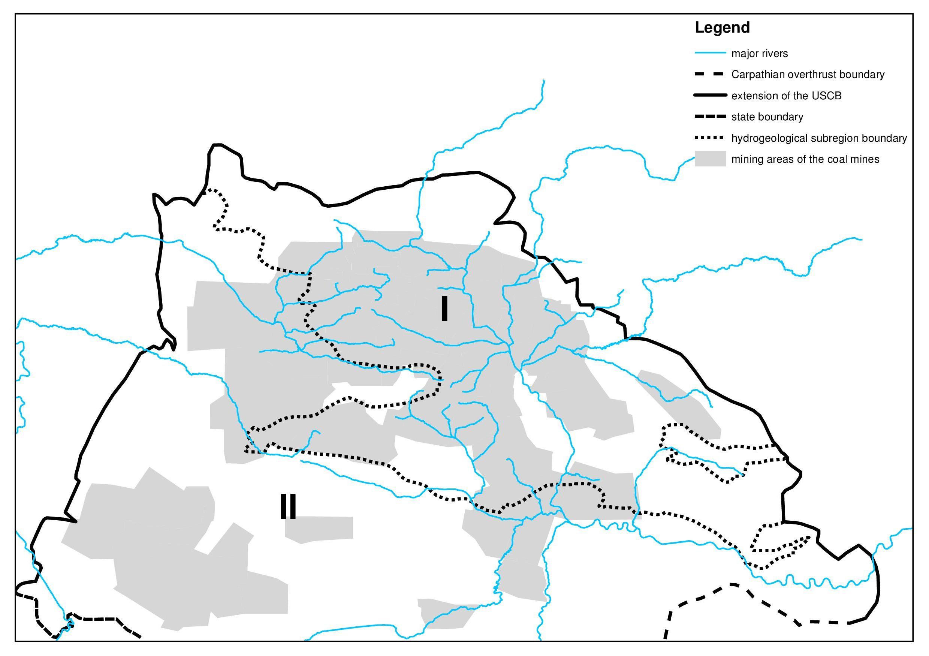
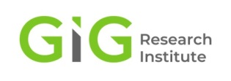
HYDROGEOLOGICAL SETTING OF USCB
53

Slide 54
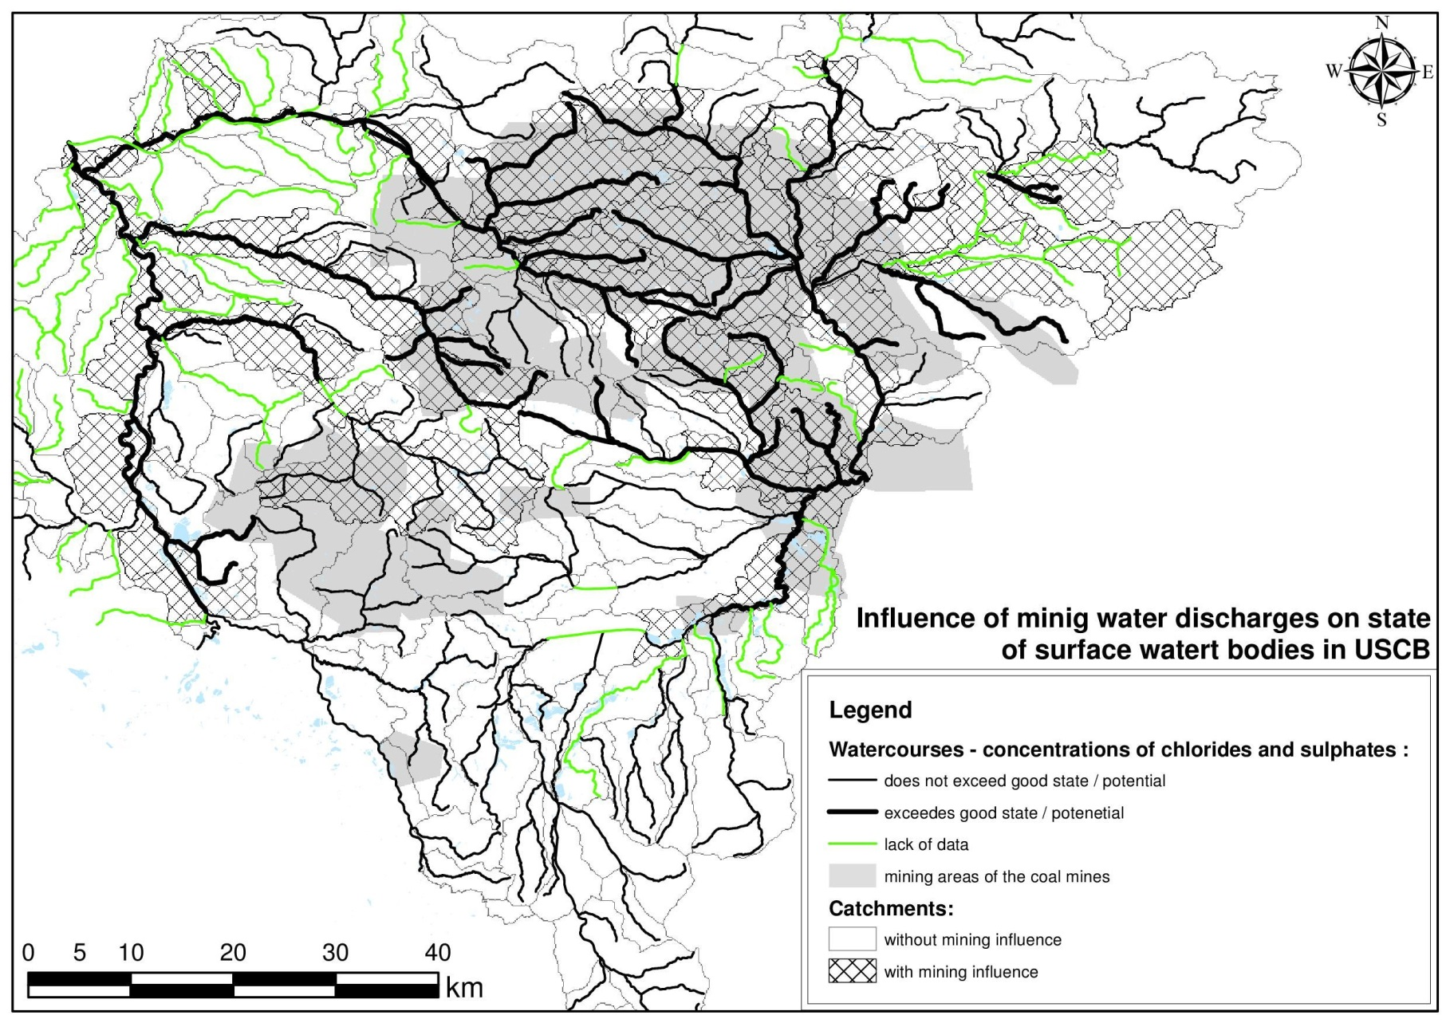
The impact of mine water discharges on surface waters in USCB
54

Slide 55
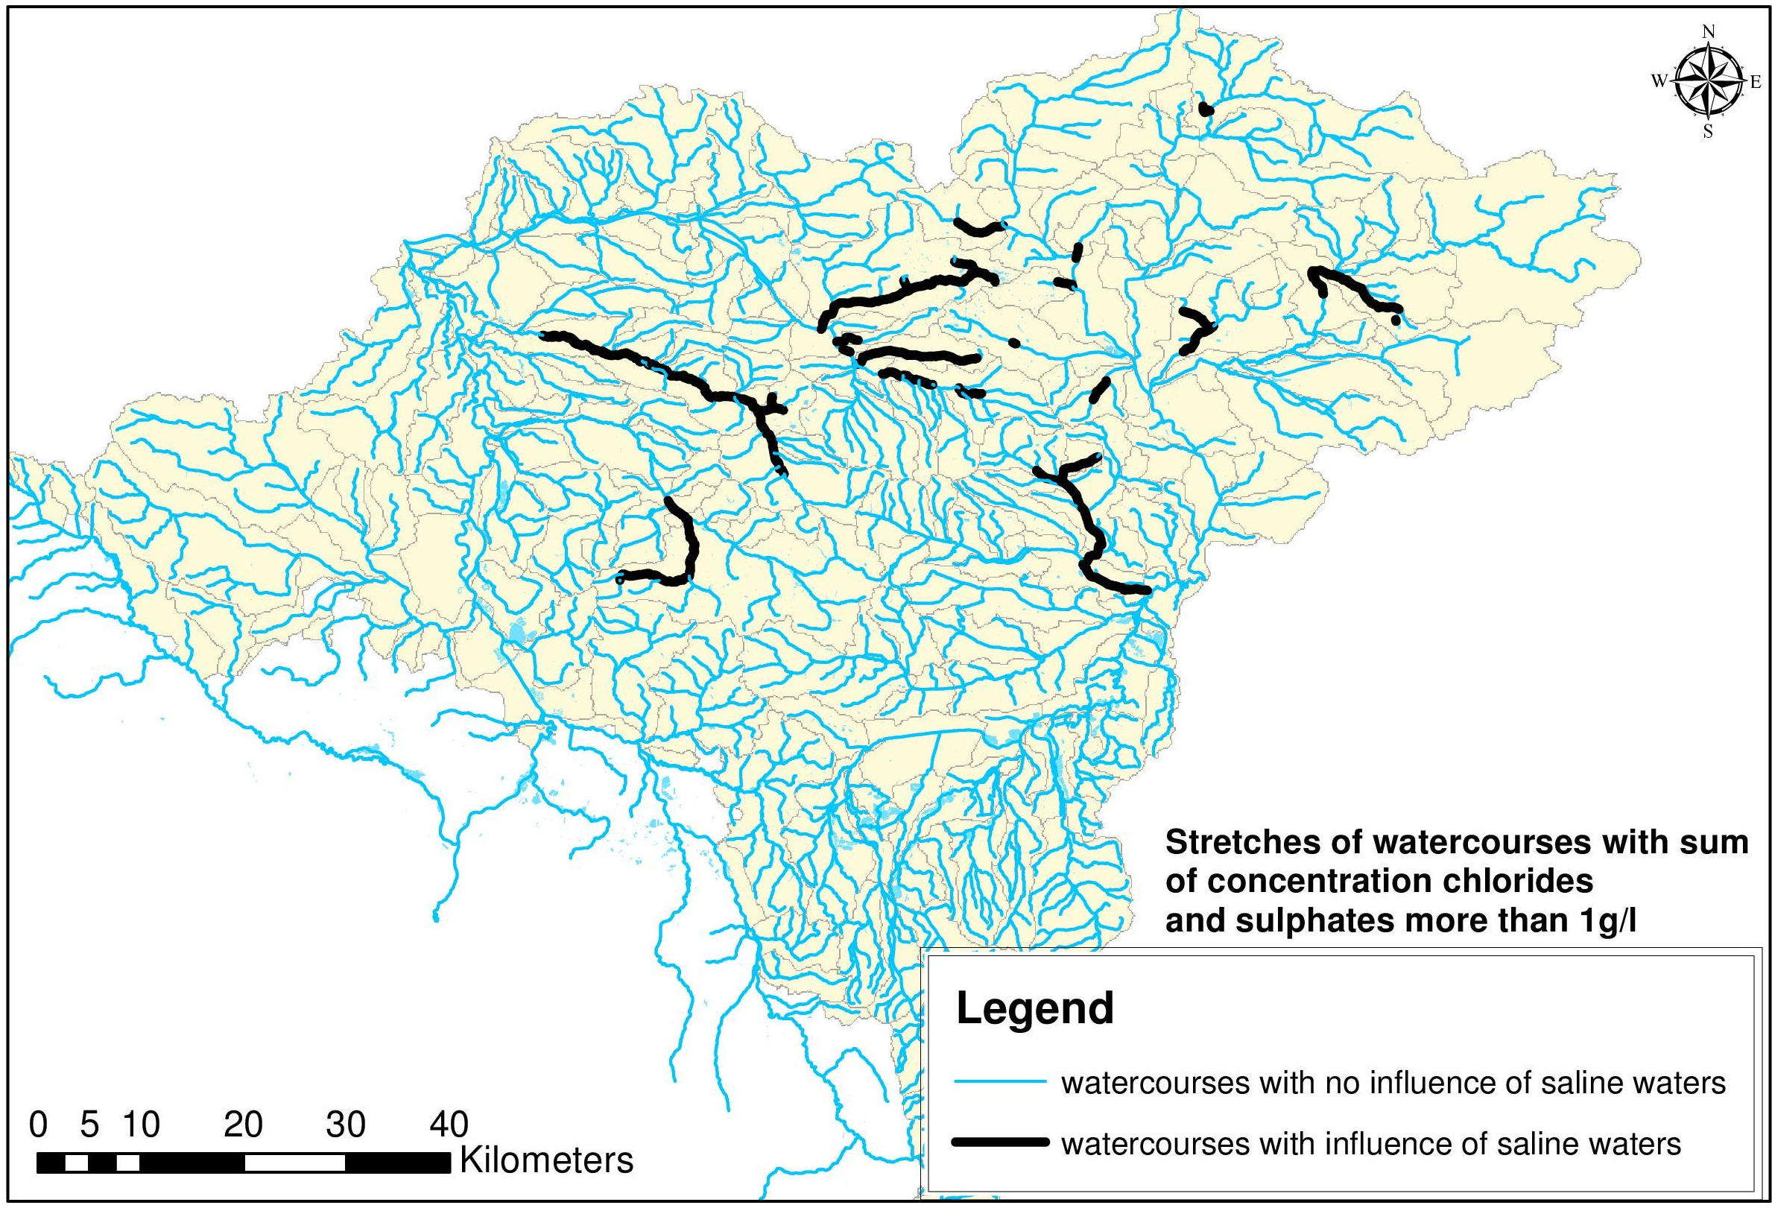
Saline rivers…
55

Slide 56
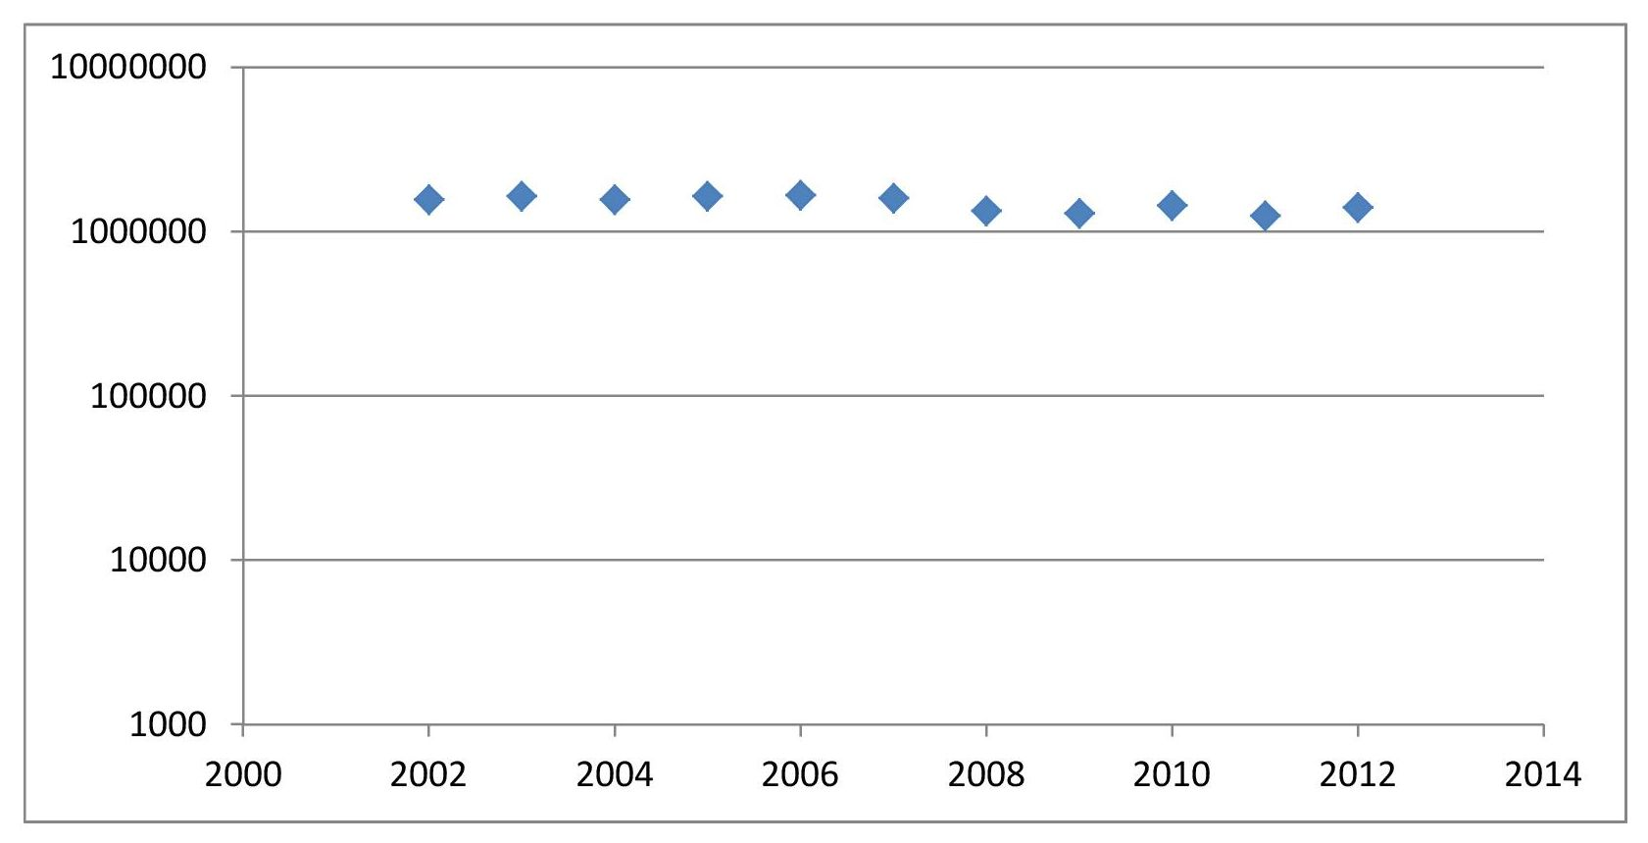
Temporal variation of total chloride and sulphate load (Mg/year)
56

Slide 57


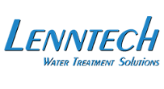
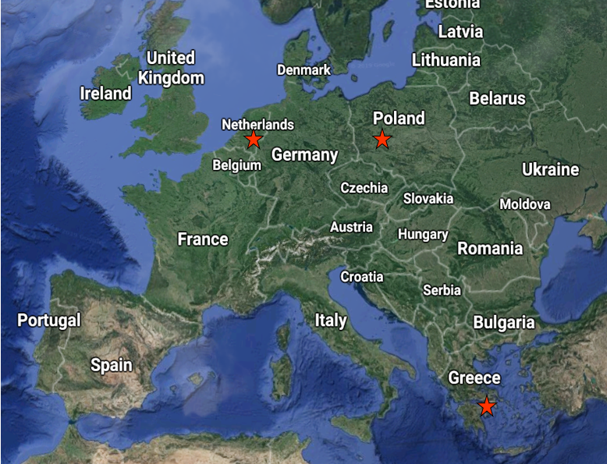
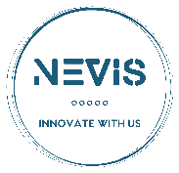

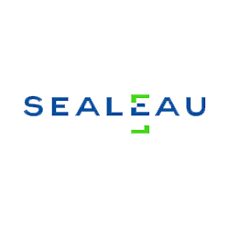




Beneficiaries
GLOWNY INSTYTUT GORNICTWA
LENNTECH
NEVIS-NOVEL Environmental Solutions S.A.
POLSKA GRUPA GORNICZA
SEALEAU B.V.
Silesian University of Technology
Coordinating beneficiary
National Technical University of Athens
THERMOSSOL STEAMBOILERS S.A.
Titan Salt B.V.
Notes:
57

Slide 58

LBM - Circular Economy Concept
LIFE Brine-Mining: From coal mine brine to marketable minerals, salts and water

Slide 59


Page No 8: Events
LBM - Latest project events
Site visit to Dębieńsko – September 2021
Dębieńsko is globally the 1st plant applying a Zero Liquid Discharge system to treat coal mine effluents, able also to recover salt of edible quality. The project team members’ visit to Dębieńsko took place at the end of September 2021.
Dębieńsko Plant Premises.
1st Stakeholder Consultation Event – September 2021
The event took place in Poland, in the premises of GIG, with representatives from the political, scientific and industrial sector.

Slide 60
Thank you for your attention
www.zerobrine.eu #ZeroBrine @zero_brine_
The ZERO BRINE project (www.zerobrine.eu) has received funding from the European Union’s Horizon 2020
research and innovation programme under grant agreement No 730390.

Slide 61

Michiel van Haersma Buma
Chairman of the Advisory Board
ZERO BRINE
Michiel van Haersma Buma studied law and received his master’s from the University of Utrecht. He has served as mayor of Markelo in the East of the Netherlands, of Voorburg and of Leidschendam-Voorburg, during which he served on several boards throughout civil society. Since then, Michiel has served as chairman of Delfland where he is responsible for the cooperation with the University of Delft and other institutions. He continues to advise the government and contribute to several other advisory boards.
WORDS FROM THE ADVISORY BOARD

Slide 62
White Paper - Challenges Ahead
Industrial waste water - Resources recovery – Waste reduction
Advisory Board 4 November 2021

Slide 63
Technologies
Technology Development:
High purity minerals and water can be recovered and reused;
Permanent investments in innovative technologies;
Some technologies can be further optimized for operational use.
Matchmaking:
Online Brine Platform (OBP): An on-line vehicle for matchmaking is available;
Further dissemination and use within Europe to be fostered.

Slide 64
EU Policy development
EU Policies: Industrial Emissions Directive and the Zero Pollution Strategy
- Requirement for EU Directive to strengthen circularity in production!
- ZERO BRINE Technologies, Best Available Techniques (BATs), to be promoted;
- Investments in circular innovations like the zero brine production chains to be developed and stimulated by a mix of taxes and subsidies;
- One of the points to address is the CO2 emission, for which emission rights need suddenly be payed once a waste stream turns into a product.

Slide 65
Market & strategic development
Business cases:
Inspiring examples to enhance circular market development;
Ever present role of government policies in valuating products and waste.
Sectoral and strategic development within Europe:
Self sustainability in natural resources;
Reduction of dependencies for scarce resources from China imports.

Slide 66
White Paper offered to prof. Luuk Rietveld

Slide 67
THANK YOU ZERO BRINE PARTNERS!

