Slide 1
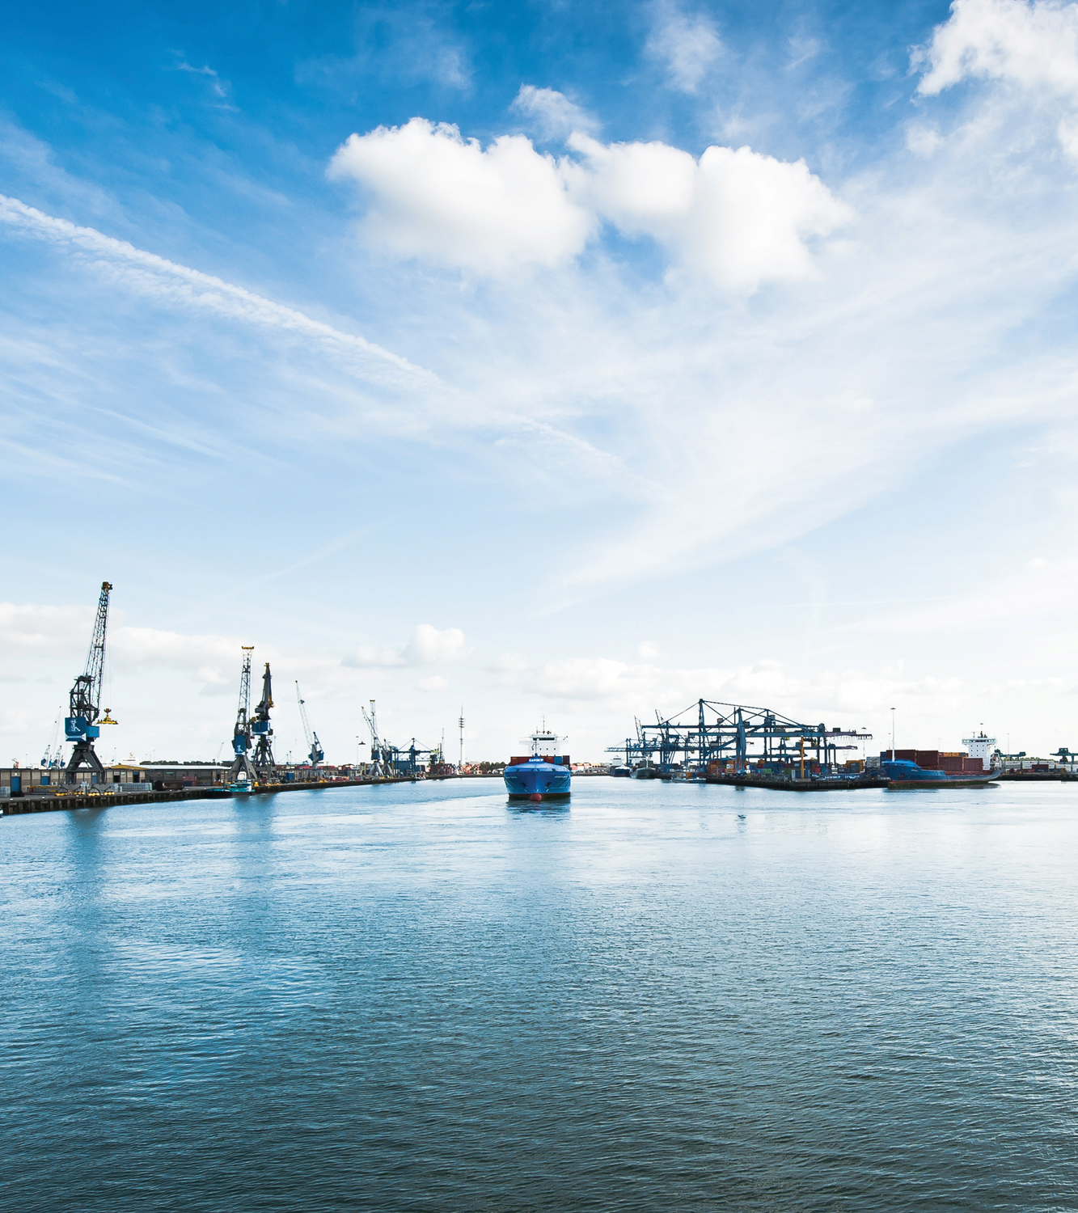
ZERO BRINE
Final Forum
De Oude Bibilotheek, Delft,
The Netherlands
4 November 2021 (10:00-16:30 CET)

Slide 2
KEY ZERO BRINE RESULTS
MORNING SESSION

Slide 3
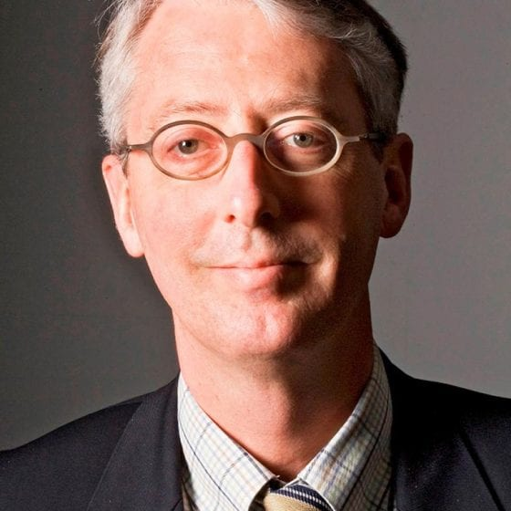
Roelof Moll
Executive Project Manager
ZERO BRINE
Roelof Moll is Executive Project Coordinator for ZERO BRINE and manager of the section Hydraulic Structures and Flood Risk at Delft University of Technology . During his career of 40 years in the water sector, he has worked at Wageningen University, Delft Hydraulics and Royal Haskoning DHV, directing large international water projects in Europe, Asia, Africa and Latin-America.
OPENING AND WELCOME

Slide 4
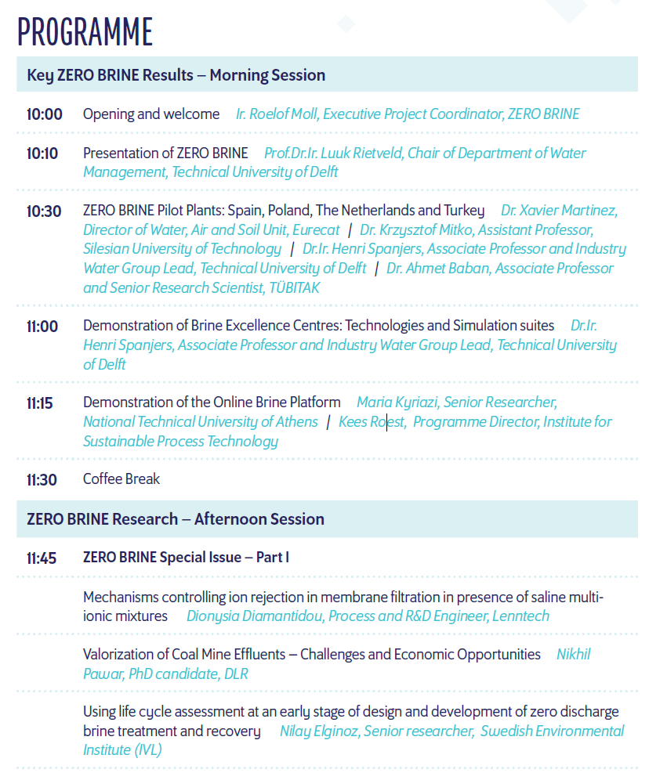
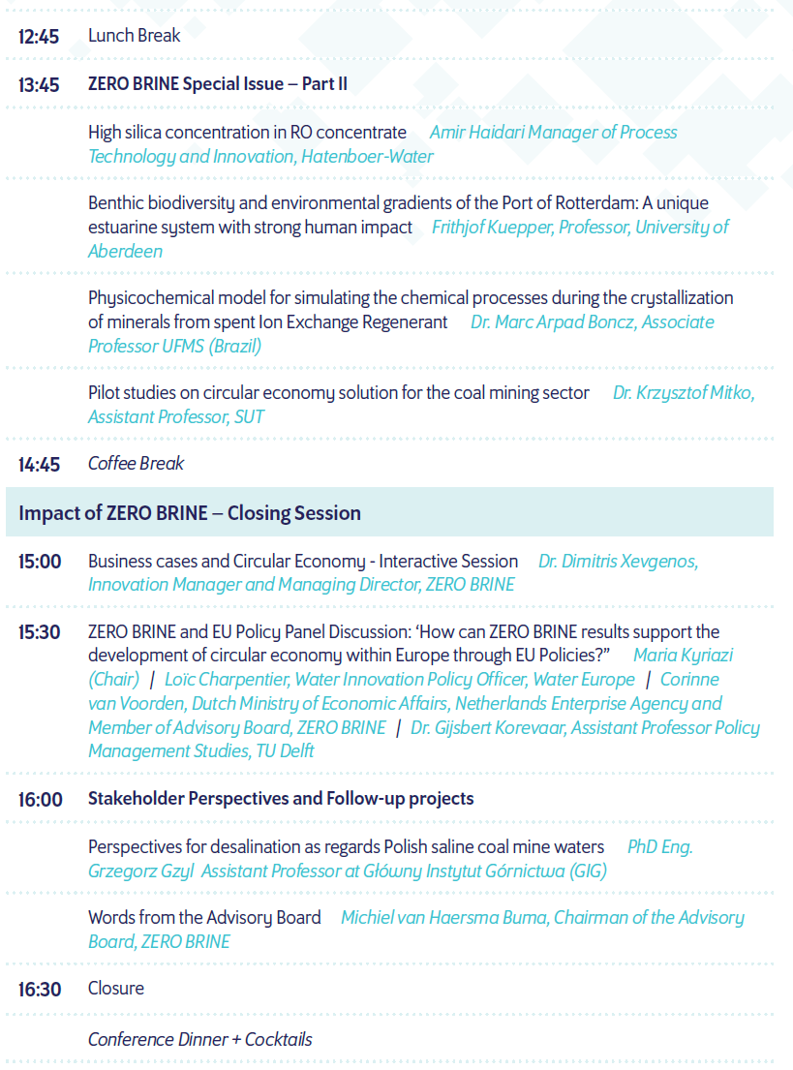

Slide 5
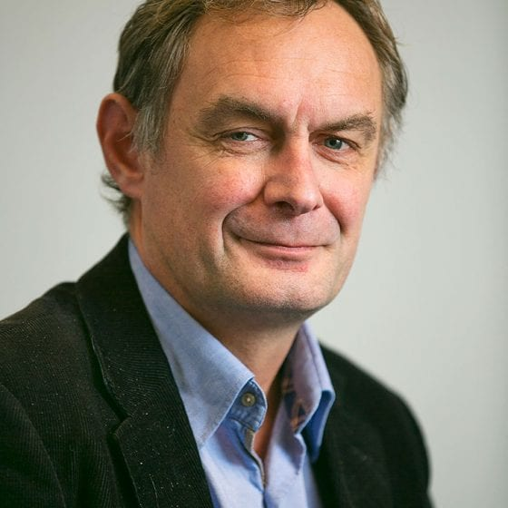
Luuk Rietveld
Scientific Coordinator
ZERO BRINE
Luuk Rietveld is Professor of Drinking Water& Urban Water Cycle Technology. He is Chairman of the Department of Water Management, Delft University of Technology, and focuses his research activities on treatment processes. His special interests include water quality and treatment, wastewater reclamation, water supply for the poor.
PRESENTATION OF ZERO BRINE

Slide 6
A circular economy approach
Industrial waste water - Resources recovery – Waste reduction
Luuk Rietveld, Scientific director, TU Delft

Slide 7
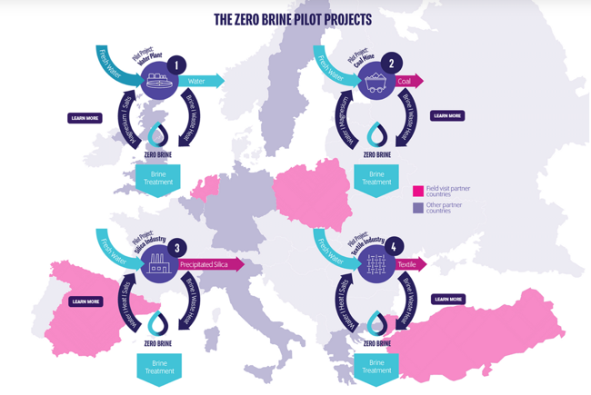
4 industrial sectors
From SPIRE Roadmap to Processes4Planet

Slide 8
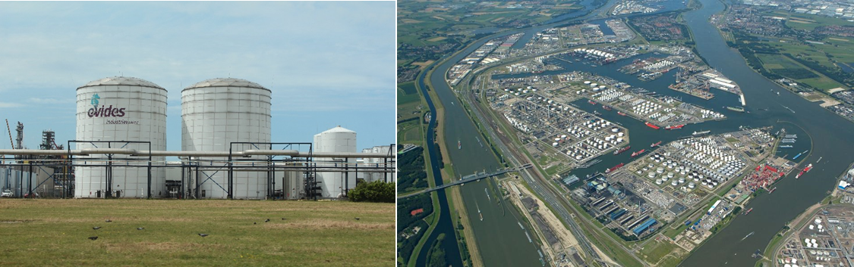
ZERO BRINE project
Project Goal: The ZERO BRINE project aims to facilitate the implementation of the Circular Economy package and the SPIRE roadmap in various process industries by developing necessary concepts, technological solutions and business models to redesign the value and supply chains of water and minerals.
  Recovery of resources from saline impaired effluents (brines) generated by the process industry.
  Eliminating wastewater discharges and minimizing the environmental impacts .
  Integrating several existing and innovative technologies to recover products of high quality and sufficient purity to represent good market value.

Slide 9
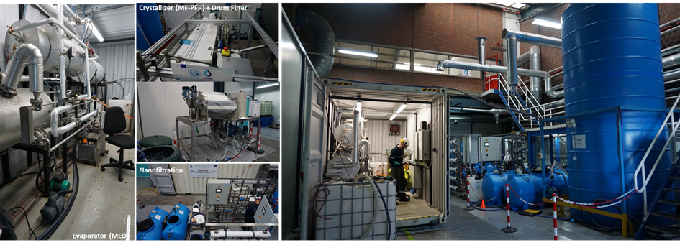
1. Demin water plant EVIDES in NL
Resources recovered:
94.7% Calcium recovery (Ca(OH)₂) for external valorisation (>95.6% purity)
87.8% Magnesium recovery (Mg(OH)₂) for external valorisation (>88.9% purity)
93% Sulphate recovery (Na₂SO₄) for external valorisation (unwashed: 94.6% purity)

Slide 10
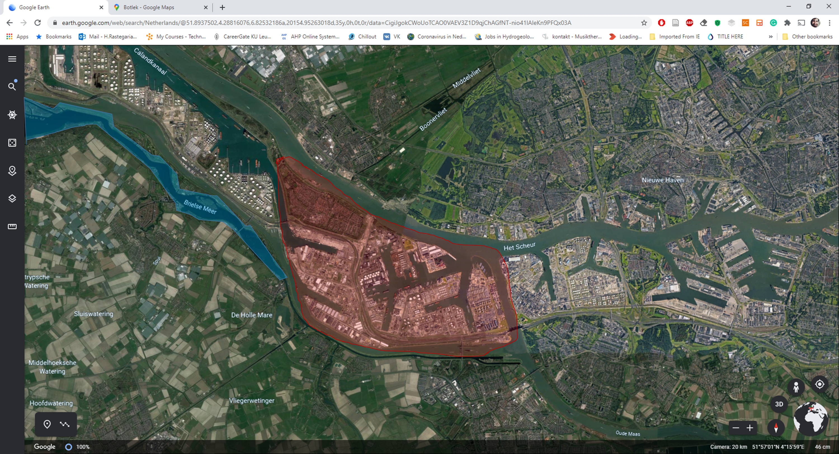

1. Demin water plant EVIDES in NL
Brine Discharge Point
PlantOne
Evides DWP
Fresh Water Source

Slide 11
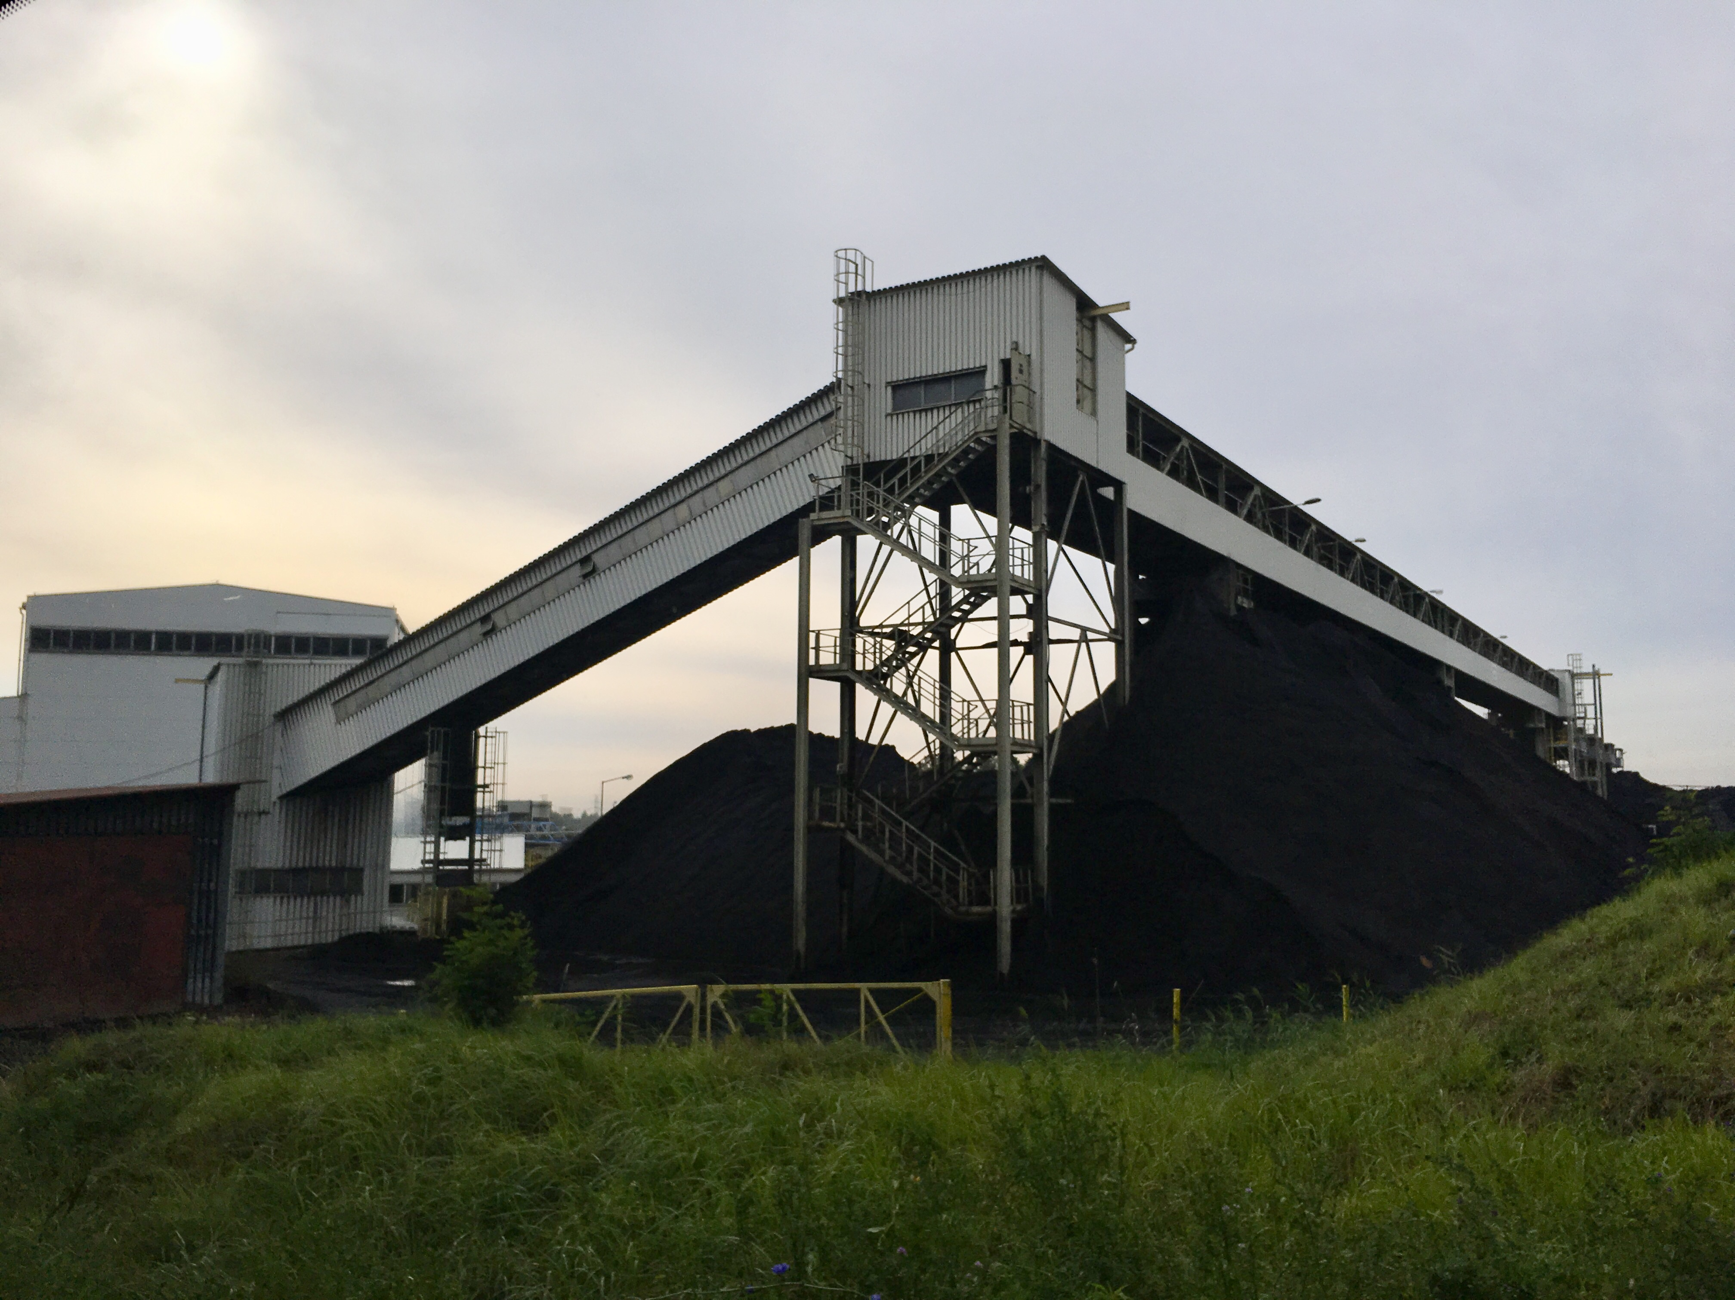
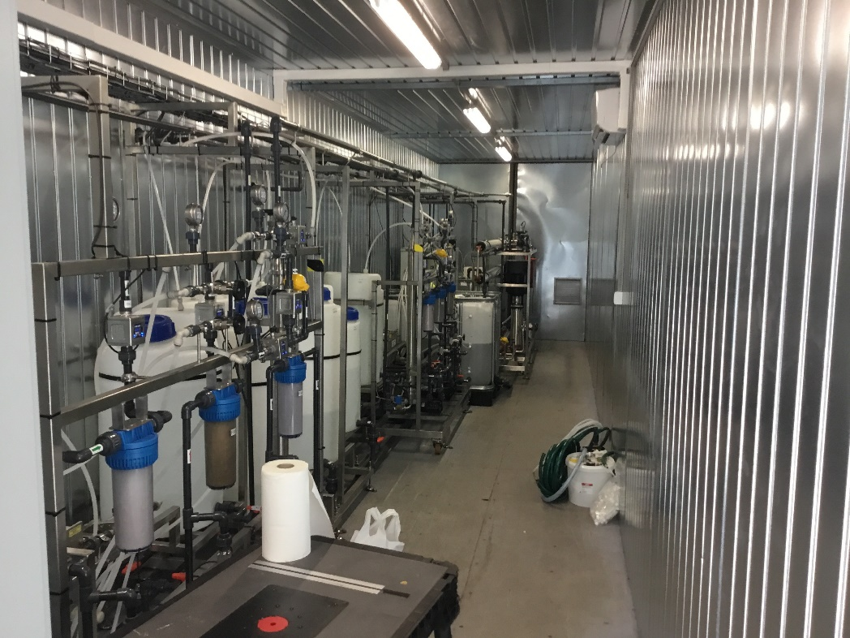
2. Coal mine Bolesław Śmiały in Poland
Emissions: 32.5% CO₂ reduction;
Energy: 33% reduction;
Resources recovery:
90.6% water recovery (demi water)
92.8% salt recovery (99% purity)
94.9% magnesium hydroxide recovery for external valorisation (97% purity)
0.84 kg/m³ gypsum for external valorisation

Slide 12
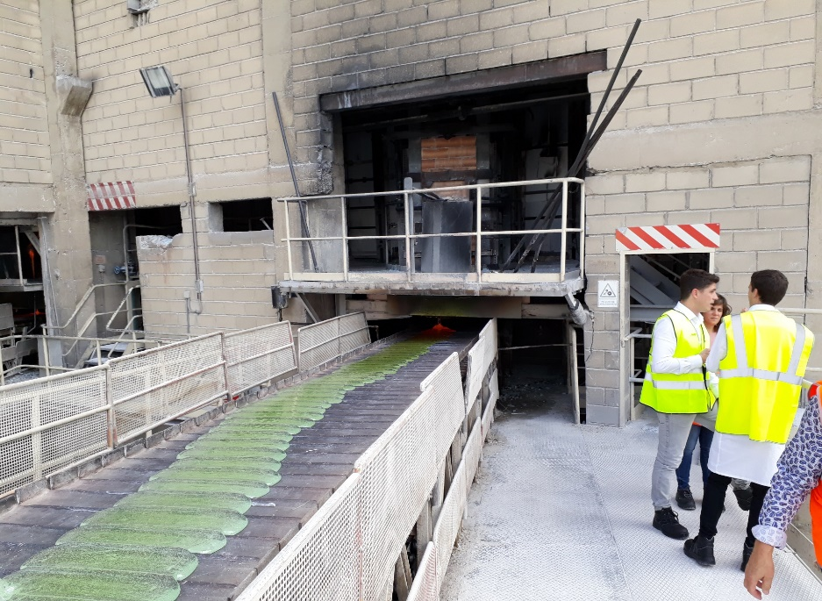
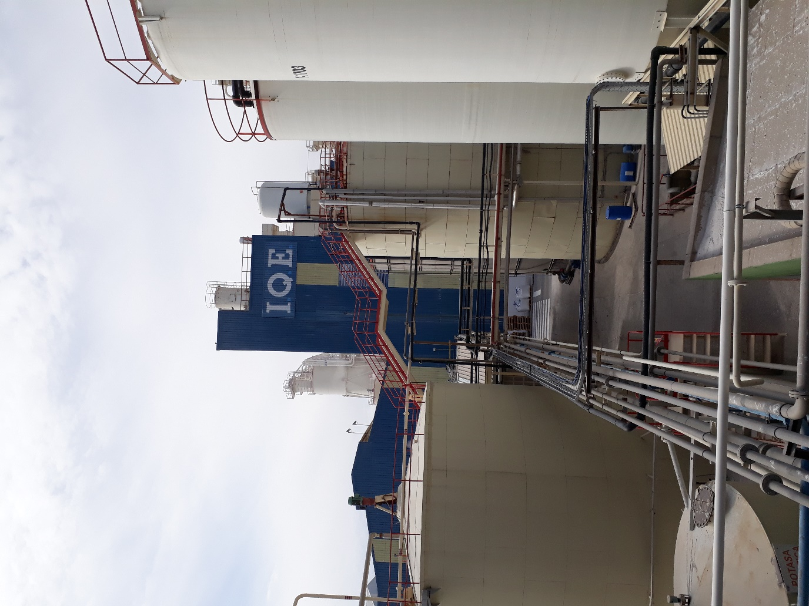
3. Silica mine IQE in Spain
Emissions:
100% reduction of brine discharged to the environment;
60% reduction of sodium sulphate (Na₂SO₄) releases into the Ebro River;
6000 tons/year CO₂ reduction;
Recovered resources:
90% recovery of sodium sulphate (Na₂SO₄) for valorisation (>99% purity);
Sodium hydroxide (NaOH) (94% purity) and sulphuric acid (H₂SO₄) (72% purity).

Slide 13
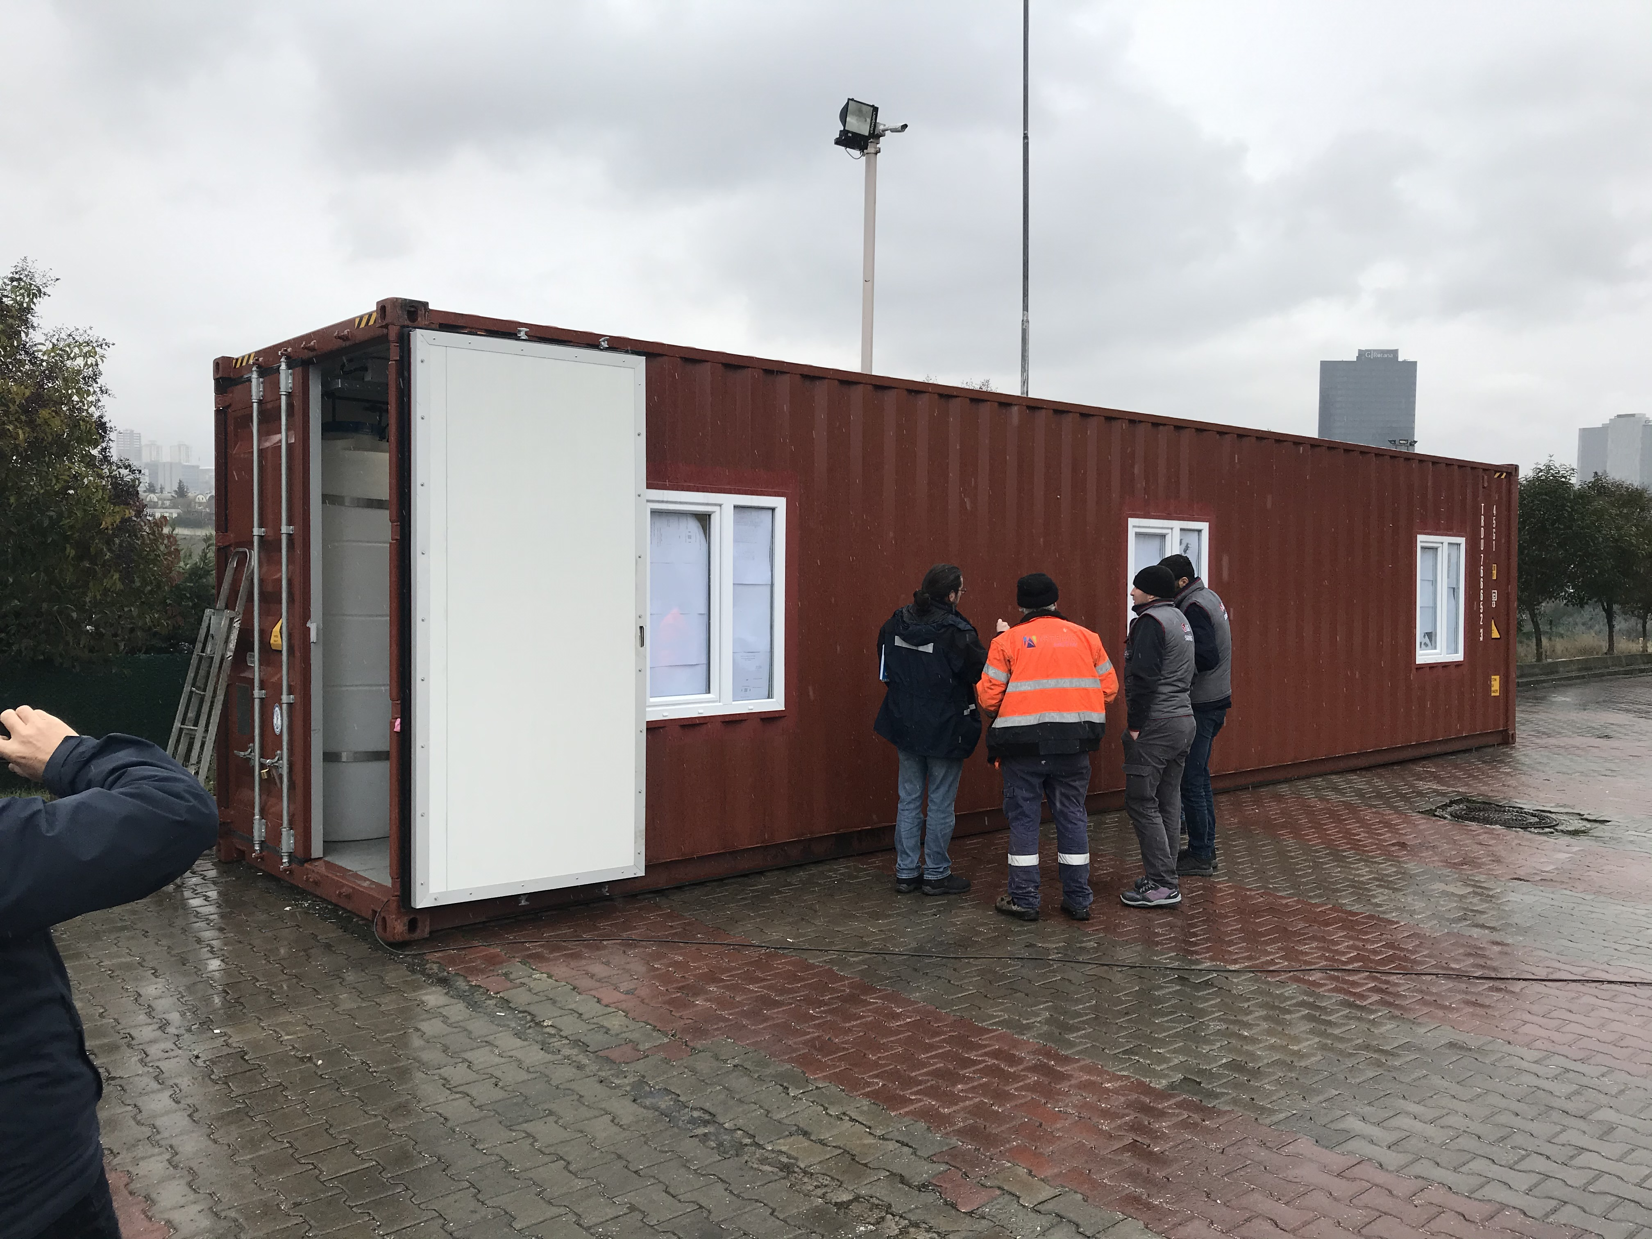
4. Textile Industry at Zorlu in Turkey
Emissions:
90-95% reduction of brine discharged to the environment;
150-200 tons/year CO₂ reduction;
Resources recovery:
70-80% water recovery from brine treatment system for onsite use;
600-700 tons salt/year for onsite dyeing of textiles.

Slide 14
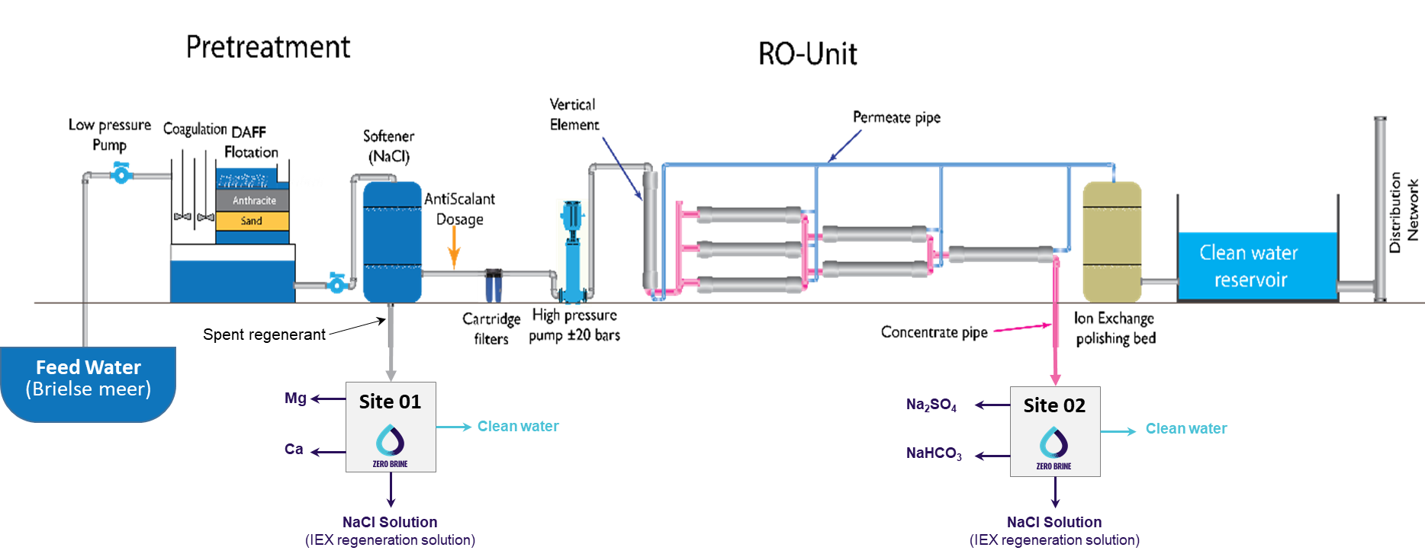
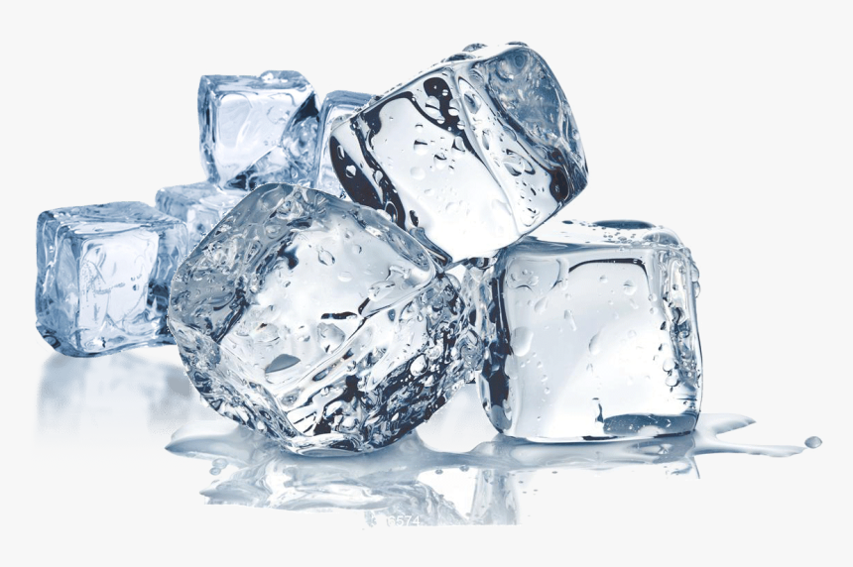


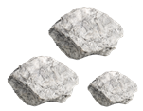
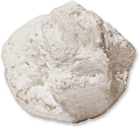
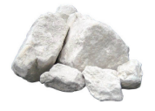
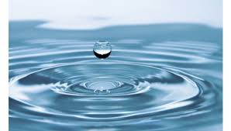

ZERO BRINE project
IEX Brine
RO Brine
Ca
SO₄
Mg
Nanofilteration
NOM
Nanofilteration
Na
Na
Mg
Na
Na
Na
Na
NOM
H₂O , CO₂
Na
Na
Ca
SO₄
Na
Na
SO₄
Ca
Na
Na
Mg
NOM
Na
Na
NYEX – Organic Removal
Multi Feed – Plug Flow Reactor
Mg
Na
Na
Ca
SO₄
Na
Na
NOM
Eutectic Freeze Crystallizer
Raw Material
Ca
Na
Mg
Na
Na
Na
NOM
Mg
Ca
NOM
NOM
Ca
Mg
Ca
Na
Na
SO₄
NOM
SO₄
NOM
SO₄
Mg
+
-
+
-
Ice
Reverse Osmosis
+
-
Ca
`
`
`
`
Na
Na
`
`
`
Ca
Multi Effect Distillation
Na
Mg
Na
Multi Effect Distillation
Raw Material
Na
Na
Na
Na
SO₄
Ca
Na
Na
Na
Na
Na
Na
Na
Na
Na
Na
Na
Na
Na
Mg Crystals
Heat Source
Na
Na
Na
Na
Heat Source
Na
Na
IEX Regeneration Solution
Na
SO₄ Crystals
Ca Crystals
Demi Water
IEX Regeneration Solution
Demi Water
Demi Water

Slide 15
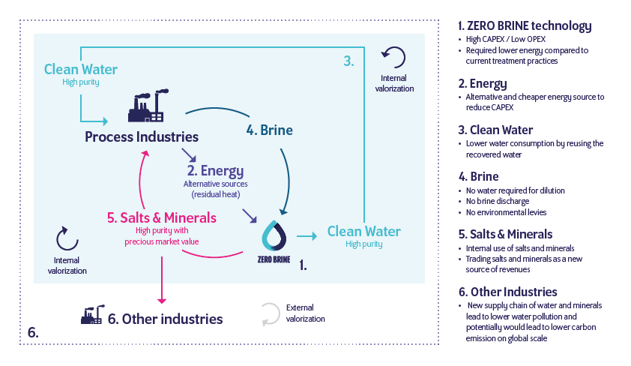
Techno-economical analysis

Slide 16
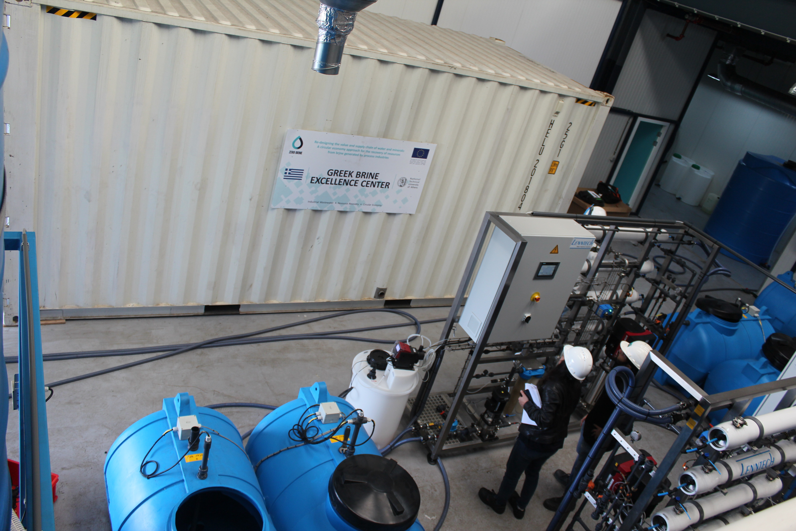
Knowledge development & sharing
BRINE Excellence Centres:
The Netherlands, Spain, Italy, Greece and Poland
RCE Simulation software package
Effectivity of technologies
Energy
Cost

Slide 17
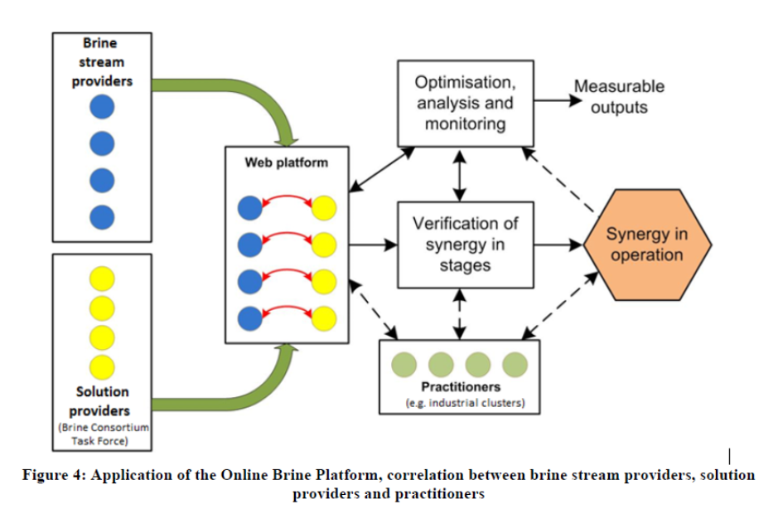
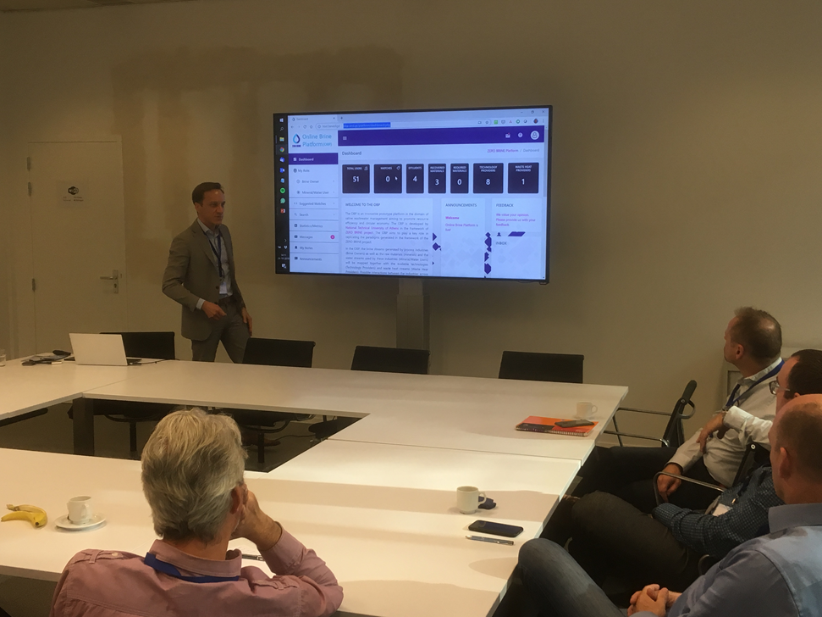
Online Brine Platform
Matchmaking between brine suppliers and salt users

Slide 18
Overall conclusions
From waste into products:
Upscaling of the technologies should be further studied
Entrepreneurs reluctant to accept responsibilities in the circular setting.
Government policies on waste and product are not tuned to circular use of resources yet.

Slide 19
Overall conclusions
Business cases:
Very site-specific character.
Permits, subsidies and taxes determine the attractiveness of ZERO BRINE technologies.
Practical considerations limit the applicability of technically sound technologies.

Slide 20
Overall conclusions
Sectoral development within Europe:
Scarce minerals can be recovered from brines and re-used to reduce dependency from other continents or China.
A global strategy for self-sustainability within Europe is not in place yet.
Resources, energy and basic industries would ask for additional policy instruments to encourage implementation of circular economy solutions.

Slide 21
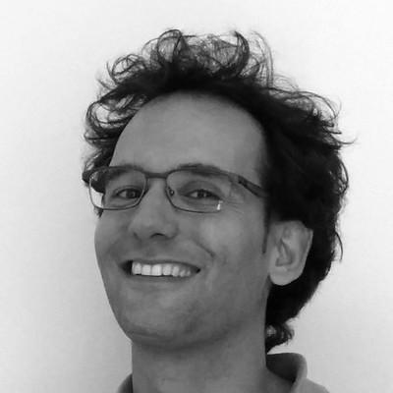
Xavier Martinez
Director of Water, Air and Soil Unit
Eurecat
Xavier Martinez is a chemical engineer and environmental researcher with professional activities focusing on the design, execution and coordination of R+D+I projects in the field of chemistry, environmental chemistry and water treatment technologies. Currently, he leads the Water, Air and Soil Unit at Eurecat.
ZERO BRINE PILOTS – SILICA FACTORY (SPAIN)

Slide 22
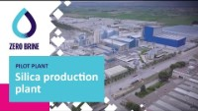

Slide 23
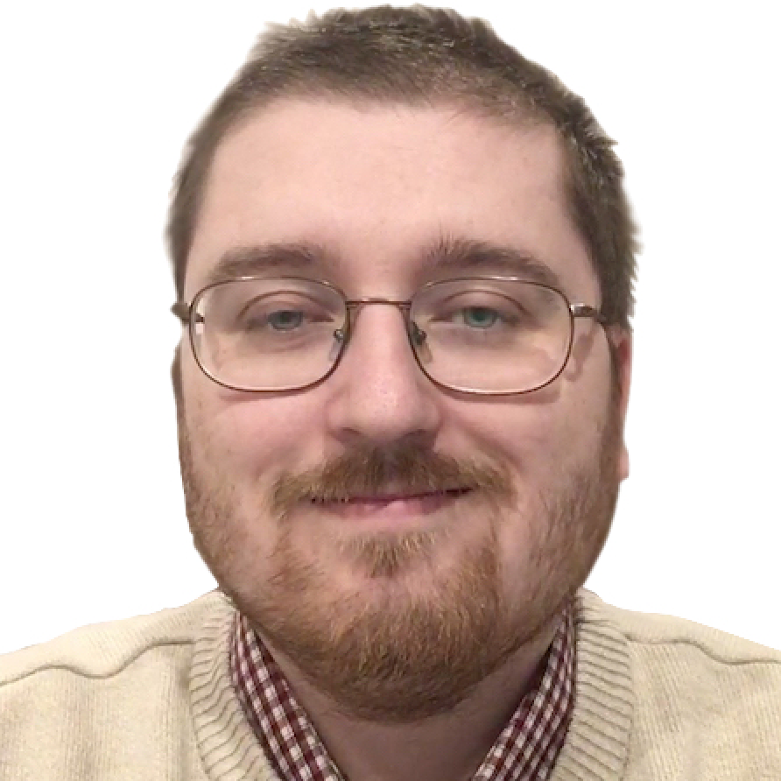
Krzysztof Mitko
Assistant Professor
SUT
Dr. Mitko is an assistant professor at the Silesian University of Technology, Faculty of Chemistry. His research interests include electromembrane processes (electrodialysis, electrodeionization, membrane capacitive deionization); removal of metal ions from the waste waters; seawater, coal mine water and industrial wastewater desalination.
ZERO BRINE PILOTS – COAL MINE (POLAND)

Slide 24
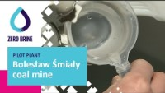

Slide 25
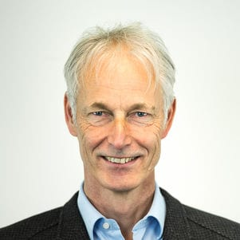
Henri Spanjers
Associate Professor, Industry Water Lead
TU Delft
Henri Spanjers graduated as an Environmental Engineer. He worked with a number of research institutes in various EU countries and was project director with a consultancy firm. He is currently professor at Delft University of Technology, faculty of Civil Engineering and Geosciences, where he leads the Industry Water group. He is Editor-in-Chief of the Water Resources and Industry journal.
ZERO BRINE PILOTS – DEMINERALISED WATER PLANT (THE NETHERLANDS)

Slide 26
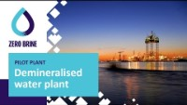

Slide 27
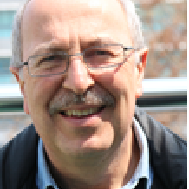
Ahmet Baban
Associate Professor, Senior Researcher
TÜBITAK
Senior Research Scientist working at TUBITAK Marmara Research Center, Environment and Cleaner Production Institute– Turkey. Research topics include water and wastewater management, water reuse, advanced treatment technologies, textile industry, food industry water management, circular economy, and sustainable water management.
ZERO BRINE PILOTS – TEXTILE FACTORY (TURKEY)

Slide 28


Slide 29
Henri Spanjers
Associate Professor, Industry Water Lead
TU Delft
Henri Spanjers graduated as an Environmental Engineer. He worked with a number of research institutes in various EU countries and was project director with a consultancy firm. He is currently professor at Delft University of Technology, faculty of Civil Engineering and Geosciences, where he leads the Industry Water group. He is Editor-in-Chief of the Water Resources and Industry journal.
DEMONSTRATION OF THE BRINE EXCELLENCE CENTRES (BECs): TECHNOLOGIES & SIMULATION SUITES

Slide 30
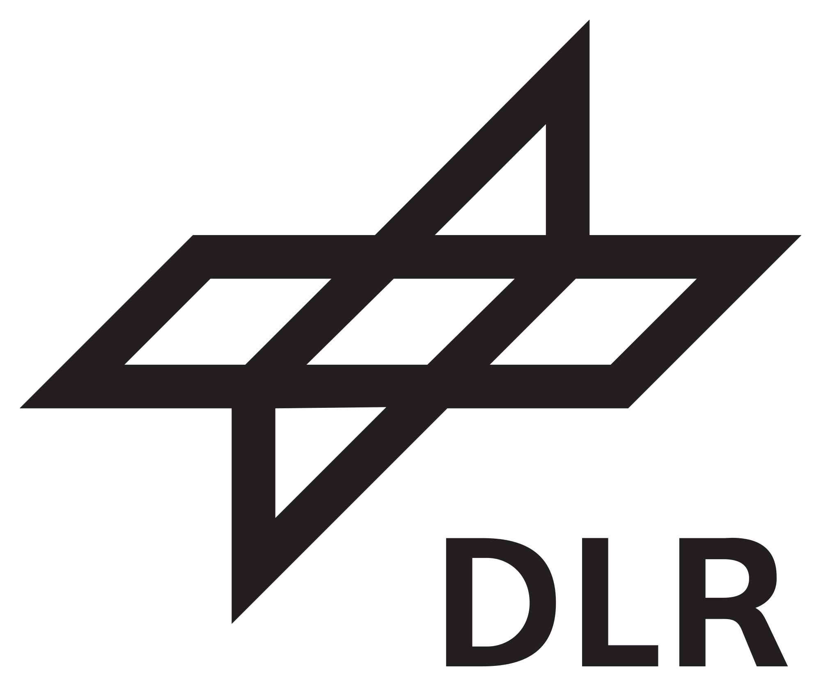
RCE simulation platform
Modeling of Circular Economy-based WW Treatment Chains
ZERO BRINE Final Forum, 4th November 2021
M.Sc. Nikhil Pawar, Dr. Thomas Pregger, Dr. Benjamin Fuchs
German Aerospace Center (DLR), Institute of Networked Energy Systems, Curiestrasse 4, 70563 Stuttgart, Germany

Slide 31
Agenda
What is RCE?
Technology Tools published via RCE
Illustration of a modeled Treatment Chain

Slide 32
What is RCE?
Remote Component Environment (RCE)¹ is an open-source, distributed integration environment which can be used to simulate complex treatment chains by combining Tools developed and shared by different teams within a project
Tools: These could be techno-economic modeling of a treatment technology like nanofiltration (NF)
Application: To determine economic feasibility of a proposed treatment chain by performing its techno-economic simulation
1. https://rcenvironment.de/

Slide 33
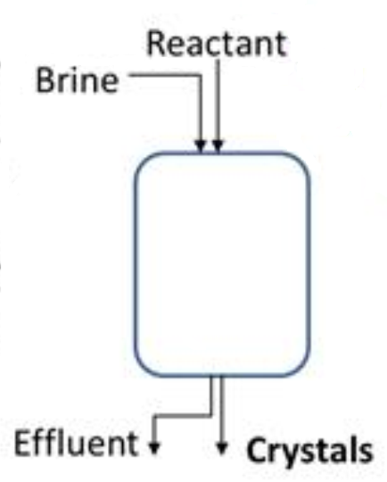
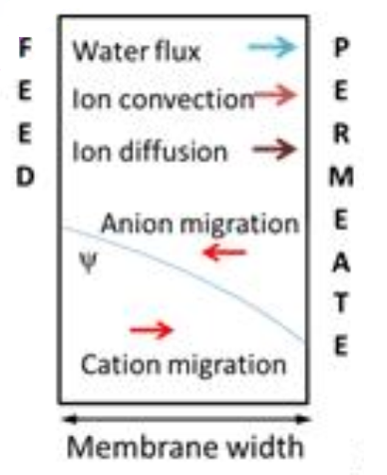
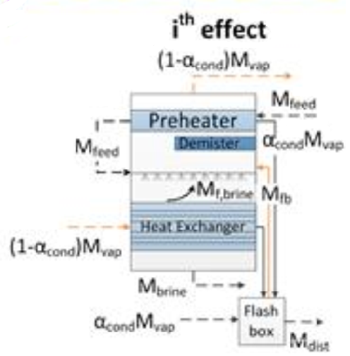
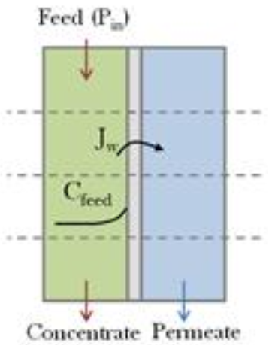
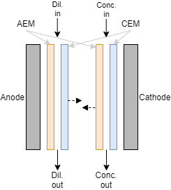
Technology Tools published via RCE
Nanofiltration (NF)
Crystallizers for several minerals & salts
(Mg, Ca, NaCl)
Reverse osmosis (RO)
Electrodialysis (ED)
Multi-effect distillation (MED)
Notes:
33

Slide 34
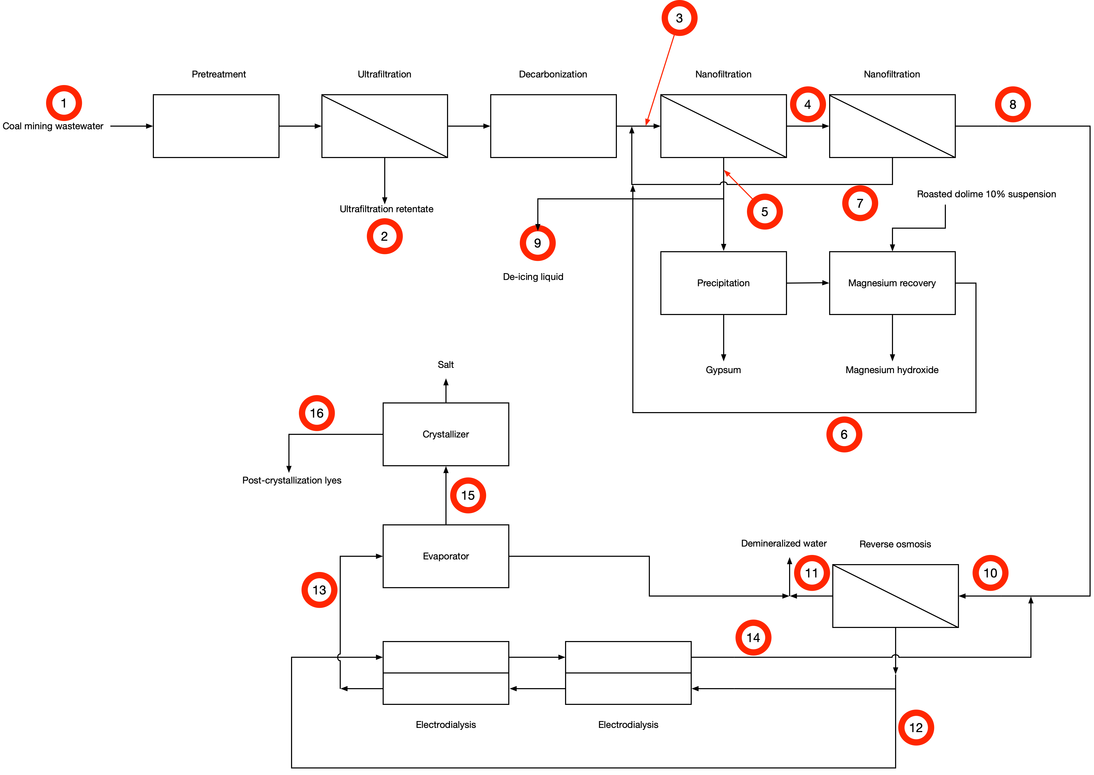
Illustration of a modeled Treatment Chain
Example: Coalmine effluent treatment chain (Polish case study)
Technologies: NF, CaSO₄ & Mg(OH)₂ precipitators, RO, ED, MED and NaCl Evaporator
Goal: Estimate economic feasibility of the chain

Slide 35
Further Information
To explain and encourage the implementation of wastewater treatment chain simulations on RCE, exemplary workflows and RCE Cookbook are available
For more information on this and getting access to the Technology Tools:
  Dr. Benjamin Fuchs (Benjamin.Fuchs@dlr.de)
  Nikhil Pawar (Nikhil.Pawar@dlr.de)

Slide 36
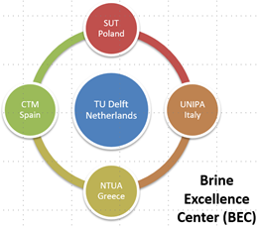
Demonstration of Brine Excellence Centers: Technologies and
Simulation Suites

Slide 37
WP5: Optimization of innovative technologies - Integration of bench-scale and optimized pilot systems into fully-equipped Brine Excellence Centers (BECs) – Development of technology libraries (software tool) and integration into a common platform
Task 5.1: Upgrade of pilot brine treatment systems
Task 5.2: Development of BECs (equipment, plan)
Task 5.3: Development of software tool and integration

Slide 38
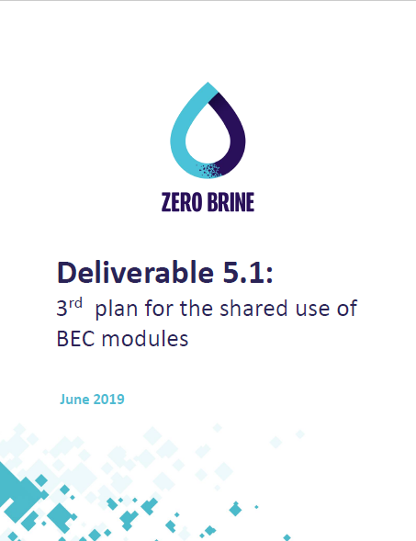
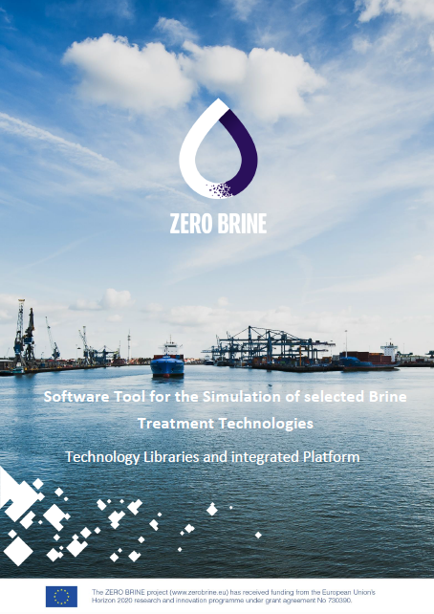
Deliverables
D5.1: Plan for the shared use of BEC modules
D5.2: Software tools for the simulation of brine treatment technologies (technology libraries and integrated platform)

Slide 39
Brine Excellence Centres (BECs)
Notes:
CTM Now Eurecat

Slide 40
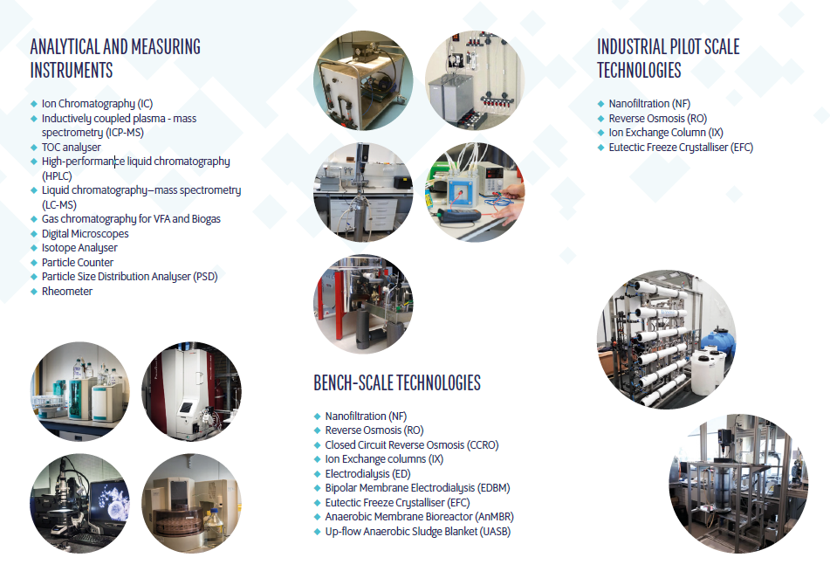
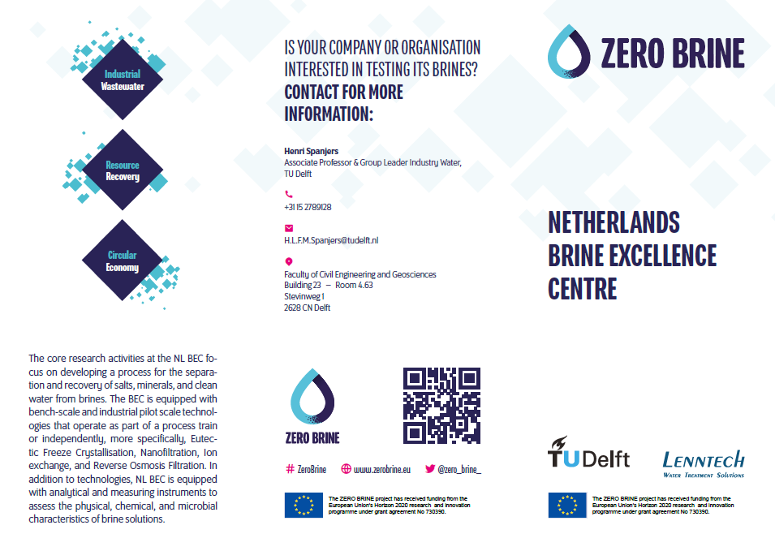
Leaflet BEC

Slide 41
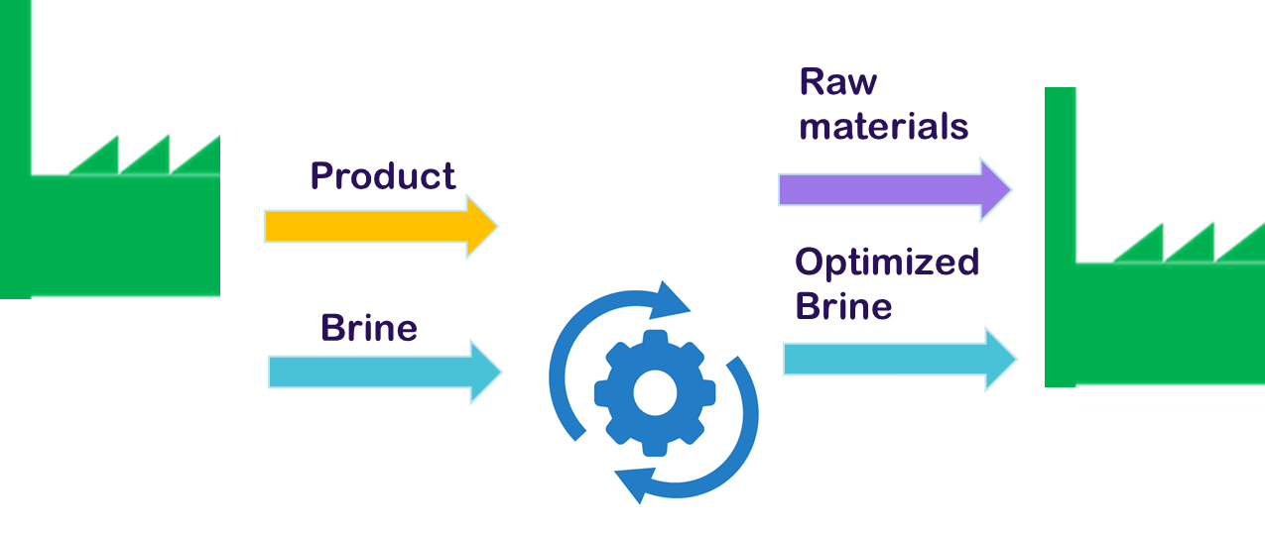
BEC follow-up examples
Sustainable Bottle Washer (Heineken): Recovery of caustic from bottle washer effluent
Brine2Beton (NEOM): use residual brine in production new materials

Slide 42
Thank you for your attention
www.zerobrine.eu #ZeroBrine @zero_brine_
The ZERO BRINE project (www.zerobrine.eu) has received funding from the European Union’s Horizon 2020
research and innovation programme under grant agreement No 730390.

Slide 43
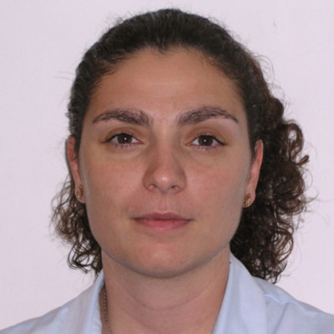
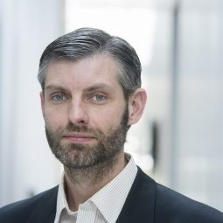
Maria Kyriazi
Senior Researcher
NTUA
Kees Roest
Programme Director
ISPT
DEMONSTRATION OF THE ONLINE BRINE PLATFORM (OBP)

Slide 44
Online Brine Platform Towards Circularity and Industrial Symbiosis
Dr Maria Kyriazi
National Technical University of Athens
kyriazimaria@mail.ntua.gr
Dr Kees Roest
Institute for Sustainable Process Technology
kees.roest@ispt.eu

Slide 45
The idea of an industrial symbiosis platform
Zero Brine aims to the implementation of smart systems which can contribute to the elimination of the negative impacts from brine discharge
Low environmental footprint
Adoption of the systems by the market
Economic feasibility
Notes:
Zero Brine aims to the implementation of smart systems which can contribute to the elimination of the negative impacts from brine discharge.
The adoption of these systems by the market has two prerequisites, the low environmental footprint and the economic feasibility. The economic feasibility is based on the value of the products that such a system can produce. These products must be raw materials that the market needs and the income from their exploitation must be higher than the capital and operational cost of the system which is used for their production.

Slide 46
The idea of an industrial symbiosis platform
The economic feasibility is based on the value of the products that water treatment systems can produce.
These products must be raw materials that the market needs and
The income from their exploitation must be higher than the capital and operational cost of the system used for their production.
Even in case that valuable raw materials are produced many problems about their exploitation have been noticed.
ZB project tried to solve this problem bringing in contact all the actors of this market with an easy and immediate way.

Slide 47
Aim of the Online Brine Platform
The OBP enables the creation of a network among different stakeholders, active in the domain of brines.
interested in wastewater management
raw material market suppliers
technology providers
wastewater aggregators
wasteheat providers
OBP addresses to industries or SMEs :

Slide 48

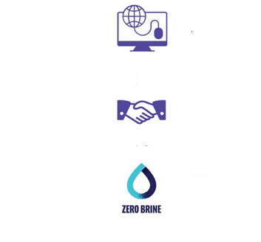
How OBP works
Water or salts end user
Technology provider
Secondary row materials flow
Wasteheat provider
Brine Producer
Brines mapping
Industrial Symbiosis Platform
Creation of stakeholders network
Matching
Circular Economy

Slide 49

OBP

Slide 50
OBP users
> 400 active users
Distribution of platform users according to the role they select during their registration
Distribution of platform users according to the country their enterprise or organization is based

Slide 51
OBP metrics

Slide 52
Thank you for your attention!

Slide 53

Kees Roest
Institute for Sustainable Process Technology
  Program director - Industrial Fluids Processing
KWR Water Research Institute
  Senior scientific researcher - Energy & Circular Systems
  Project manager
  Programme Manager TKI Water Technology projects KWR

Slide 54
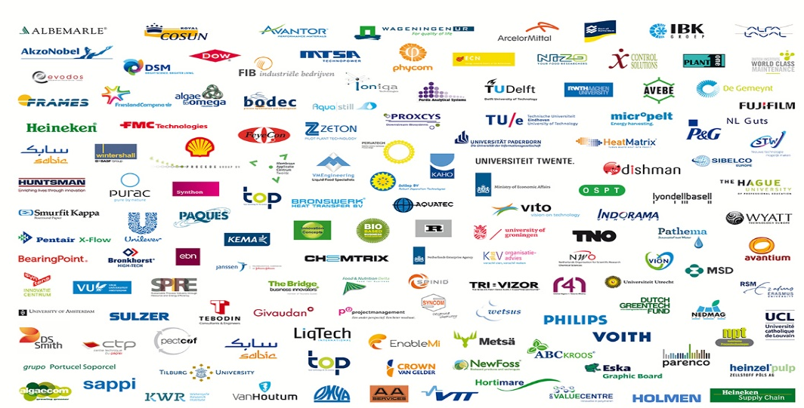
Institute for Sustainable Process Technology (ISPT)
Independent open innovation platform, founded by and for the process industry.
Facilitates research and development of sustainable process technologies through joint projects in which process industries, knowledge institutes and technology providers collaborate.
Collaboration, sharing and dissemination is crucially needed to accelerate innovation.
"...Creating an environment of trust among companies, knowledge institutes and technology providers that share a common goal..."

Slide 55
The way ISPT works: clusters
Process Intensifi
-cation
Drying and Dewatering
Deep Eutectic Solvents
A cluster is a set of multiple innovation activities with a common theme, all results are shared.
Industrial Fluids Processing
Circular Heat
Industry
4.0
System Integration & Hydrohub
Mild Fractionation for Food
Social Acceptance

Slide 56

ZERO BRINE
Reusing resources from industrial wastewater

Slide 57
WHAT RESOURCES CAN
THE ZERO BRINE PROCESS RECOVER?
Minerals
(magnesium)
Salts
(sodium chloride, potassium salts, carbonates, other salts)
Clean water
Waste heat

Slide 58
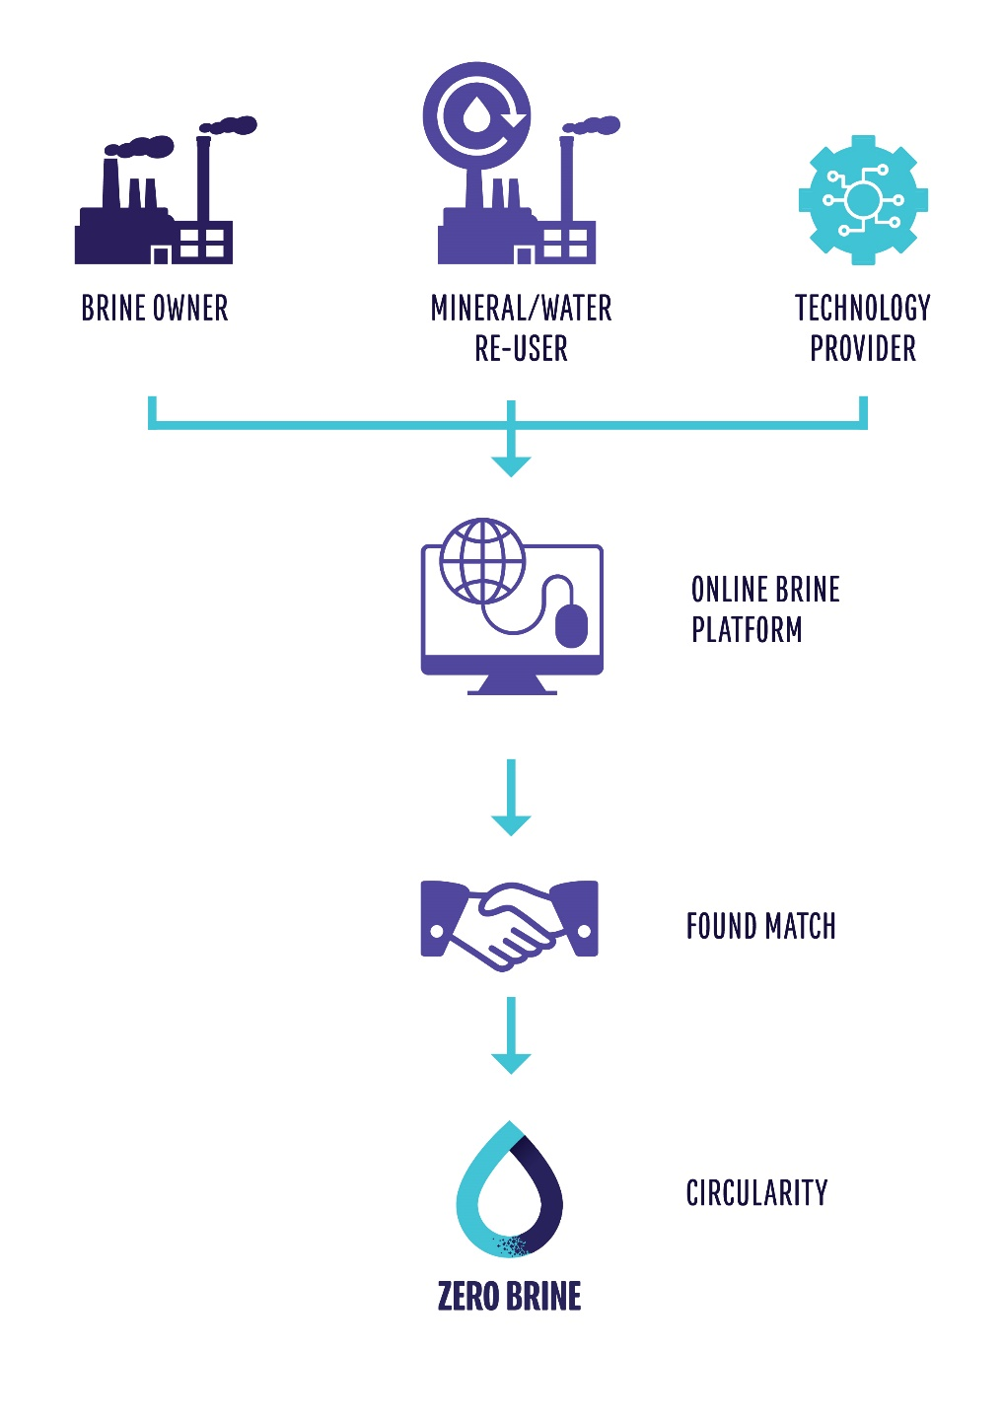
Online
Brine
Platform
(zerobrine.eu)

Slide 59
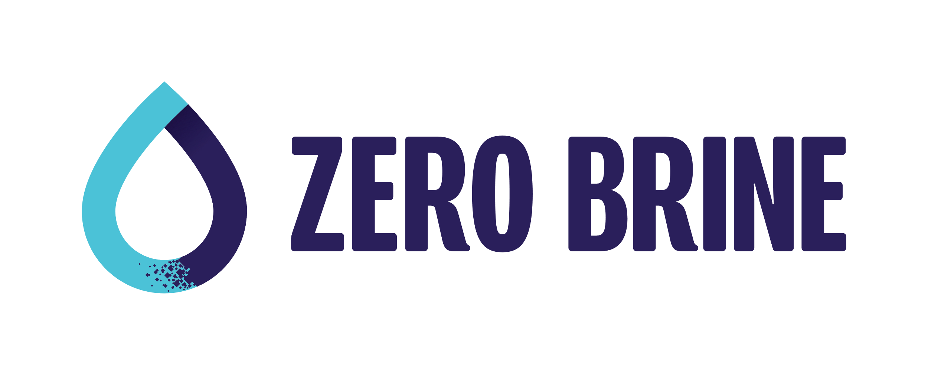
ONLINE BRINE PLATFORM
WEB PLATFORM
Industry
Technology providers
End users
Match brine producers with end-users
Match brine recovery/treatment needs with technology providers
Online market place for brines
Notes:
The aim is to develop a Online Brine Platform for digital use to advance industrial symbiosis in Europe and worldwide
i) increased customer traction for the Brine Consortium of technology suppliers
ii) providing effective brine treatment solutions to process industries (problem owners),
iii) link problem owners to end-users, promoting resource efficiency and circular economy concepts (WP8) as well as
facilitate and ensure the extensive knowledge exchange and dialogue between key stakeholders.

Slide 60

ONLINE BRINE PLATFORM

Slide 61


Accelerating the transition to a Dutch circular economy

Slide 62
ZERO BRINE Work Package 6 (Online Brine Platform – Application of the software for the case of the Netherlands)
Online training sessions
  Online Training for Industrial Cluster Authorities
  Towards Circularity and Industrial Symbiosis
  Online Training for Companies:
  Towards Circularity and Industrial Symbiosis
Capacity building (Circular Economy, Industrial Ecology, Industrial Symbiosis)
Demonstration events
Online Brine Platform (video, tutorial and questionnaire)

Slide 63







Work Package 6 (Online Brine Platform – Application of the software for the case of the Netherlands)

Slide 64

Demonstration events

Slide 65

Online Brine Platform

Slide 66

Database with brine producers & minerals end-users
Contains:
Brine producers
  Qualitative information: Cluster, sector, etc.
  Quantitative information: chloride release, sulphates release, etc
Minerals end-users:
  Quality
  Quantity

Slide 67


Circular economy among companies = Industrial symbiosis
+ Economic benefits
+ Environmental benefits
+ Social benefits
Lack of cooperation among industries
Lack of trust among industries
Lack of information sharing

Slide 68

Questions?
Dr.ir. Kees Roest
Program Director
Institute for Sustainable Process Technology
T: +31 626046573
E: kees.roest@ispt.eu
www.zerobrine.eu
#ZeroBrine
@zero_brine_

Slide 69


Slide 70
COFFEE BREAK
11:30-11:45

