Slide 1
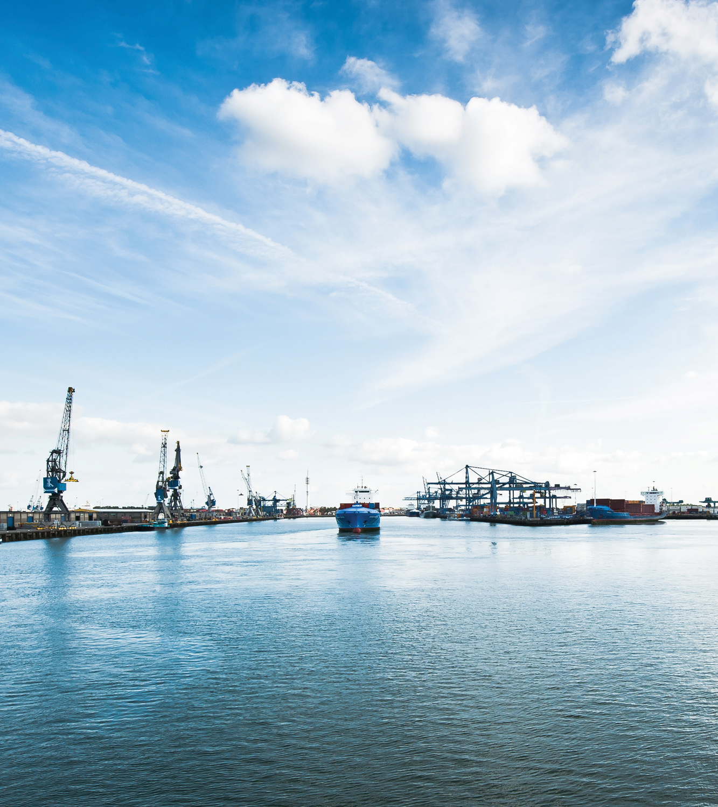
ZERO BRINE
Final Forum
De Oude Bibilotheek, Delft,
The Netherlands
4 November 2021 (10:00-16:30 CET)

Slide 2
ZERO BRINE RESEARCH
Special Issue Part I
AFTERNOON SESSION

Slide 3
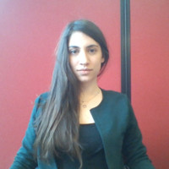
Dionysia Diamantidou
Process and R&D Engineer
Lenntech
Dionysia Diamantidou is a Process and R&D Engineer with experience in water treatment applications. Born in Greece, obtained civil engineering diploma in AUTH and water management MSc in TU Delft, specializing in sanitary engineering.
SPECIAL ISSUE PART I –Dionysia Diamantidou

Slide 4
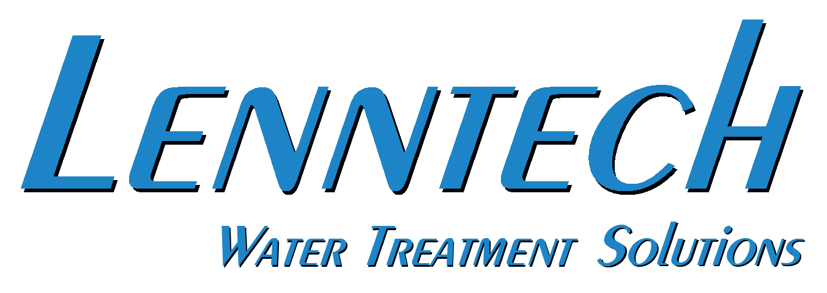
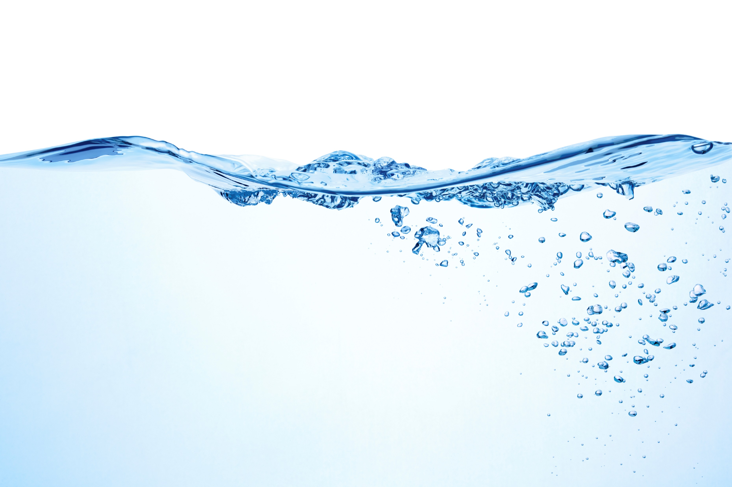
Mechanisms controlling ion rejection in membrane filtration in presence of saline multi-ionic mixtures
Zero Brine Conference
Date: Thursday 4th of November 2021
Lenntech Water Treatment Solutions,
Distributieweg 3, 2645 EG Delfgauw, The Netherlands
Tel: +31(0)152610900/ Fax: +31(0)152616289
info@lenntech.com I www.lenntech.com

Slide 5

Contents
Overview of topics to be presented
Topics
Zero Brine Project: Case Study Description
Lab-Scale Research Objectives
Material and Methods
Results
Conclusions
5
Lenntech Water Treatment Solutions I Distributieweg 3, 2645 EG Delfgauw, The Netherlands I www.lenntech.com I info@lenntech.com I +31(0)152610900
Notes:
5

Slide 6
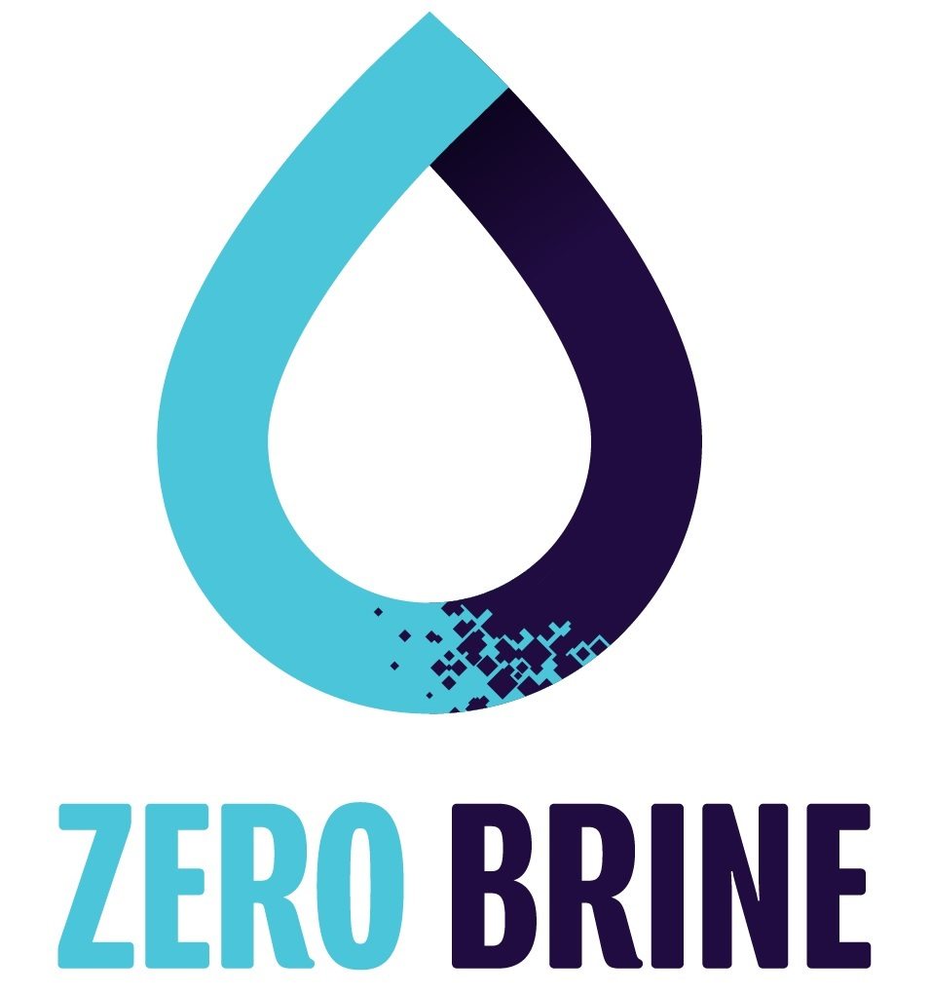
1. Zero Brine Project: Case study description
1.1 Treatment line of the IEX brine
Nanofiltration
First step of the treatment of the IEX regeneration stream
Separation of monovalent & divalent ions
Objectives of the case study
Recovery and reuse of NaCl as IEX regenerant
Recovery of Mg(OH)₂ and Ca(OH)₂
Recovery of water
6
Lenntech Water Treatment Solutions I Distributieweg 3, 2645 EG Delfgauw, The Netherlands I www.lenntech.com I info@lenntech.com I +31(0)152610900
Notes:
Therefore, maximizing the separation of monovalent and divalent ions by NF, contributes to the improvement of the quality of the NaCl solution, which leads to a more efficient regeneration of the IEX resin and limits the need for new NaCl for the regeneration of the IEX resin
6

Slide 7
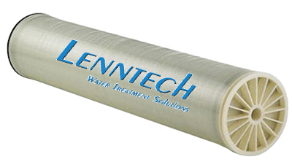
2. Lab-Scale Research Objective
Scientific objective:
Assess the membrane performance and the mechanisms that control the ion rejection in presence of saline multi-ionic mixtures
Practical objective:
Select the most suitable nanofiltration membrane that contributes to an optimal separation of monovalent (Na⁺, K⁺ and Cl) from divalent ions (Mg²⁺ and Ca²⁺) in the IEX brine and highly rejects the divalent cations
7
Lenntech Water Treatment Solutions I Distributieweg 3, 2645 EG Delfgauw, The Netherlands I www.lenntech.com I info@lenntech.com I +31(0)152610900
Notes:
Therefore, maximizing the separation of monovalent and divalent ions by NF, contributes to the improvement of the quality of the NaCl solution, which leads to a more efficient regeneration of the IEX resin and limits the need for new NaCl for the regeneration of the IEX resin
7

Slide 8
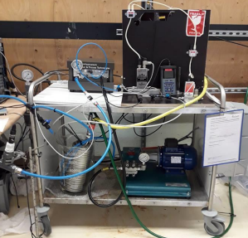
3. Materials and Methods
Equipment:
Flat sheet cross-flow cell
Active membrane area: 0.014 m²
Membranes:
NF270 and NF90 (Dow)
NFG and NFW (Synder)
SR3D (Koch)
TS80 (Microdyn Nadir)
RO98pHt (Alfa Laval)
LFC3 (Hydranautics)
Molecular Weight Cut off (MWCO) experiment:
Filtering a mixture of polyethylene (PEGs) at a concentration of 0.6 g/L
MW ranging from 62 to 1000 Da
Permeability experiment:
Filtering demineralized water at different applied pressures
8
Lenntech Water Treatment Solutions I Distributieweg 3, 2645 EG Delfgauw, The Netherlands I www.lenntech.com I info@lenntech.com I +31(0)152610900
Notes:
8

Slide 9
3. Material and Methods
Ion rejection experiment:
Assess the membrane performance in presence of the multi-ionic mixture:
  Test three different fluxes (15, 30, 45 L/m²/h)
Compare the membranes and conclude on the best performing membrane
Keeping the flux constant at 30 L/m²/h, the feed water was concentrated
Concentration and properties of the ions:
Solute | Ion concentration (ppm) | MW (g/mol) | r_{i} (nm) | Hydration free energy (kJ/mol) | D_{i,oo} (x 10⁻⁹ m² s⁻¹)
Na⁺ | 3266 | 23 | 0.184 | 365 | 1.33
Cl⁻ | 23919 | 35 | 0.121 | 340 | 2.03
K⁺ | 520 | 39 | 0.138 | 295 | 1.95
Mg²⁺ | 1700 | 24 | 0.347 | 1828 | 0.706
Ca²⁺ | 7590 | 40 | 0.309 | 1504 | 0.792
9
Lenntech Water Treatment Solutions I Distributieweg 3, 2645 EG Delfgauw, The Netherlands I www.lenntech.com I info@lenntech.com I +31(0)152610900
Notes:
9

Slide 10
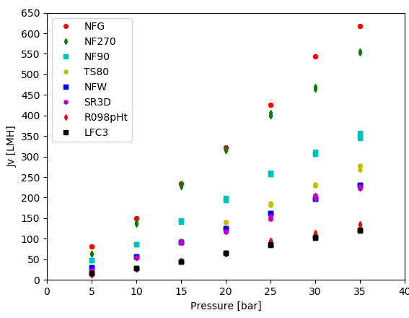
4. Results: Water Permeability
RO membranes (RO98pHt, LFC3): lower permeabilities than NF membranes
10
Lenntech Water Treatment Solutions I Distributieweg 3, 2645 EG Delfgauw, The Netherlands I www.lenntech.com I info@lenntech.com I +31(0)152610900
Notes:
10

Slide 11
4. Results: MWCO and water permeability
Membrane Νame | MWCO (Da) | Lp (LMH/bar)
NFG | 508 | 16.5
NF270 | 272 | 15.0
NFW | 242 | 6.2
SR3D | 200* | 5.9
TS80 | 142 | 6.8
NF90 | 115 | 9.7
RO98pΗt | – | 3.3
LFC3 | – | 3.2
*According to the manufacturer
Tight NF membranes (NFW, TS80, NF90, SR3D): lower water permeabilities than loose NF membranes (NFG, NF270)
NFG and NF270: Similar water permeability but NFG had double the MWCO
NF90 and TS80: NF90 is tighter but more permeable
→ NF270 and NF90 might be thinner or have bigger porosity
11
Lenntech Water Treatment Solutions I Distributieweg 3, 2645 EG Delfgauw, The Netherlands I www.lenntech.com I info@lenntech.com I +31(0)152610900
Notes:
11

Slide 12
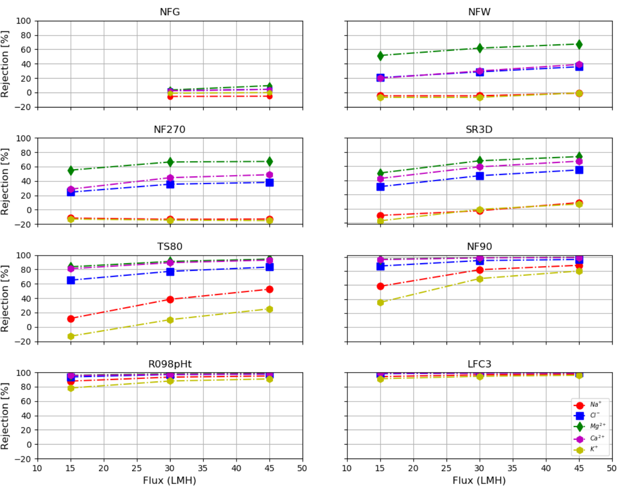
4. Results: Ionic rejections
Order of the ionic rejections (R): RMg > Rca > RNa > RK, due to hydrated radius, hydration free energy and diffusion coefficient of each ion
Higher fluxes: higher ionic rejections
Strong dependence of the ionic rejection on membrane MWCO
12
Lenntech Water Treatment Solutions I Distributieweg 3, 2645 EG Delfgauw, The Netherlands I www.lenntech.com I info@lenntech.com I +31(0)152610900
Notes:
12

Slide 13
4. Results: Ionic rejections
TS80 membrane:
    efficient ion separation
    high rejections of divalent cations
    concentration of Ca²⁺ and Mg²⁺ by almost two times
13
Lenntech Water Treatment Solutions I Distributieweg 3, 2645 EG Delfgauw, The Netherlands I www.lenntech.com I info@lenntech.com I +31(0)152610900
Notes:
13

Slide 14
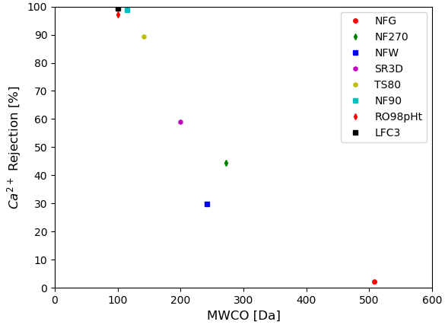
4. Results: Ionic rejections - MWCO
Ca²⁺ rejection:
  lower than 10% for a membrane with MWCO higher than 500 Da
  higher than 95% for a membrane with MWCO lower than 115 Da
14
Lenntech Water Treatment Solutions I Distributieweg 3, 2645 EG Delfgauw, The Netherlands I www.lenntech.com I info@lenntech.com I +31(0)152610900
Notes:
14

Slide 15
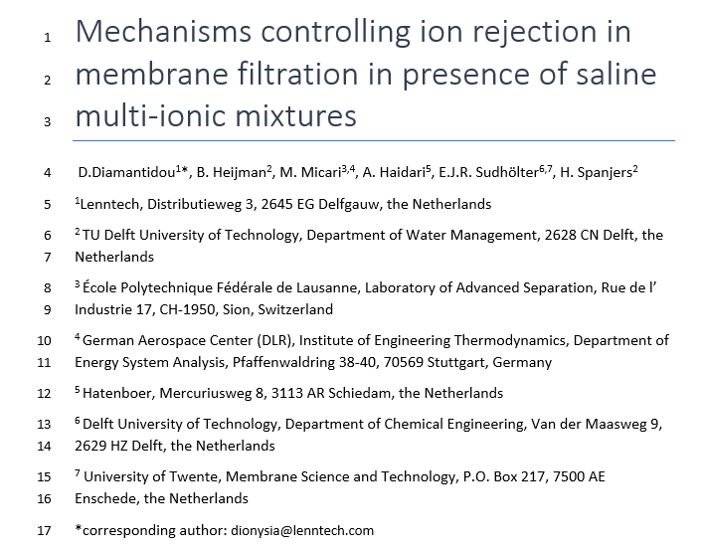
5. Scientific Conclusions
Ion rejection by membrane filtration correlated with ion properties
RO and tight NF membranes have lower water permeabilities and higher ion rejections compared to loose NF membranes
Strong impact of the membrane MWCO on the ion rejection
15
Lenntech Water Treatment Solutions I Distributieweg 3, 2645 EG Delfgauw, The Netherlands I www.lenntech.com I info@lenntech.com I +31(0)152610900
Notes:
Variation of the feed solution
15

Slide 16
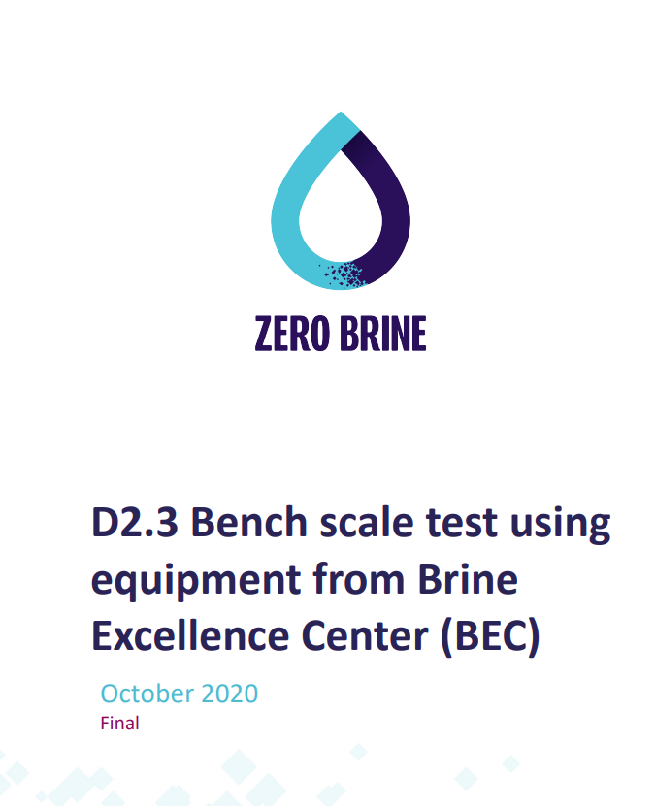
5. Practical Conclusions
TS80 membrane was proven to be most effective: more than 90% rejection of Ca²⁺ and Mg²⁺ and more than 62% permeation of monovalent ions
Concentration factor of Ca²⁺ and Mg²⁺ ions by almost two times was achieved, allowing for more effective recovery of Ca(OH) and Mg(OH)₂.
16
Lenntech Water Treatment Solutions I Distributieweg 3, 2645 EG Delfgauw, The Netherlands I www.lenntech.com I info@lenntech.com I +31(0)152610900
Notes:
16

Slide 17
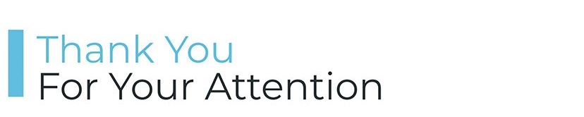
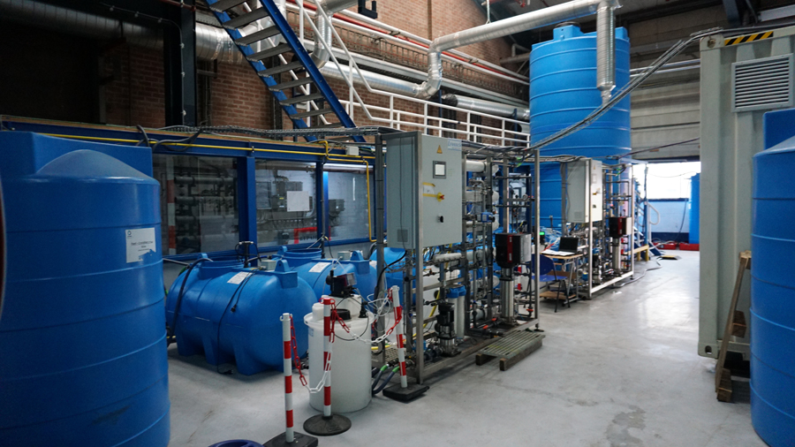
17
Lenntech Water Treatment Solutions I Distributieweg 3, 2645 EG Delfgauw, The Netherlands I www.lenntech.com I info@lenntech.com I +31(0)152610900
Notes:
17

Slide 18
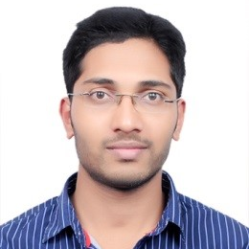
Nikhil Pawar
PhD candidate
DLR
Nikhil Pawar completed his Master’s at the Technical University of Berlin in Business Engineering (Energy) and is currently a PhD candidate at DLR, Stuttgart with Energy-Water Nexus being his focus area. In the ZERO BRINE project he contributed to the techno-economic modeling of treatment chains on the RCE simulation platform.
SPECIAL ISSUE PART I - Nikhil Pawar

Slide 19
Valorization of Coal Mine Effluents –
Challenges & Economic Opportunities
Paper Presentation, ZERO BRINE Final Forum, 4th November 2021
Nikhil Pawarª, Steve Harris^{b}, Krzysztof Mitko^{c}, Gijsbert Korevaar^{d}
ª Institute of Networked Energy Systems, German Aerospace Center (DLR), Curiestrasse 4, 70563 Stuttgart, Germany;
^{b}IVL Swedish Environmental Research Institute, Aschebergsgatan 44, 411 33 Göteborg, Sweden;
^{c}Faculty of Chemistry, Silesian University of Technology, ul. B. Krzywoustego 6, 44-100 Gliwice, Poland;
^{d}Faculty of Technology, Policy and Management, Delft University of Technology, Jaffalaan 5, 2628 BX, Netherlands

Slide 20
Agenda
Motivation
Pilot plant: Implementation at Site
Technology Modeling and Simulation
Results
Conclusion & Outlook
The ZERO BRINE project (www.zerobrine.eu) has received funding from the European Union’s Horizon 2020
research and innovation programme under grant agreement No 730390.
04 November 2021

Slide 21
Motivation
Poland: EU’s dominant hard coal producer (~92%) ^{[1]}
Mine water discharge containing chlorides and sulphates in Polish rivers^{[2]}
Circular Economy Approach: Reduce pollution by pretreatment of effluents, but also recover valuable minerals (Mg, Ca, NaCl)
Polish pilot site: Economic feasibility of a full-scale implementation
The ZERO BRINE project (www.zerobrine.eu) has received funding from the European Union’s Horizon 2020
research and innovation programme under grant agreement No 730390.
04 November 2021

Slide 22
Pilot Plant: Implementation at Site
ZERO BRINE technology
Coal mine effluent
(Na⁺, Cl⁻, Mg²⁺, Ca²⁺, SO₄⁻¹)
Pre-treatment
(NF, cryst)
Concentration
(RO, ED, MED, NaCl cryst)
Post-crystallization Iyes
Electricity and heat
Dolime solution
(Mg²⁺, Ca²⁺, (OH)₂⁻¹)
Co-products
Mg(OH)₂
Ca(SO)₄
Dem.
water
NaCl
Main product
The ZERO BRINE project (www.zerobrine.eu) has received funding from the European Union’s Horizon 2020
research and innovation programme under grant agreement No 730390.
04 November 2021

Slide 23
Technology Modeling and Simulation (1/2)
Technology Tools: Techno-economic modeling on Python
These Tools are integrated and simulated as a treatment chain on DLR‘s open-source integration platform RCE (Remote Component Environment)^{[3]}
Levelized cost of salt (LSC) is used as an economic indicator
Deviation from site:
  ED is modeled as a single unit instead of two units in a cascade system
  100% mineral recovery from the Crystallizers
The ZERO BRINE project (www.zerobrine.eu) has received funding from the European Union’s Horizon 2020
research and innovation programme under grant agreement No 730390.
04 November 2021

Slide 24
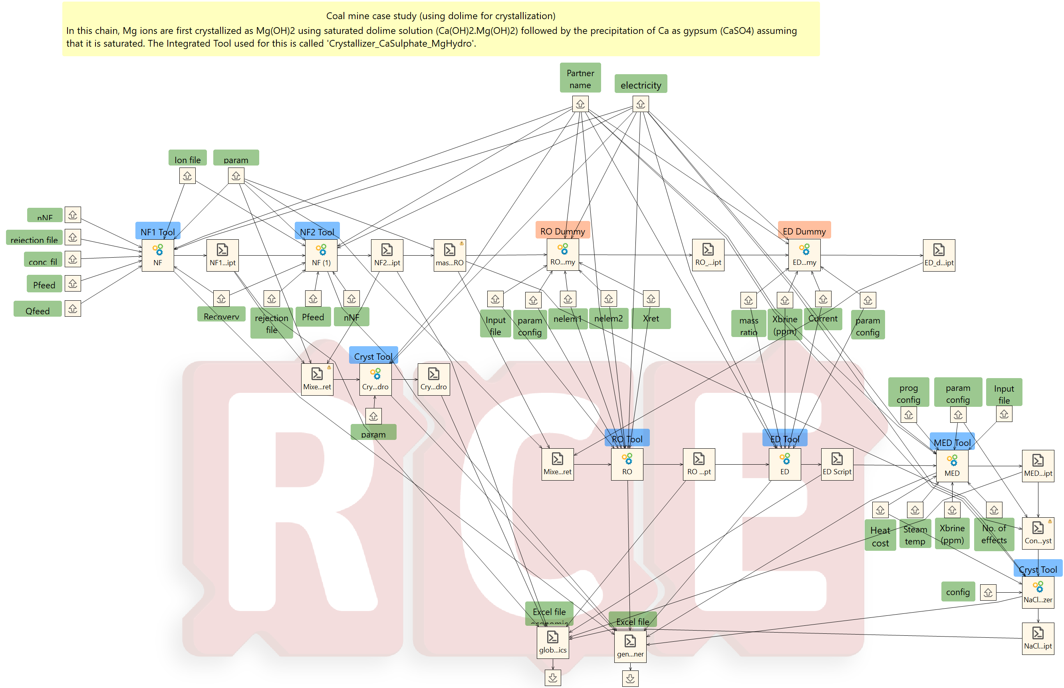
Technology Modeling and
Simulation (2/2)
Technology Tools:
Economic calculations for the complete chain
The ZERO BRINE project (www.zerobrine.eu) has received funding from the European Union’s Horizon 2020
research and innovation programme under grant agreement No 730390.
04 November 2021

Slide 25
General Economic Assumptions^{[4]}
Parameter | Value
Electricity cost [USD/kWh_{el}] | 0.1035
Heat cost [USD/kWh_{th}] | 0.01
Dolime [USD/ton] | 60
Mg(OH)₂ [USD/ton] | 1200
CaSO₄ [USD/ton] | 40
Pure water price [USD/m³] | 1
Capacity factor of the plant [-] | 0.94
Interest rate [%] | 6%
The ZERO BRINE project (www.zerobrine.eu) has received funding from the European Union’s Horizon 2020
research and innovation programme under grant agreement No 730390.
04 November 2021

Slide 26
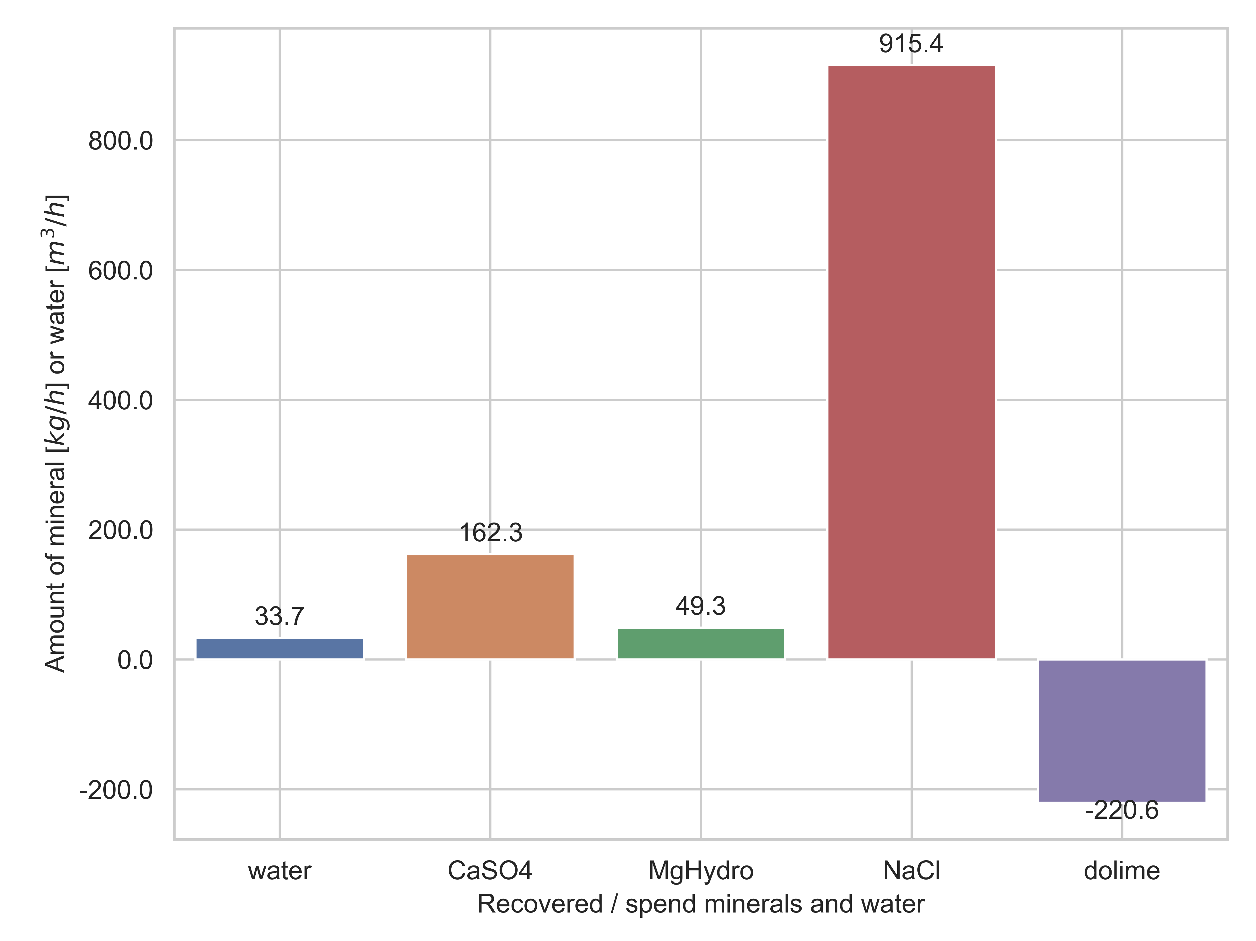
Results: Mineral Recovery
Recovery: water, CaSO₄, Mg(OH)₂, NaCl
Assumption: effluent at 50m³/h
Smallest & largest recovery are Mg(OH)₂ & NaCl resp.
800
600
400
200
0
-200
Amount of mineral [kg/h] or watr [m³/h]
Water CaSO₄ Mg(OH)₂ NaCl dolime
The ZERO BRINE project (www.zerobrine.eu) has received funding from the European Union’s Horizon 2020
research and innovation programme under grant agreement No 730390.
04 November 2021

Slide 27
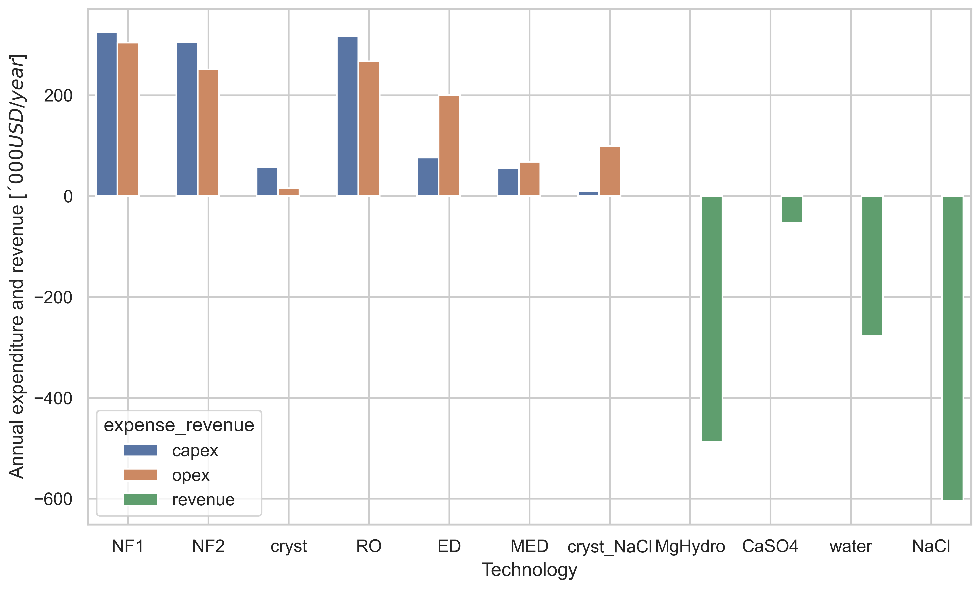
Results: Expenditures & Revenues
NF and RO have the highest expenses with NF accounting for ~50% of the CAPEX & OPEX
Total revenue/yr is ~60% of the total expenditure/yr
200
0
-200
-400
-600
Annual expenditure and revenue []‘000 USD/year]
NF1 NF2 Cryst RO ED MED Cryst_{NaCl} Mg(OH)₂ CaSO₄ water NaCl
The ZERO BRINE project (www.zerobrine.eu) has received funding from the European Union’s Horizon 2020
research and innovation programme under grant agreement No 730390.
04 November 2021

Slide 28
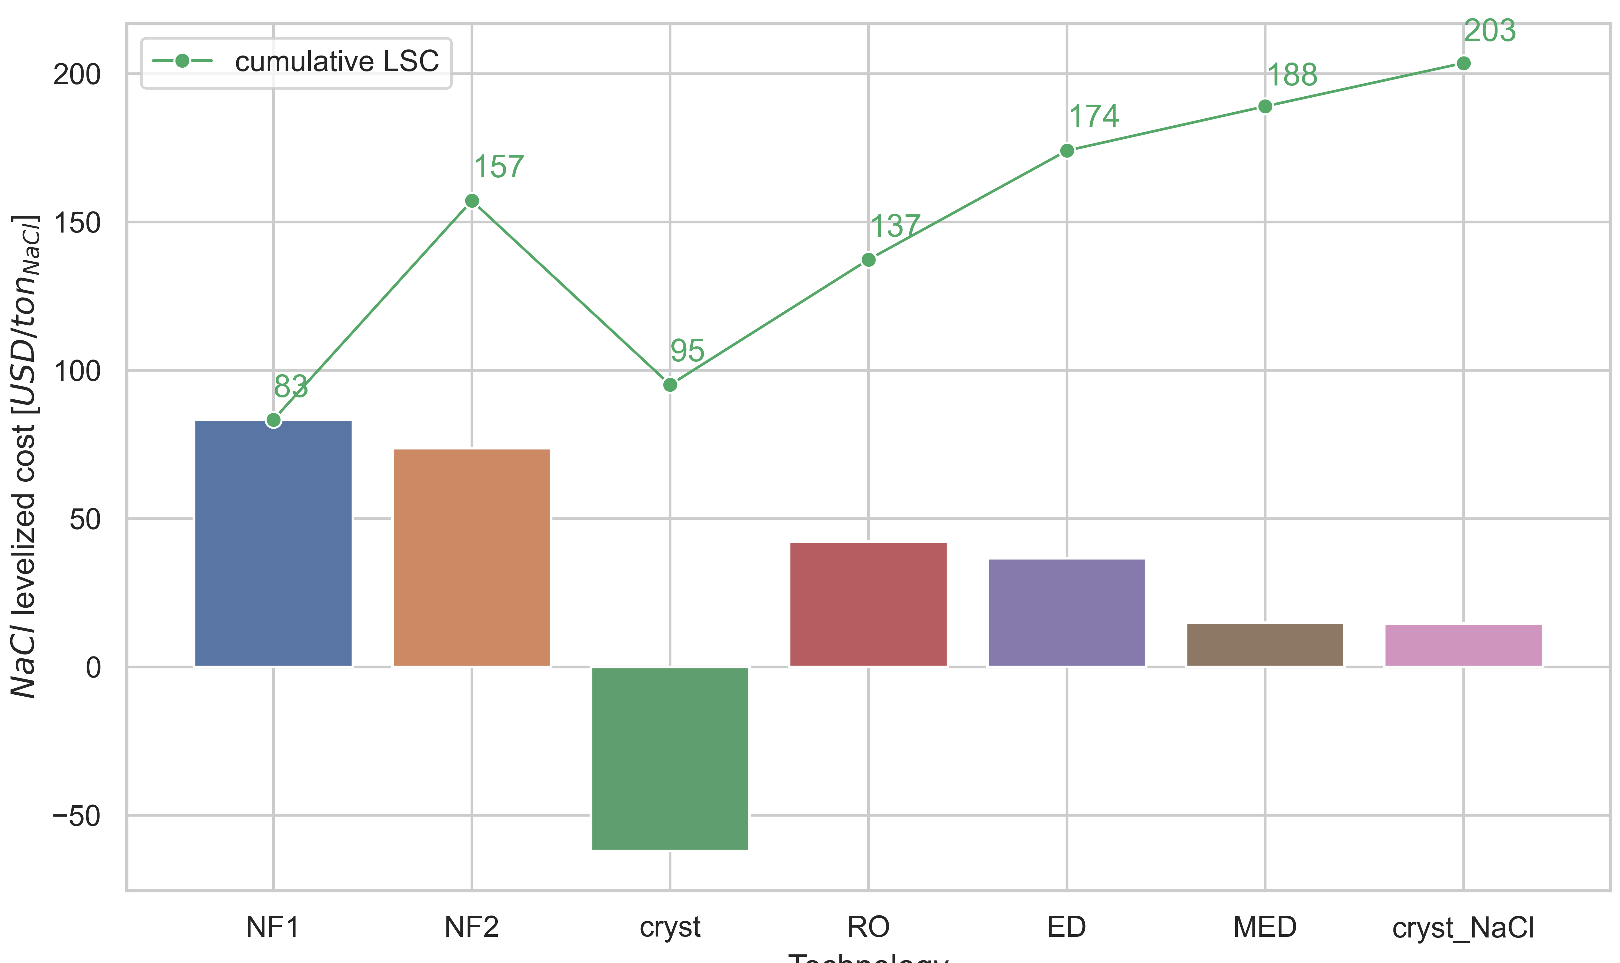
Results: Levelized Cost of Salt (LSC)
LSC: 203 USD/ tonne NaCl
Market price: 80 to 150 USD/ tonne NaCl^{[4]}
200
150
100
NaCl levelized cost [USD/ton_{NaCl}]
50
0
-50
NF1 NF2 Cryst RO ED MED Cryst_{NaCl}
The ZERO BRINE project (www.zerobrine.eu) has received funding from the European Union’s Horizon 2020
research and innovation programme under grant agreement No 730390.
04 November 2021

Slide 29
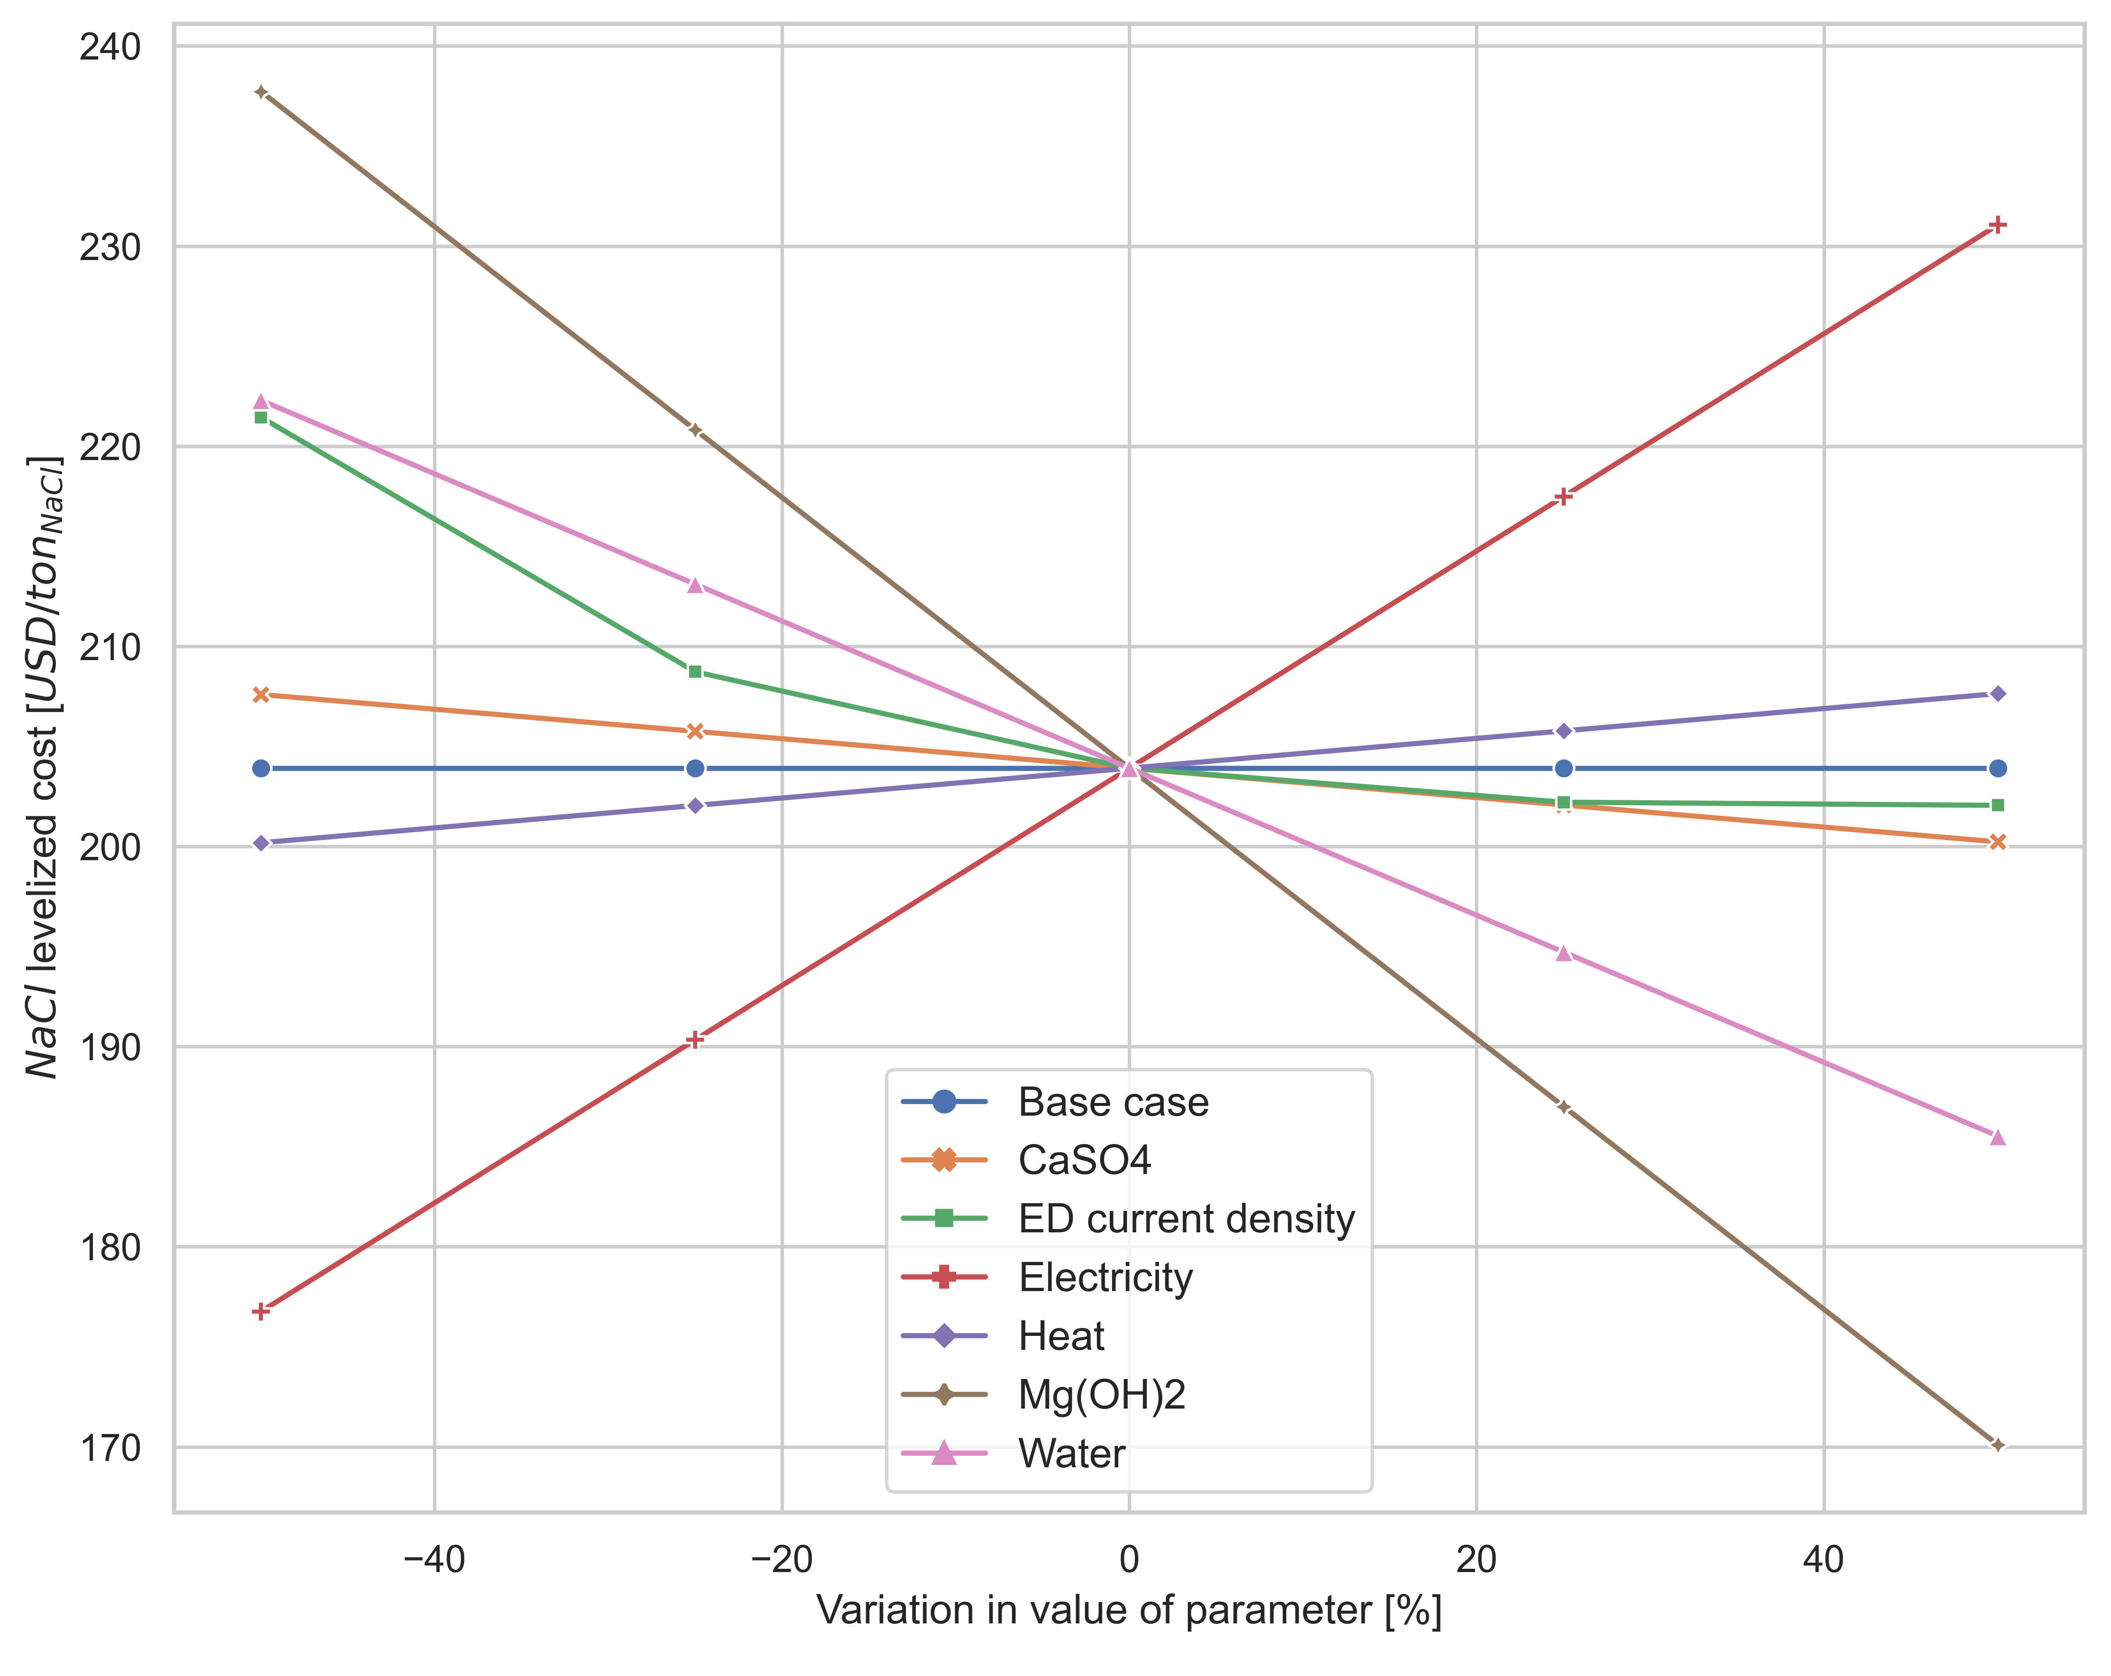
Results: Sensitivity Analysis
240
Parameters: prices/costs of CaSO₄, Mg(OH)₂, water, heat, and electricity
Variation: -50% to +50%
LSC: 170 to 180 USD/ tonne_{NaCl}: Reduction in electricity price by 50% or increase in price of Mg(OH)₂
230
220
210
NaCl levelized cost [USD/ton_{NaCl}]
200
190
Electricity
180
Mg(OH)₂
170
-40 -20 0 20 40
Variation in value of parameter [%]
The ZERO BRINE project (www.zerobrine.eu) has received funding from the European Union’s Horizon 2020
research and innovation programme under grant agreement No 730390.
04 November 2021

Slide 30
Conclusion & Outlook
Treatment of coal mine effluent & recovery of minerals is technically feasibile
Economic feasibility of the treatment chain is possible by improving one or more cost factors
Outlook: To model ED as a cascade system of two units and to account for partial recovery in crystallizers
The ZERO BRINE project (www.zerobrine.eu) has received funding from the European Union’s Horizon 2020
research and innovation programme under grant agreement No 730390.
04 November 2021

Slide 31
References
EURACOAL (2020). EURACOAL Annual Report 2019. Brussels, European Association for Coal and Lignite.
Turek, M., et al. (2005). "Salt production from coal-mine brine in ED–evaporation–crystallization system." Desalination 184(1-3): 439-446.
(DLR), D. Z. f. L.-u. R. e. V. (2021). "RCE." from https://rcenvironment.de/.
Micari, M., et al. (2020). "Techno-economic analysis of integrated processes for the treatment and valorisation of neutral coal mine effluents." Journal of Cleaner Production 270: 122472.
The ZERO BRINE project (www.zerobrine.eu) has received funding from the European Union’s Horizon 2020
research and innovation programme under grant agreement No 730390.
04 November 2021

Slide 32
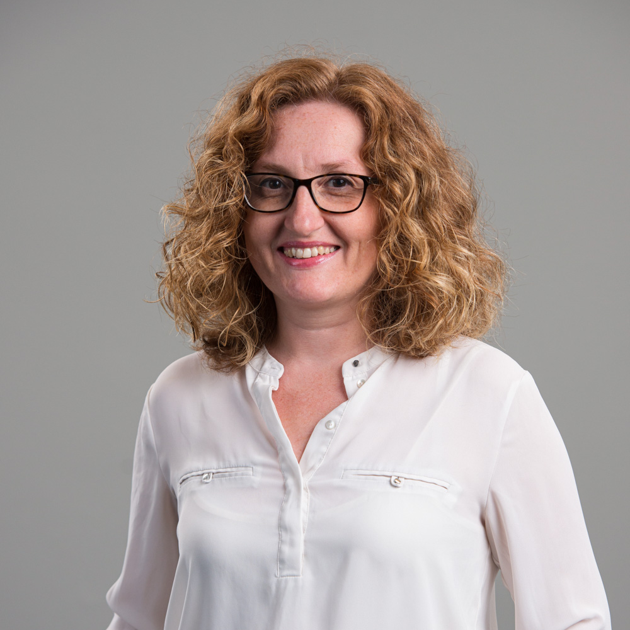
Nilay Elginoz
Senior Researcher
IVL
Dr. Nilay Elginoz is a senior researcher at IVL Swedish Environmental Institute, with her research focused on environmental sustainability assessment of emerging resource recovery systems. Before IVL, she worked as a researcher for KTH Royal Institute of Technology and Istanbul Technical University. She completed her PhD on nature based coastal protection structures and their impact on coastal erosion in 2010.
SPECIAL ISSUE PART I - Nilay Elginoz

Slide 33
Using life cycle assessment at an early stage of design and development of zero discharge brine treatment and recovery
Nilay Elginoz Kanatª, Christina Papadaskalopoulou^{b}, Steve Harrisª
ªIVL Swedish Environmental Research Institute, Sweden
^{b}National Technical University of Athens, Greece

Slide 34
Aim
Evaluate the implications of utilising different input data, from two stages of development, on the LCA results.
Specific objectives
  (i) Identify the extent of impact on results by comparing results of LCA’s using initial design and bench scale data with improved data from pilot scale and simulations.
  (ii) Assess the resultant consequences for informing the design process and highlight potential pitfalls.
  (iii) Identify the key challenges in early application of LCA and propose methods to manage.
The ZERO BRINE project (www.zerobrine.eu) has received funding from the European Union’s Horizon 2020
research and innovation programme under grant agreement No 730390.

Slide 35
Scope
System boundaries of LCAs cover operation of the treatment and resource recovery units and credits provided by recovered products
Recovered products were credited by using system expansion method in the LCA model.
  gypsum
  deionised water
  sodium chloride
  magnesium hydroxide
The ZERO BRINE project (www.zerobrine.eu) has received funding from the European Union’s Horizon 2020
research and innovation programme under grant agreement No 730390.

Slide 36
Scope
Out of the system boundaries
  Construction and operation of the brine generating facilities
  Construction of the treatment and resource recovery units
In the system boundaries
  Chemical and energy consumptions
  Component replacement for each unit
The ZERO BRINE project (www.zerobrine.eu) has received funding from the European Union’s Horizon 2020
research and innovation programme under grant agreement No 730390.

Slide 37
Scope
The International Reference Life Cycle Data System, ILCD 2011 midpoint
  climate change
  acidification
  freshwater eutrophication
  abiotic resource depletion for mineral, fossil and renewable resources
Normalization method for Environmental Footprints
Perturbation analysis
The ZERO BRINE project (www.zerobrine.eu) has received funding from the European Union’s Horizon 2020
research and innovation programme under grant agreement No 730390.

Slide 38
Coal mine case
First stage,
  Experimental data and PH REdox EQuilibrium (PHREEQC) simulations
Second stage
  Pilot plant with treatment capacity of 1m³/h, onsite at the mine
  Upscaled to a conceptual plant with 50 m³/h plant capacity
The ZERO BRINE project (www.zerobrine.eu) has received funding from the European Union’s Horizon 2020
research and innovation programme under grant agreement No 730390.

Slide 39
First stage,
  Experimental data and PH REdox Equilibrium (PHREEQC) simulations
Second stage
  Pilot plant with treatment capacity of 1m³/h, onsite at the mine
  Upscaled to a conceptual plant with 50 m³/h plant capacity
The ZERO BRINE project (www.zerobrine.eu) has received funding from the European Union’s Horizon 2020
research and innovation programme under grant agreement No 730390.

Slide 40
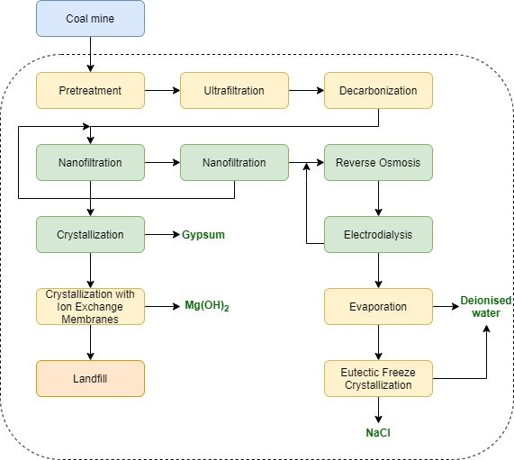
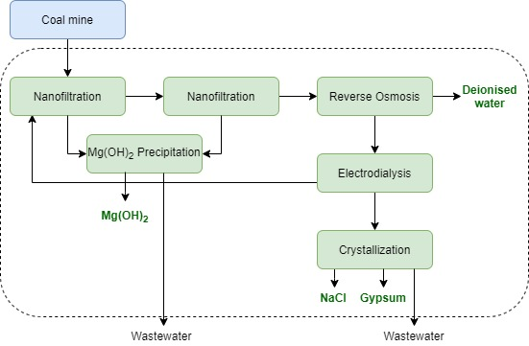
Second stage
Coal mine case
First stage
The ZERO BRINE project (www.zerobrine.eu) has received funding from the European Union’s Horizon 2020
research and innovation programme under grant agreement No 730390.

Slide 41
First stage,
  Experimental data of the brine treatment processes and PHREEQC simulations
Second stage
  Pilot plant with treatment capacity of 1m³/h, onsite at the plant
The ZERO BRINE project (www.zerobrine.eu) has received funding from the European Union’s Horizon 2020
research and innovation programme under grant agreement No 730390.

Slide 42
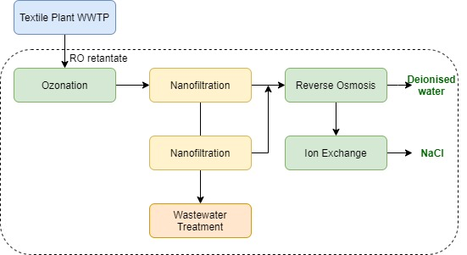
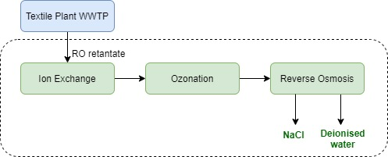
Textile plant case
First stage
Second stage
The ZERO BRINE project (www.zerobrine.eu) has received funding from the European Union’s Horizon 2020
research and innovation programme under grant agreement No 730390.

Slide 43
Results: Coal mine case
Design of the coal mine ZB system changed substantially in the second stage
Climate change and acidification impacts are 28% and 52% higher
Freshwater eutrophication is 10% lower in the second stage
1% difference in the mineral, fossil and renewable resource depletion
The ZERO BRINE project (www.zerobrine.eu) has received funding from the European Union’s Horizon 2020
research and innovation programme under grant agreement No 730390.

Slide 44
Electricity consumption in the treatment steps is the major contributor
9kWh and 11 kWh per 1 m³ brine in the 1st and 2nd stages
Dolomite production in the magnesium precipitation in the 1st stage
Hydrochloric acid consumption in the decarbonation stage in the 2nd stage
Hydrochloric consumption in the 2nd stage and the increase in the electricity consumption is the main reason of the increase in the impacts
Sodium chloride recovery increase from 6.5 to 16.5 kg
The increase in deionized water and gypsum recovery doesn`t have a visible impact on the results
Results: Coal mine case
The ZERO BRINE project (www.zerobrine.eu) has received funding from the European Union’s Horizon 2020
research and innovation programme under grant agreement No 730390.

Slide 45
Results: Textile plant case
2nd stage configuration cause more burdens in all impact categories
  Climate change 36%
  Acidification 85%
  Freshwater eutrophication 78%
  Resource depletion 25 times
higher
The ZERO BRINE project (www.zerobrine.eu) has received funding from the European Union’s Horizon 2020
research and innovation programme under grant agreement No 730390.

Slide 46
Electricity consumption in the treatment steps is the major contributor
19 kWh and 22 kWh per 1 m³ brine in the 1st and 2nd stages
Compressed air consumption in ozonation unit in the 2nd stage
Recovered sodium chloride is the same on both stages
The increase in recovered water from 0.6 to 0.861 m3 in the second stage does not result in any visible improvement on the impacts
Results: Textile plant case
The ZERO BRINE project (www.zerobrine.eu) has received funding from the European Union’s Horizon 2020
research and innovation programme under grant agreement No 730390.

Slide 47
Sensitivity and uncertainty analysis for climate change
Parameter | Sensitivity Ratio
 | Coal mine first stage | Coal mine second stage | Textile plant first stage | Textile plant second stage
Electricity | 0.89 | 0.85 | 0.88 | 0.75
Sodium chloride | 0.11 | 0.21 | 0.04 | 0.04
Magnesium hydroxide | 0.21 | 0.07 | - | -
Deionised water | <0.01 | 0.02 | 0.01 | 0.02
Gypsum | <0.01 | <0.01 | - | -
Climate change results are very sensitive to electricity consumption
+-10% variation of electricity consumption cause 7.5 to 8.9% variation of the results
Amount of sodium chloride recovery impacts the climate change results less in the textile plant case compared to coal mine case
The ZERO BRINE project (www.zerobrine.eu) has received funding from the European Union’s Horizon 2020
research and innovation programme under grant agreement No 730390.

Slide 48
Key challenges in early application of LCA
LCAs investigated in this study were conducted simultaneously with the development of ZB technologies from (TRL) 2-3 to TRL 4-5.
The results were of limited use for the process design team.
The main focus, during the pilot stage was solving technical issues and minimizing energy consumption.
The ZERO BRINE project (www.zerobrine.eu) has received funding from the European Union’s Horizon 2020
research and innovation programme under grant agreement No 730390.

Slide 49
Key challenges in early application of LCA
Experimental data was combined with simulations and engineering based calculations for scaling up the proposed treatment systems to industrial scale.
In ZB case studies scaling up was executed in collaboration with technology developers as recommended.
Data availability issue was overcome by the close collaboration of technology developers, pilot plant implementers and LCA team.
Background electricity production processes (which determine the mix of coal and other sources) have a crucial impact on the LCA results.
The ZERO BRINE project (www.zerobrine.eu) has received funding from the European Union’s Horizon 2020
research and innovation programme under grant agreement No 730390.

Slide 50
LUNCH BREAK
12:45-13:45

Slide 51
ZERO BRINE RESEARCH
Special Issue Part II
AFTERNOON SESSION

Slide 52
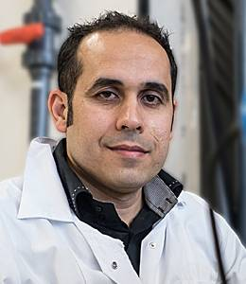
Amir Haidari
Process Technology & Innovation Manager
Hatenboer-Water
Amir Haidari was born in Afghanistan and has been living in the Netherlands for more than 20 years. In 2011, he graduated specialized in the topic of zero brine in horticulture. He got his doctoral degree on improvements of reverse osmosis membrane construction. In 2016, he became the coordinator of ZERO BRINE project. After four-years of working on ZERO BRINE, he changed his carrier towards industry. Since 2020, he is the Manager of Process Technology and Innovation at Hatenboer-Water.
ZERO BRINE SPECIAL ISSUE – PART II – Amir Haidari

Slide 53
High silica concentration in RO concentrate
RO as pretreatment to EFC
Amir Haidari
amir.haidari@hatenboer-water.com
The ZERO BRINE project (www.zerobrine.eu) has received funding from the European Union’s Horizon 2020
research and innovation programme under grant agreement No 730390.
Notes:
Good afternoon everyone.
How was the lunch?
Nice, then we have two things in common. We both liked the lunch and you don’t know what I’m going to say… and neither do I.
53

Slide 54
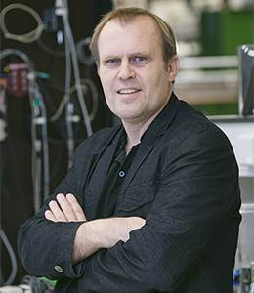
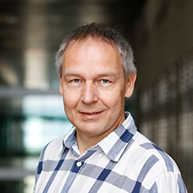
Introduction
Amir Haidari: manager of R&D at Hatenboer-water
Bas Heijman: Associate professor at Delft University of Technology
Geert-Jan Witkamp: Professor, Environmental Science and Engineering at KAUST
The ZERO BRINE project (www.zerobrine.eu) has received funding from the European Union’s Horizon 2020
research and innovation programme under grant agreement No 730390.
Notes:
Let me then start with introducing myself and two coathours of the paper where my presentation is based on.
My name is Amir haidari and I’m the one in the white lab coat for the case you didn’t recognize me from the two handsome gentelmens
In the middle is Bas Heijman: associate professor at delft university of technology
On the right of you. A picture of prof Green-Jan witkamp who is working now for couple of years at KAUST as professor in environmental science and engineering
54

Slide 55
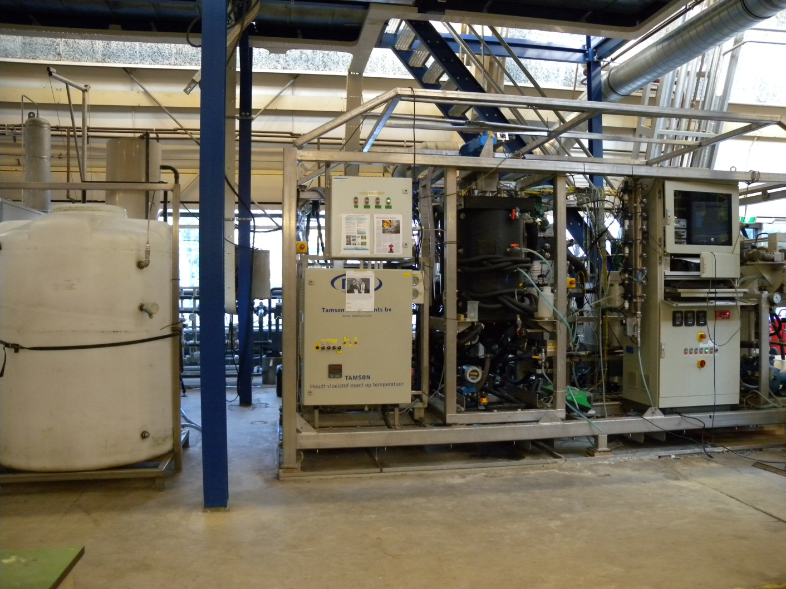
Introduction
Eutectic Freeze Crystallization (EFC) is one the instrument used during ZEOR BRINE project
The ZERO BRINE project (www.zerobrine.eu) has received funding from the European Union’s Horizon 2020
research and innovation programme under grant agreement No 730390.
Notes:
Eutectic Freeze Crystallization (EFC) is one the instrument used during ZEOR BRINE project
EFC is a device the separate the inorganic aqueous solution into pure ice and solidified solutes by means of freezing at eutectic point. The device is made of different units, such as pipe, valves, pumps, data acquisition unit and the crystalizator, where the separation between ice and salts happens.
55

Slide 56
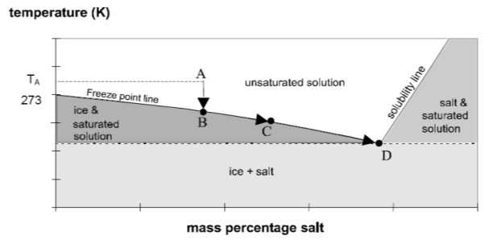
Introduction
A: Solution
B: Formation of ice
C: Increase concentration
D: Saturation solution, start formation of salts (Eutectic point)
The ZERO BRINE project (www.zerobrine.eu) has received funding from the European Union’s Horizon 2020
research and innovation programme under grant agreement No 730390.
Notes:
Imagine a solution with a temperature of 20oC at point A, if we cool the solution at 0oC or 273K ice starts to form, this means that density of the solution increase a bit. In this way the formed ice stay above the solution. By further freezing of the solution the concentration of ions solution increases and reach point C and eventually point D, or so called eutectic point. In this point ions become oversaturated and start to form salts. Since the density difference of ice and salts is in order of 1000, the salts settled in bottom and ice floats in top of the solution and in this way they can separated.
Now that is nice, but what is the problem then.
Compared to evaporators, EFC needs less energy however, when compared with for instance RO the required energy for m3 of produces water is much higher. So to increase the efficiency of EFC, a common method is to provide a water to the instrument with high concentration of salts and less water.
If there was a method to achieve both goals. I hope you realize that somebody who done 4-years of his PhD on reverse osmosis will not come up with any other solution than RO.
56

Slide 57
Introduction
High concentration and RO → Scaling
Calcium, Magnesium, Silica
Recovery of RO is limited to particularly silica
The silica concentration may not exceed 120 mg/L
The ZERO BRINE project (www.zerobrine.eu) has received funding from the European Union’s Horizon 2020
research and innovation programme under grant agreement No 730390.
Notes:
The first things I learnt during my study was that high concentration and RO are not best friends.
The second thing I learned was look at the feed water composition and particularly, calcium, magnesium and silica.
The third thing I learnt was that silica is the most devil of all three with regard to RO. You may ask why. Simply because if silica scaling happens on RO membranes, you have better through them away. Membrane manufacturers do not give any guarantee for their membranes when silica concentration in concentrate of RO exceed 120 mg/L.
57

Slide 58
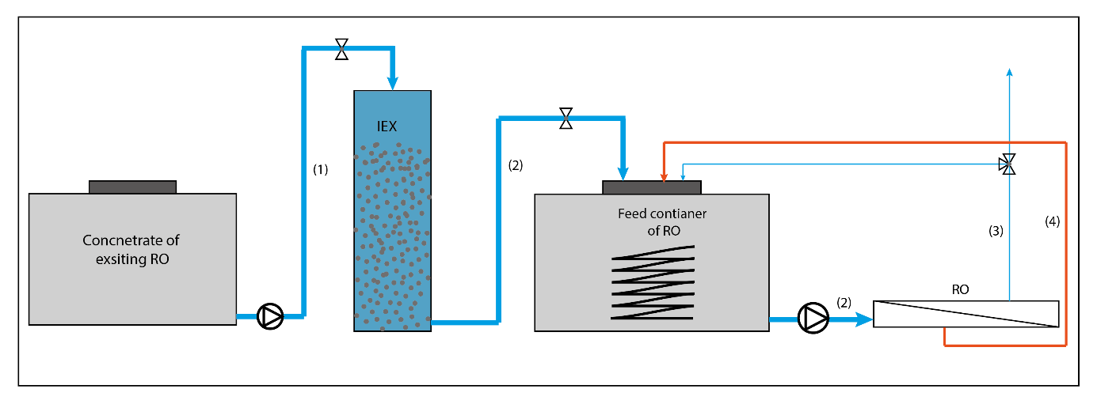
Setup
Our feed water: SiO2 = 45-65 mg/L
When removing the positively charged cation is 120 mg/L SiO2 valid?
Soften the water → Can 120mg/L be exceeded
The ZERO BRINE project (www.zerobrine.eu) has received funding from the European Union’s Horizon 2020
research and innovation programme under grant agreement No 730390.
Notes:
In our case, all kinds of ions were present. Now, the silica concentration was around 60-65mg/L. We though with our self, what happens if we remove other ions or a part of them an increase the silica in concentrate? Does silica scaling happens? And that is what I going to share with you in the remaining of this presentation.
In our case, all kinds of ions were present. Now, the silica concentration was around 60-65mg/L. We though with ourselves, what happens if we remove other ions or a part of them an increase the silica in concentrate? Does silica scaling still happen at 120mg/L or a higher silica concentration is possible? And that is what I going to share with you in the remaining of this presentation.
To find the answer, we thought removing of other difficult ions, thus Ca and Mg, or to soften the water which is also a very typical process in water treatment.
The step-up is straight forward. The water extracted form the concentrate of an existing O, passes through an IEX column to remove ions such as Ca, Mg, Iron, Mn, etc. the softer water serves the feed of the RO in our experiment.
The feed temperature of RO kept constant using a cool spiral. The concentrate recirculated back al the time to the feed water tanks of RO. For permeate, there was two option or discharge into drain or also recirculated back to the feed water tank of RO.
58

Slide 59
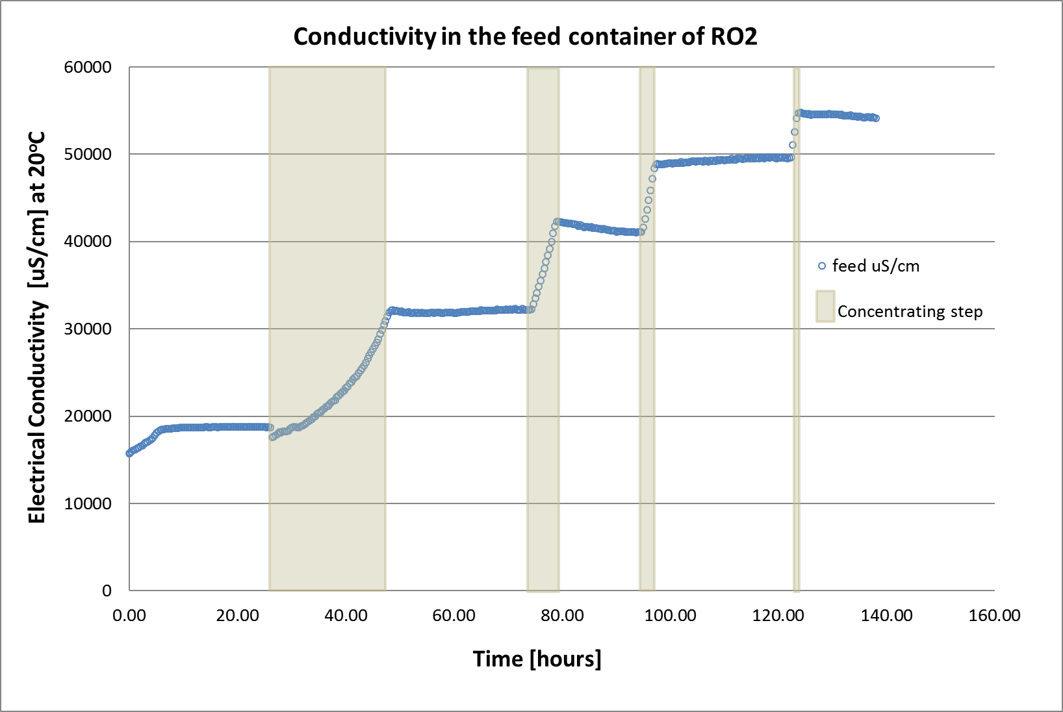
Method
During the recirculation of permeate the mass transfer coefficient of the membrane is measured
During discharge of the permeate, the concentration factor is increased
The experiment is repeated three times to ensure the results
The ZERO BRINE project (www.zerobrine.eu) has received funding from the European Union’s Horizon 2020
research and innovation programme under grant agreement No 730390.
Notes:
Now, why discharging or recirculating the permeate.
During the recirculation of permeate the mass transfer coefficient of the membrane was measured. MTC give an indication about the membrane scaling.
During discharge of the permeate, the concentration factor was increased
59

Slide 60
Method (Experiments)
The difference between three experiments was due to concentration difference between calcium and magnesium.
Parameter | Ex 01 | Ex 02 | Ex 03
Ca²⁺ | 0.43 | 7 | 50
Mg²⁺ | 0.16 | 29 | 74
The ZERO BRINE project (www.zerobrine.eu) has received funding from the European Union’s Horizon 2020
research and innovation programme under grant agreement No 730390.
Notes:
For implementation of the experiments, we made use of natural breakthrough of the IEX resins.
In the tables the initial value of Calcium and magnesium are shown for each experiment.
60

Slide 61
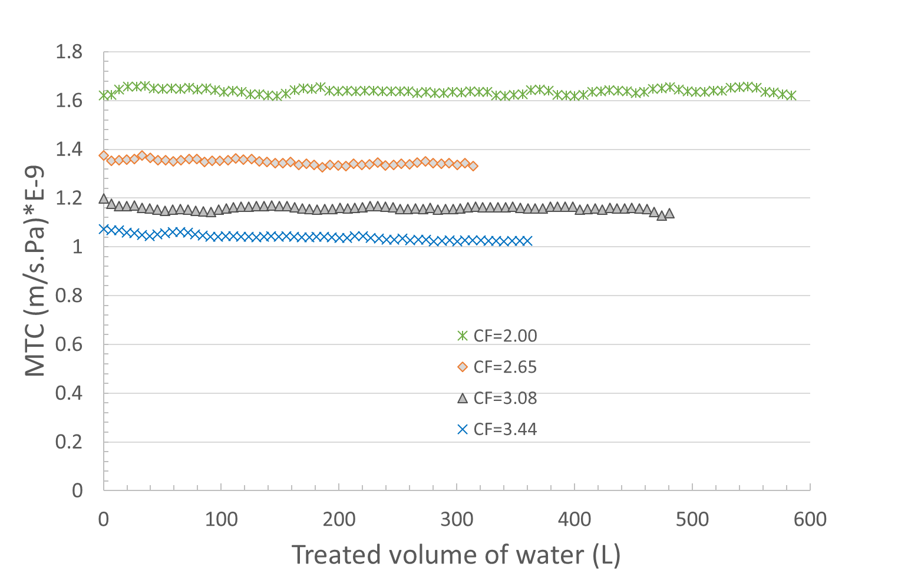
Results (Experiment 02)
The results from all three experiment were the same up to concentration factor of 3.00
The ZERO BRINE project (www.zerobrine.eu) has received funding from the European Union’s Horizon 2020
research and innovation programme under grant agreement No 730390.
Notes:
That is a graph which shows if the membrane undergone an scaling or not.
What you see on the graph MTC on the x-axis and circulated amount of water on the x-axis. The shown volume represents 8-12 hours of water reciurculation.
The concentration factor is calculated based on the electrical conductivity in the feed water.
As the results show the MTC remains stable within 8 hours from starting of the experiment . This was particularly the case by lower concentration factors, thus below 3.0.
By concentration factor 3.5, there was a slight decrease in MTC, in experiment 01 and experiment 02. as an example I showed only the results from experiment 02.
In experiment 3, thus the one with the highest calcium and magnesium concentration, No MTC decrease was observed by concentration factor of 3 or smaller
However, at a higher concentration factor there was a rapid decrease of MTC
61

Slide 62
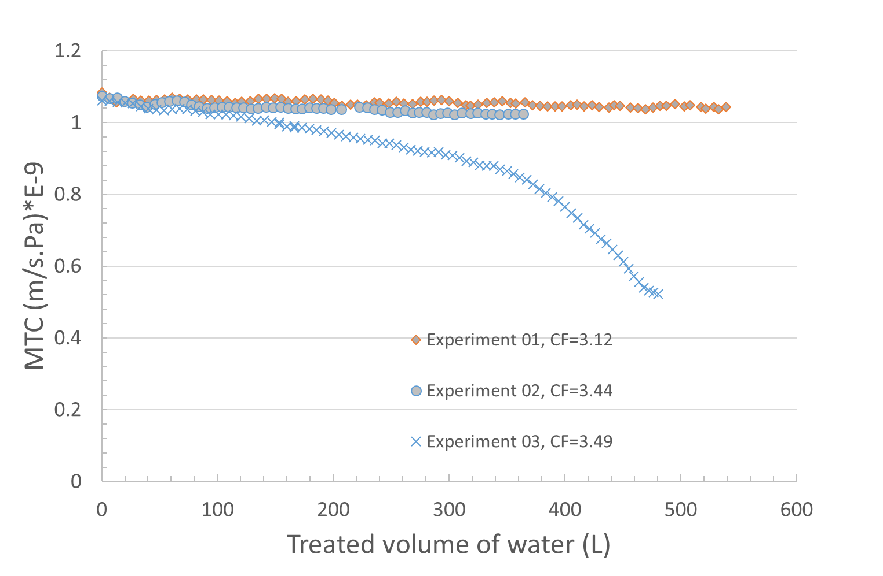
Results (highest concentration factor)
Increase of Ca and Mg results in decrease of Mass Transfer Coefficient
The ZERO BRINE project (www.zerobrine.eu) has received funding from the European Union’s Horizon 2020
research and innovation programme under grant agreement No 730390.
Notes:
That is how does it look like.
In this graphs we compared the three experiment at a concentration factor around 3,5.
In all three experiments there is a decrease in MTC, however the highest is when the concentration of Ca and Mg is higher.
So far, we showed only that the amount of water that passes through the membrane decrease, however, we didn’t know the exact reason. Is that really fouling that cased the MTC decrease?
62

Slide 63
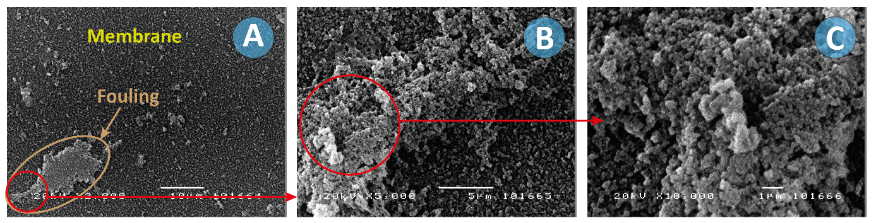
Results (fouling visualization)
Scaling under electron microscope
A = x2000, B = x5000 and C = x10000
The ZERO BRINE project (www.zerobrine.eu) has received funding from the European Union’s Horizon 2020
research and innovation programme under grant agreement No 730390.
Notes:
To find the answer we made an membrane autopsy. The with eyes look for places which was different than other places, took them out and observed them under the electron microscope.
This pictures show a suspected part of membrane at different magnitude. But how sure you can be that this is really fouling. And if that is fouling what type of fouling is this?
63

Slide 64
Results: Destruction
Chemical element | Symbol | Amount [µg/cm²]
 |  | Clean Coupon | Fouled Coupon
iron | Fe | 0.41 | 0.73
Silicon (Silica) | Si | 28 (60) | 100 (214.29)
Calcium | Ca | 1.7 | 0.061
Magnesium | Mg | 0.09 | 0.12
The ZERO BRINE project (www.zerobrine.eu) has received funding from the European Union’s Horizon 2020
research and innovation programme under grant agreement No 730390.
Notes:
To find the answer we destruct a part of membrane and determine the consisting elements.
We used a clean membrane a cut of a 5x5cm part and also a 5x5cm part from the used membrane. The membrane is destructed in HF solution and elemental part are measured using ICPMS.
The most interesting elements are shown in this table.
An obvious increase in silica concentration, iron and magnesium shows that most probably these materials are precipitating on the membrane.
The calcium concentration is strange. In the foulded coupon the calcium concentration becomes lower. We couldn’t find out why. But if any of you have any idea please let us also know.
64

Slide 65
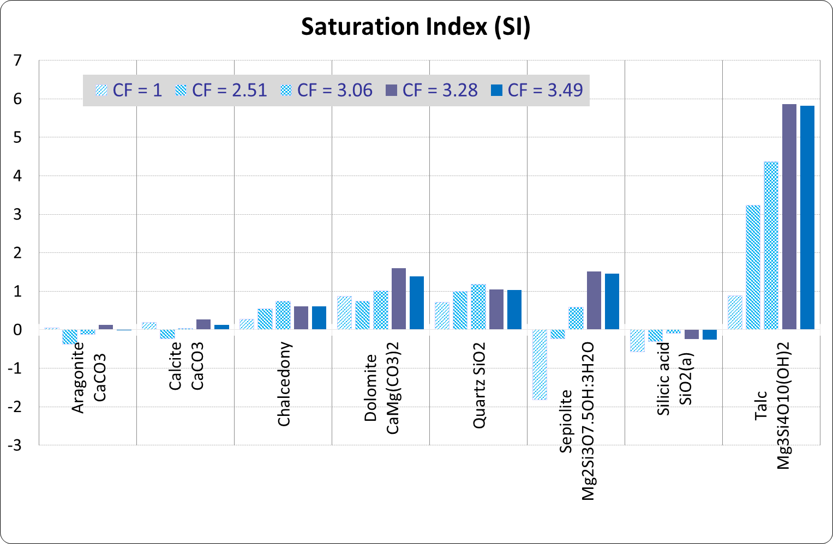
Results (PhreeqC)
The ZERO BRINE project (www.zerobrine.eu) has received funding from the European Union’s Horizon 2020
research and innovation programme under grant agreement No 730390.
Notes:
The last thing we done was to model the experiment no 03 in PhreeqC to investigate if the destruction experiment is correct or not. So the ion concentration from the solution by the last experiment where filled in PhreeqC and satuation idexes are calculated.
This graph shows the achieved saturation indexes. There are three classes that could bedistingusished.
substances that have only silica molecules in their chemical formulations such as chalcedony, quartz and silicic acid (SiO₂(a)). The SI value of this group increases by increasing the CF up to CF = 3.28 and then decreases by further increase, which indicates that they are used up somewhere.
Substances with magnesium and silica in their chemical formulation such as sepiolite and talc. The SI values of this group show a fast increase with the increase of the CF. In the last concentration step the SI does not further increase indicating the start of scaling.
It is observed that Talc has a very high supersaturation, but the SI increases with each concentration step. Only the last concentration step shows a constant SI indicating that the ions for this salt are no longer accumulating and scaling occurs. This agrees with the MTC-decrease at highest concentration of experiment 03.
Also, the SI of seplolite is not further increasing at the last concentration step. So also, this silica component will be scaling in this experiment.
Apparently, no calcium-silica precipitates were formed during the experiment. Additionally, dolomite which is composed of the calcium, magnesium and carbonate is a possible scaling component.
65

Slide 66
Conclusions
In absence of divalent hardening ions, the brine of RO can be thickened to 3.5 times its initial value
In the absence of divalent cations, silica scaling happens a concentration higher than 120 mg/L.
In higher concentration of divalent ions, mostly silica-magnesium polymers are oversaturated
The ZERO BRINE project (www.zerobrine.eu) has received funding from the European Union’s Horizon 2020
research and innovation programme under grant agreement No 730390.
Notes:
The main aim of this study was to determine the effects of calcium and magnesium in silica scaling of reverse osmosis (RO). Magnesium plays an important role in silica scaling. In fact, in the absence of any antiscalant, no membrane mass transfer (MTC) decrease was observed up to a silica concentration of 280 mg SiO₂/L at low concentration of calcium and magnesium, indicating no membrane fouling. This is of course only valid for the timeframe of this experiment (8 hours).
Increasing calcium and magnesium concentration resulted in decline of mass transfer coefficient (MTC) in the membrane.
Analysing different membrane coupons obtained from the membrane with decreased MTC showed a high concentration of silica on some parts of the membrane and calcium on other parts. Simulation with PHREEQC software and results from membrane destruction showed that the potential of formation of magnesium-silica precipitates is much greater than calcium-silica precipitates at the given conditions. The conclusion is that for the conditions such as those of this study especially magnesium ions enhance the silica scaling probably by formation of talc and/or sepiolite. It is probably helpful to use the closed-circuit reverse osmosis (CCRO) techniques instead of continues RO to reduce the concentrate volume from BWRO without having silica scaling. This could be topic for our next study.
66

Slide 67
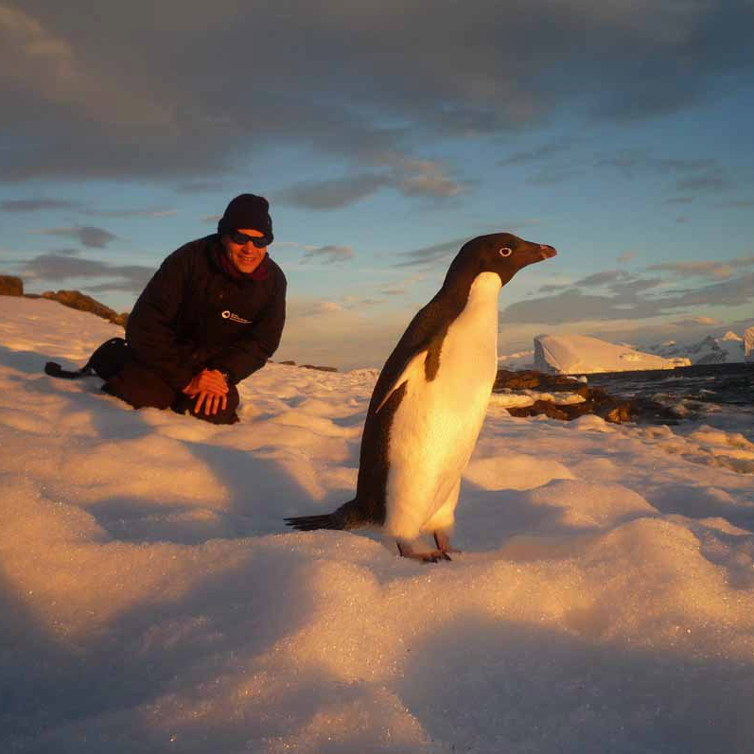
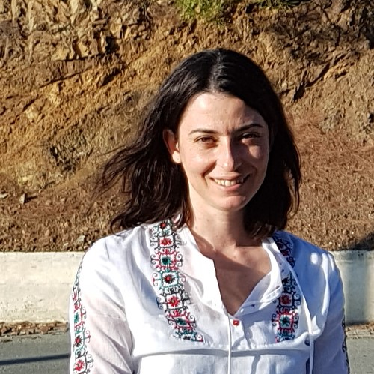
Frithjof Kuepper
Professor
University of Aberdeen
Dr. Frithjof Küpper is a Professor (Chair in Marine Biodiversity) at University of Aberdeen since 2011. He has served as Head of the Culture Collection of Algae and Protozoa (CCAP) at the Scottish Association for Marine Science in addition to other postdoc and research positions in the US and Germany. He has 109 ISI-listed, peer-reviewed papers including publications in Nature and PNAS, 5 book chapters, and a long track record in algal halogen research.
Eleni Avramidi
Environmental Engineer & PhD candidate
University of Aberdeen
ZERO BRINE SPECIAL ISSUE – PART II – Frithjof Kuepper

Slide 68
Benthic biodiversity and environmental gradients of the Port of Rotterdam:
A unique estuarine system with strong human impact
Frithjof Kuepper, Professor (Chair in Marine Biodiversity), School of Biological Sciences, University of Aberdeen
Eleni Avramidi, Honorary Research Assistant and PhD candidate, School of Biological Sciences, University of Aberdeen

Slide 69
Objectives
Assess the ecological quality status of the Port of Rotterdam and in particular of Evides DWP Botlek in the Brittaniëhaven area and Evides DWP Maasvlakte in Hartelkanaal area due to brine discharge-related activities.
FOCUS ON
Benthic macroinvertebrates
SUPPLEMENT
Physical and chemical characteristics of seabed and aquatic environment
&
Ideal bioindicators due to their sensitivity to water quality and inability to escape a disturbance once settled
Biological quality element in Water Framework Directive 2000/60/EC (WFD) and Marine Strategy Framework Directive 2008/56/EC (MSFD) for the assessment of the ecological quality status of a water body.
The ZERO BRINE project (www.zerobrine.eu) has received funding from the European Union’s Horizon 2020
research and innovation programme under grant agreement No 730390.
5 November 2021
Notes:
This study focuses on the impacts of brine on benthic macroinvertebrates as:
they are ideal bioindicators due to their sensitivity to water quality and inability to escape a disturbance once settled (Clark et al., 2018).
constitute a biological quality element in the European umbrella regulations for water systems, namely the Water Framework Directive 2000/60/EC (WFD) and the Marine Strategy Framework Directive 2008/56/EC (MSFD) for the assessment of the ecological quality status of a water body.
Physical and chemical parameters of the aquatic environment and seabed as well as macroalgal species were also studied as they are considered important for the thorough assessment of the aquatic environmental quality.
69

Slide 70
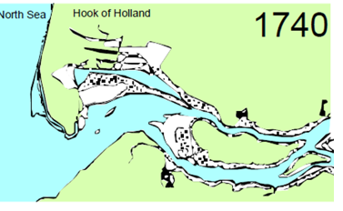
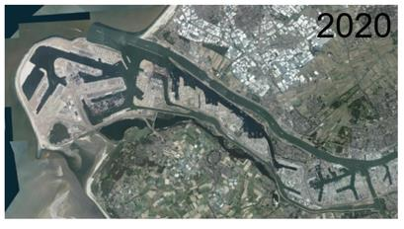
Port of Rotterdam – Manmade estuarine environment
1960-1970
Τhe pollution of the Port of Rotterdam was severely degrading the ecosystem, reducing biodiversity to a low number of pollution-tolerant species (Wolff, 1978).
1978
Rhine Action Programme (RAP) introduced by the International Commission for the Protection of the Rhine (ICPR) in 1987, a year after the Sandoz chemical accident (ICPR. International 2021).
2000
European Parliament and the European Council adopted the WFD with the purpose to establish a framework for the protection of European waters. For artificial water bodies, like the Port of Rotterdam, the WFD stipulates that Member States shall protect and achieve good ecological potential and good chemical status by 2015, with extensions to 2021 and 2027, respectively.
During more recent years, the pollution status of the Rhine and of many of its tributaries has distinctly improved
The ZERO BRINE project (www.zerobrine.eu) has received funding from the European Union’s Horizon 2020
research and innovation programme under grant agreement No 730390.
Notes:
Between 1960 and 1970 the pollution of the Port of Rotterdam was severely degrading the ecosystem, reducing biodiversity to a low number of pollution-tolerant species (Wolff, 1978).
During more recent years, the pollution status of the Rhine and of many of its tributaries was distinctly improved due to the implementation of the Rhine Action Programme (RAP) introduced by the International Commission for the Protection of the Rhine (ICPR) in 1987, a year after the Sandoz chemical accident (ICPR. International 2021).
Also, the European Parliament and the European Council adopted the WFD with the purpose to establish a framework for the protection of European waters. For artificial water bodies, like the Port of Rotterdam, the WFD stipulates that Member States shall protect and achieve good ecological potential and good chemical status by 2015, with extensions to 2021 and 2027, respectively.
70

Slide 71
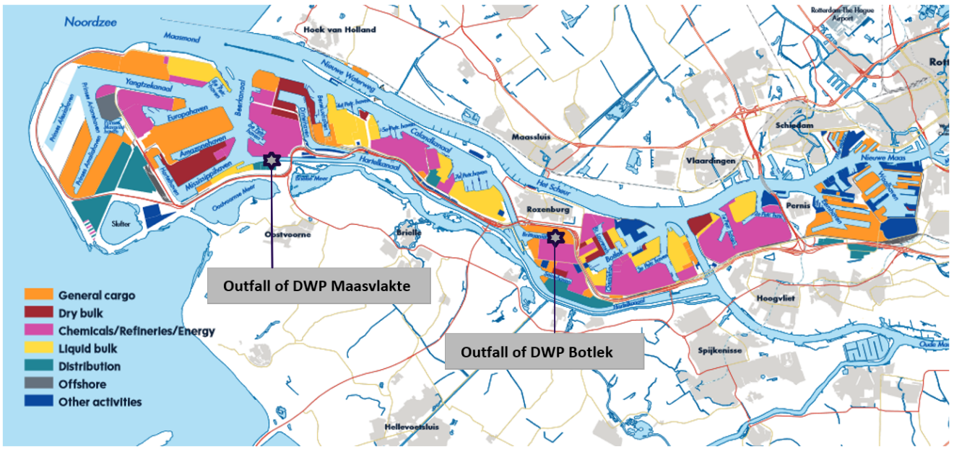
Port of Rotterdam – Manmade estuarine environment
Highly industrialized
Europe’s largest seaport in 2015
29,491 seagoing vessels & 85,969 inland vessels in 2019
Distribution of activities in the Port of Rotterdam (Source: P.o.R Authority, 2019)
The ZERO BRINE project (www.zerobrine.eu) has received funding from the European Union’s Horizon 2020
research and innovation programme under grant agreement No 730390.
Notes:
The Port of Rotterdam is highly industrialized. The total area of the Port of Rotterdam is 12,713 ha of which the land area is 7,903 ha and the water area is 4,810 ha. In 2019, the Port of Rotterdam was Europe’s largest seaport. Shipping in the Port of Rotterdam is intensive. 29,491 seagoing vessels and 85,969 inland vessels visited the port of Rotterdam in 2019 (P.o.R. Authority, 2019).
71

Slide 72
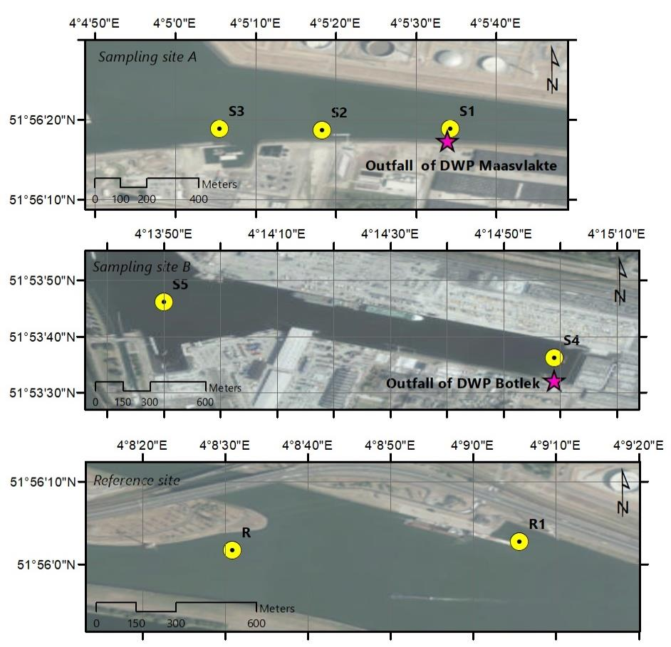
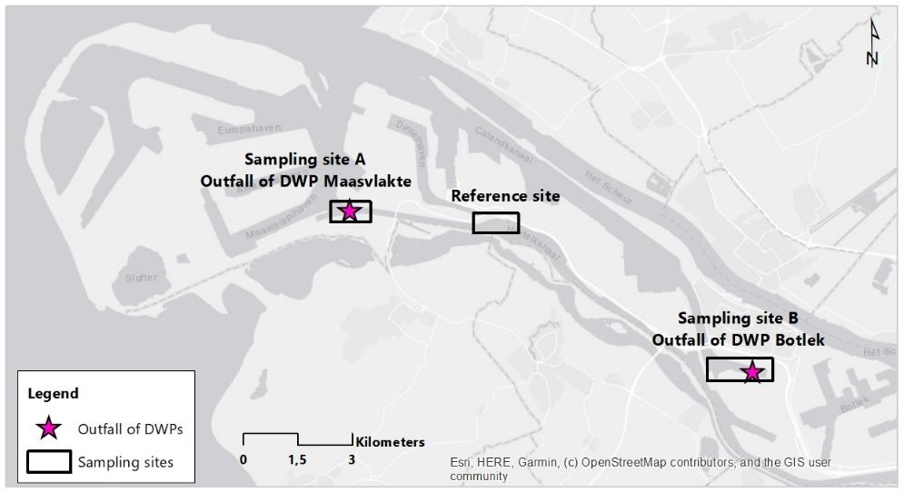
Methods - Sampling stations
3 sites and 6 stations were selected and established for the survey.
September 2019
1st sampling survey
January 2020
2nd sampling survey
April 2021
3rd sampling survey
September 2021
4th sampling survey
Service layer credits: Source: ESRI, DigitalGlobe, GeoEye, Earthstar Geographics, CNES/Airbus DS, USDA, USGS, AeroGRID, IGN, and the GIS User Community.
The ZERO BRINE project (www.zerobrine.eu) has received funding from the European Union’s Horizon 2020
research and innovation programme under grant agreement No 730390.
Notes:
3 sites were sampled :
Sampling site A in the vicinity of DWP Maasvlakte in the Hartelkanaal area.
Sampling site B: one in the vicinity of the DWP Botlek in the Brittaniëhaven area.
Reference site: one in the Elbeweg area of Hartelkanaal that was designated as Reference site.
72

Slide 73
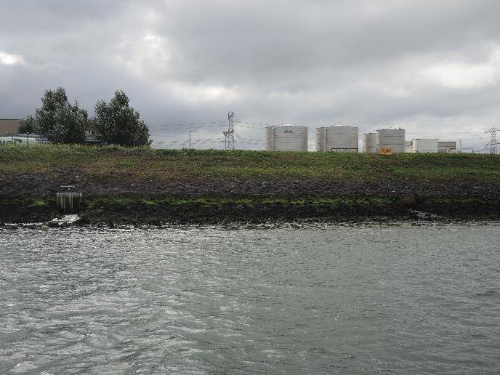
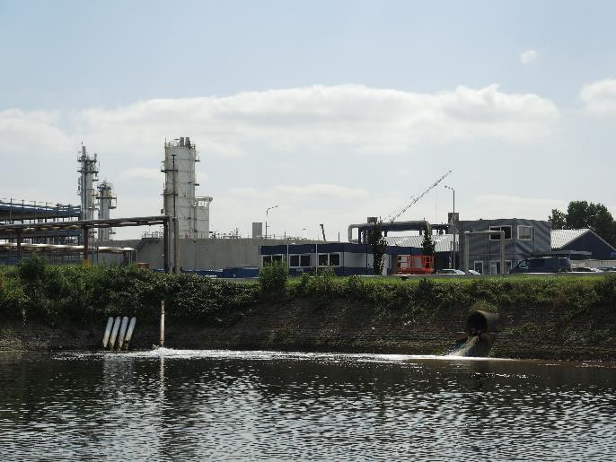
Methods - Characteristics of
sampling sites
Sampling site A Hartelkanaal
DWP Maasvlakte
Inherently variable salinities,
Sampling site B Brittaniehaven
DWP Botlek
Dead-end waterway, poorly flushed environment,
Reference site
Has been selected following the advice of the Port of Rotterdam Authority as the less polluted site in the port,
Receives also effluent form Huntsman WWTP and Wilmar oil refinery processing vegetable oils,
Seabed mainly silt,
Depth around 10 meters.
Has no river input and is entirely marine,
Well flushed environment,
Seabed consists of Crassostrea gigas reef,
Depth around 6-8 meters depending on the tide conditions.
Naturally changing salinities,
Seabed mainly sandy, depth around 9-13 m.
The ZERO BRINE project (www.zerobrine.eu) has received funding from the European Union’s Horizon 2020
research and innovation programme under grant agreement No 730390.
5 November 2021
73
5 November 2021
73
Notes:
Sampling site A (Hartelkanaal): inherently variable salinities due to being located on a waterway directly connected with the open North Sea, well flushed environment, seabed consists of Crassostrea gigas reef, depth around 6-8 meters depending on tide conditions.
Sampling site B (Brittaniëhaven): dead-end waterway, i.e. it has no river input and it is entirely marine, poorly flushed environment, receives also effluents from Huntsman WWTP and Wilmar which is an oil refinery processing vegetable oils, seabed consists mainly of silt and the depth reaches 10 meters.
The Reference site has been selected following the advice of the Port of Rotterdam Authority as a less-polluted site in the port.
73

Slide 74
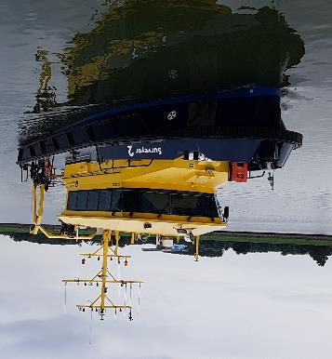
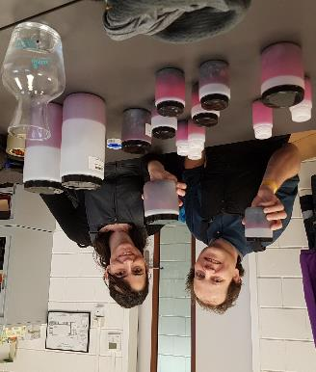
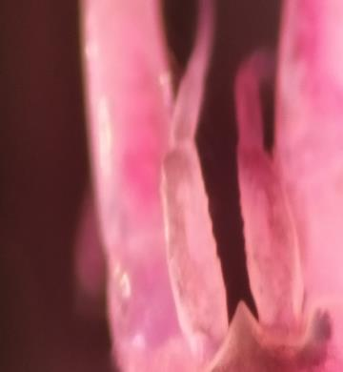
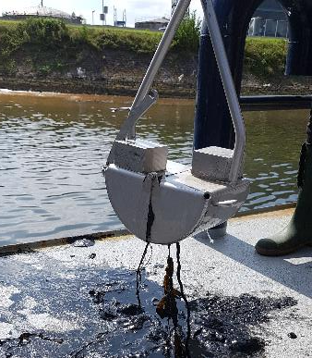
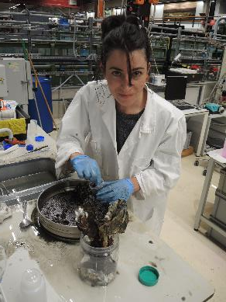

Methods – Field sampling and laboratory analysis – Benthic macroinvertebrates
Collection of sediment using a Van Veen grab.
3 replicates at each station of 4lt sediment
Sediment samples were sieved through a 0.5 mm mesh, stained with Rose Bengal and preserved in ethanol.
In the laboratory, macrobenthic invertebrates were sorted, identified to the lowest taxonomic level possible, and counted.
The ZERO BRINE project (www.zerobrine.eu) has received funding from the European Union’s Horizon 2020
research and innovation programme under grant agreement No 730390.

Slide 75


Methods – Field sampling and laboratory analysis – Water and sediment
Water samples
Collected from 3 stations out of 6 (S1, S4, and R).
Collected from a depth of 1.5 m from the water surface.
Sediment samples
Collected from 3 stations out of 6 (S3, S4, and R).
Granulometric analysis, TOC, Kjeldahl nitrogen, a suite of heavy metals and 16 PAHs content.
Analysed for Ph, EC, TSS, nutrients, a suite of heavy metals, and 16 PAHs.
Collected with a Van Veen grab.
The ZERO BRINE project (www.zerobrine.eu) has received funding from the European Union’s Horizon 2020
research and innovation programme under grant agreement No 730390.
Notes:
Water samples from S1, S4, and R were analysed for Ph, EC, TSS, nutrients, a suite of heavy metals, and 16 PAHs. Water samples were collected from a depth of 1.5 m from the water surface and were stored in appropriate bottles and analyzed in the laboratories of SYNLAB Analytics & Services B.V. (Steenhouwerstraat 15, 3194 AG Rotterdam, Netherlands) and C-MARK B.V (Munsterstraat 9, 7418 EV Deventer, Netherlands).
Sediment was also sampled as it is a major sink for contaminants such as trace metals that are not biodegradable and can accumulate over time and sediments may reach a level toxic to aquatic life. Specifically, samples from S3, S4, and R were analysed for granulometric analysis, TOC, Kjeldahl nitrogen, a suite of heavy metals and 16 PAHs content. Sediment samples were collected with a Van Veen grab and stored in appropriate bottles and analysed by the laboratory Eurofins (Barneveld, Netherlands).
75

Slide 76

Methods- Existing monitoring data from Rijkswaterstaat and HELCOM
Existing monitoring data
HELCOM Biodiversity database 2004-2020
Benthic invertebrates, phytoplankton, macrophytes, fish and lamprey, and bacteria.
Rijkswaterstaat 2003-2019
Phytoplankton, diatomeae and macrozoobenthos, water physical and chemical parameters.
The ZERO BRINE project (www.zerobrine.eu) has received funding from the European Union’s Horizon 2020
research and innovation programme under grant agreement No 730390.
Notes:
Data on benthic invertebrates, phytoplankton, macrophytes, fish and lamprey, and bacteria in the Port of Rotterdam are reported to the HELCOM Biodiversity database (2004-2020 – one measurement of 1982 is also included) and were taken into consideration for the evaluation of the results of this study. Similarly, Rijkswaterstaat monitors phytoplankton, diatomeae and macrozoobenthos in the Port of Rotterdam and the results from 2003 to 2019 were also considered. Some of the monitoring stations coincide with the sampling site B. Apart from the biological indicators, Rijkswaterstaat monitors periodically the physical and chemical parameters in the Port of Rotterdam through a dense monitoring network with long timeseries. None of these monitoring stations coincide with the study sites.
76

Slide 77


Results – Brine characteristics
DWP effluents (2 streams)
IEX effluent
high salinity and density, ambient seawater temperature, low nutrient content, elevated levels of chloride (Cl), TDS, bicarbonate (HCO⁻₃), sulphate (SO³⁻₄) elevated levels of chromium (Cr), aluminum (Al), copper (Cu), zinc (Zn), barium (Ba) and lead (Pb).
RO effluent
high salinity and density, ambient seawater temperature, low nutrient content, elevated levels of chloride (Cl), TDS, bicarbonate (HCO⁻₃), sulphate (SO³⁻₄), elevated levels of lithium (Li) and boron (B).
The ZERO BRINE project (www.zerobrine.eu) has received funding from the European Union’s Horizon 2020
research and innovation programme under grant agreement No 730390.
Notes:
In both DWPs, the purification process combines ion exchange technology (IEX) and membrane technology (RO). Two effluent streams are generated.
The IEX and RO effluent is characterized by its high salinity and density (negatively buoyant), ambient seawater temperature, low nutrient content, and elevated levels of chloride (Cl), TDS, bicarbonate (HCO3), sulphate (SO4). RO effluent also contains high organic content.
As for heavy metal concentrations, the IEX effluent contains elevated levels of chromium (Cr), aluminum (Al), copper (Cu), zinc (Zn), barium (Ba) and lead (Pb).
The RO effluent contains elevated levels of lithium (Li) and boron (B).
77

Slide 78
Results – Existing monitoring data from Rijkswaterstaat – Ecological and chemical status reported in RMBP 2015
Port of Rotterdam (SWB NL 94_9),
Info from the River Basin Management Plan of Rhine, 2015
Ecological potential
MODERATE
Chemical status
NOT GOOD
Phytoplankton, phytobenthos / macrophytes and macrozoobenthos
GOOD
Fish fauna
Moderate
The most significant pressure is due to introduced species and diseases (invasive alien species).
The most significant impact is elevated temperature.
“Good” ecological potential and “good” chemical status will not be achieved in 2021 but it is expected to be achieved beyond 2027.
The ZERO BRINE project (www.zerobrine.eu) has received funding from the European Union’s Horizon 2020
research and innovation programme under grant agreement No 730390.
Notes:
According to the WISE-WFD database for the River Basin Management Plan (RBMP) 2015 (WISE-WFD, 2015), the ecological potential of the Surface Water Body (SWB NL94_9) was characterized as “moderate” and the chemical status as “not good”.
Regarding the biological quality elements, phytoplankton, phytobenthos / macrophytes and macrozoobenthos were characterized as “good” ecological potential and the fish fauna with “moderate” ecological potential.
In WISE-WFD 2015 database, it was stated that the goal of WFD for “good” ecological potential and “good” chemical status will not be achieved in 2021 but it is expected to be achieved beyond 2027.
It was also stated that the most significant pressure is the introduced species and diseases (invasive alien species), and the most significant impact is the elevated temperature.
78

Slide 79







Results – Existing monitoring data from Rijkswaterstaat – Water quality (2010-2019)
Timeseries of concentrations of metals and P_{T}, N_{T} (2010-2019, monitoring stations BEERKNMDN, MAASSS) that have exceeded the Maximum Permissible Concentration (MPC) set in the Staatcourant, The Netherlands, June 2000.
The ZERO BRINE project (www.zerobrine.eu) has received funding from the European Union’s Horizon 2020
research and innovation programme under grant agreement No 730390.
Notes:
With regards to the PAHs and heavy metals measurements of BEERKNMDN and MAASSS monitoring stations for the time period 2010-2019 (Rijkswaterstaat, 2021) and compared to the Maximum Permissible concentration (MPC) and Target values set in the Staatcourant, The Netherlands, June 2000, it can be concluded that most of the PAHs and heavy metals are below the MPC however in some cases above the Target Value.
Copper (Cu), Zinc (Zn), Beryllium (Be) are above MPC as well as the most measurements of Nickel (Ni), Thallium (Ti). A slight improvement was observed in the last five years regarding the concentrations of metals exceeded the MPC.
P_{T} and N_{T} measurements exceed in some cases the MPC set in the Staatcourant, The Netherlands, June 2000. Improvement of the quality of the surface water in terms of P_{T} has been observed over the last five years but the situation for the concentrations of N_{T} is stable.
79

Slide 80
Results – Existing monitoring data from Rijkswaterstaat & HELCOM database – Benthic macroinvertebrates (2003-2016 & 2014)
Port of Rotterdam (SWB NL 94_9)
Benthic macroinvertebrates
Rijkswaterstaat period 2003 – 2016
208 species and 77968 individuals have been recorded.
HELCOM database for the year 2014
82 species and 935 individuals have been recorded.
Several non-native species with significant number of individuals have been recorded in the Port of Rotterdam.
Non-native species may have been introduced by shipping and ballast waters and lead to competition with native biota such as in the case of the native Mytilus edulis that has been put under competitive pressure by the invasive Pacific oyster, Crassostrea (Magallana) gigas.
The ZERO BRINE project (www.zerobrine.eu) has received funding from the European Union’s Horizon 2020
research and innovation programme under grant agreement No 730390.

Slide 81



Results – Benthic macroinvertebrates communities – Number of species and individuals
In total, 1761 individuals were identified belonging to 89 species.
14 species are non-native with 1573 individuals counted.
Most individuals in Hartelkanaal (DWP Maasvlakte):
- Non-native Balanidae Amphibalanus (small sessile crustacean),
- Native Capitella capitata (Class Polychaeta).
Large abundance of the non-native crustacean Crassostrea gigas at Site 1, just under one of the outfalls – FULL SCALE REEF
Most individuals in Brittaniehaven (DWP Botlek):
- Native Capitella capitata (Class Polychaeta)
- Native Streblospio cf shrubsolii (Class Polychaeta)
- Non-native Theora lubrica (Class Bivalvia)
Capitella capitata,
WoRMS Photogallery
Crassostrea gigas,
Photo credits: Eleni Avramidi
Amphibalanus (Balanidae)
WoRMS Photogallery
The ZERO BRINE project (www.zerobrine.eu) has received funding from the European Union’s Horizon 2020
research and innovation programme under grant agreement No 730390.

Slide 82
Results – Benthic macroinvertebrates communities – Species richness, abundance and diversity
The values of species richness and abundance of macrofauna are relatively low, with significant variations between stations and sites.
Overall, the highest species richness and abundance was recorded at stations in Hartelkanaal and was mostly related with sessile animals from hard substrate. In the replicates with the highest numbers, more than half of the individuals belonged to the Family Balanidae (barnacles) or other hard substrate bivalves (mussels), which probably grew on the Crassostrea gigas reef or fall off the ships.
Diversity values are noticeably low, always below 2 and closer to 1 in many occasions, yet due to the lack of dominance of few species and the overall disturbance status.
The ZERO BRINE project (www.zerobrine.eu) has received funding from the European Union’s Horizon 2020
research and innovation programme under grant agreement No 730390.

Slide 83
Results – Benthic macroinvertebrates communities
– Biotic index AMBI
Fig. AMBI index for the sampled stations in the three surveys. The classification of ecological status for the sampling points according to the AMBI index is indicated on the right side.
Fig. Contribution of the AMBI distinct ecological groups for the stations sampled on each sampling occasion. The contribution of groups IV and V, more tolerant to perturbations, only dominate in a few samples mainly of 4 and 5 sites. na: no samples available.
The results in the majority of the cases showed a slightly disturbed system and stations 4 and 5 were characterised on occasions as moderately or heavily disturbed.
The ZERO BRINE project (www.zerobrine.eu) has received funding from the European Union’s Horizon 2020
research and innovation programme under grant agreement No 730390.

Slide 84
Results – Water and sediment quality analysis
Heavy metals in sediment samples
Higher at Brittaniehaven (S4) in comparison to Hartelkanaal (S1 and R)
Result of atmospheric deposition of air emissions from industrial processes and discharge of metal containing effluent without adequate treatment.
Correlates with the presence of tolerant benthic macroinvertebrates species in this area.
TOC and Kjedahl nitrogen values in sediment samples
Higher at Brittaniehaven (S4) in comparison to Hartelkanaal (S1 and R)
Result of the decomposition of biomass of plant, animal or planktonic origin and / or anthropogenic sources.
Correlates with the reduced species richness to this station as an overabundance of organic matter.
The ZERO BRINE project (www.zerobrine.eu) has received funding from the European Union’s Horizon 2020
research and innovation programme under grant agreement No 730390.
Notes:
TOC and Kjedahl nitrogen values in sediment samples are higher at Brittaniehaven (S4) in comparison to Hartelkanaal (S1 and R). This could be a result of the decomposition of biomass of plant, animal or planktonic origin and / or anthropogenic sources. This can also be correlated with the reduced species richness to this station in comparison to the others as an overabundance of organic matter can lead to this due to due to oxygen depletion and buildup of toxic by-products (ammonia and sulphide) associated with the break-down of these materials (Pearson & Rosenberg 1978, Diaz & Rosenberg 1995, Gray et al. 2002).
Brittaniehaven (S4) sediment has considerably higher concentrations of metals in comparison to S3 and R which is related to the environment which is much more influenced by anthropogenetic activities. This can be correlated to the presence of tolerant benthic macroinvertebrates species in this area. Heavy metal contamination can be associated with atmospheric deposition of air emissions from industrial processes and combustion plants of fossil fuels and discharge of metal containing effluent without adequate treatment.
84

Slide 85
Conclusions
This study has established a baseline understanding of the environmental conditions in the vicinity of DWPs Botlek and Maasvlakte.
Provides essential background information for the assessment of environmental benefits from the implementation of large scale zero brine technology in the future.
A remarkable diversity of taxa has been observed, enabling a detailed characterization of biological communities, which constitutes a significant asset considering how little published literature exists about the unique system of the Port of Rotterdam.
The ZERO BRINE project (www.zerobrine.eu) has received funding from the European Union’s Horizon 2020
research and innovation programme under grant agreement No 730390.
Notes:
85

Slide 86
Conclusions
Similar macrobenthic composition, although with a lower abundance and diversity in comparison with nearby environments of the North Sea
The invasive species present and the negative biodindicators is comparable to what has been observed in similarly impacted areas previously.
Monitoring periodically the area to detect any potential impact of the desalination plant in the long term.
High distribution of the non-native Crassostrea gigas just under the outfalls of DWP Maasvlakte.
Study the reason behind the larger abundances of C. gigas at Site 1
The ZERO BRINE project (www.zerobrine.eu) has received funding from the European Union’s Horizon 2020
research and innovation programme under grant agreement No 730390.
Notes:
This study has established a baseline understanding of the environmental conditions in the vicinity of DWP Botlek and DWP Maasvlakte in the Port of Rotterdam and provides essential background information for the assessment of environmental benefits from the implementation of large scale zero brine technology in the future.
A remarkable diversity of taxa has been observed, enabling a detailed characterization of biological communities, which constitutes a significant asset considering how little published literature exists about the unique system of the Port of Rotterdam.
Even when we consider the invasive species present and the negative biodindicators (Spionidae and Capitellidae Families) in the area, the present data confirm that the community established in our study area is comparable to what has been observed in similarly impacted areas previously (Reise et al, 1994 among other studies). Therefore, it is necessary to continue monitoring periodically the area to detect any potential impact of the desalination plant in the long term.
It is necessary to study the reason behind the larger abundances of C. gigas at Site 1, just under one of the outfalls. Temperature measurements and other physico-chemical variables would help us understand its distribution in this area, since the temperatures recorded in the area are lower than the 20º C that C. gigas needs for the recruitment of its larvae (Wrange et al., 2010). More data on the current velocities, winds and turbulence in Site 1 would also help explaining the presence of C. gigas presence as they have shown to determine the conditions necessary for its initial establishment and growth to a full-scale reef (Markert et al. 2010; Kluijver & Leewis, 1994).
86

Slide 87
Acknowledgements
Dr. Sokratis Papaspyrou, Associate Professor at Universidad de Cádiz, for his valuable formal analysis of benthic invertebrate results.
Sergio Carlos Garcia Gomez, invertebrate zoologist and analyst of benthic macrofauna species.
Port of Rotterdam Authority for providing access to the Tender and Survey vessel 2, sharing necessary information and data, and providing support during the field work and especially during the survey of July 2020 performed amidst COVID-19 pandemic. Specifically, we would like to thank Chris Schot (Constructions & Dredging Asset Manager), Ed de Boom (Planner Baggerwerk), Robbert Wolf (Nature and environmental advisor), and the crew Peter Mourik, Edwin Smit, Leo de Jong, Daan Koornneef, and Ed Veth.
Rijkswaterstaat of the Dutch Ministry of Infrastructure and Water Management for providing monitoring data of the environmental quality in the Port of Rotterdam.
The ZERO BRINE project (www.zerobrine.eu) has received funding from the European Union’s Horizon 2020
research and innovation programme under grant agreement No 730390.

Slide 88

Thank you for your attention!
The ZERO BRINE project (www.zerobrine.eu) has received funding from the European Union’s Horizon 2020
research and innovation programme under grant agreement No 730390.

Slide 89

Marc Arpad Boncz
Associate Professor
UFMS (Brazil)
Dr. Marc Arpad Boncz is Associate professor at UFMS (Brazil) with degrees in Chemistry from VU Amsterdam and a PhD in Environmental Technology (WUR).
He works on projects on industrial and domestic wastewater treatment (anaerobic, microalgae) with a special interest in bioenergy and in water and resource conservation.
He worked a post-doc in 2017-2018 at TU Delft, contributing to Zero Brine project.
ZERO BRINE SPECIAL ISSUE – PART II – Marc Arpad Boncz

Slide 90
Physicochemical model for simulating the chemical processes during the crystallization of minerals from spent Ion Exchange Regenerant
Marc Arpad Boncz^{1,2}, Niels van Linden^{1,3}, Amir Haidari^{1,4}, Yundan Wang^{1,5} and Henri Spanjers¹
1 Delft University of Technology, Faculty of Civil Engineering and Geosciences, Stevinweg 1, 2628 CN, Delft, the Netherlands.
2 Federal University of Mato Grosso do Sul, Faculty of Architecture, Engineering, and Geography, Av. Costa e Silva S/N, 79070-900, Campo Grande-MS, Brazil.
3 Lenntech B.V., Distributieweg 3, 2645 EG, Delfgauw, the Netherlands.
4 Hatenboer, Mercuriusweg 8, 3113 AR, Schiedam, the Netherlands.
5 Arcadis Consultancy (Shanghai) Co. Ltd., 11th Floor, Building C, The Place, No.150 Zunyi Road, Changning District, 200051, Shanghai, PR China.
The ZERO BRINE project (www.zerobrine.eu) has received funding from the European Union’s Horizon 2020 research and innovation programme under grant agreement No 730390.
November 4, 2021
90

Slide 91

About the author...
Dr. Marc Arpad Boncz, associate professor, UFMS (Brazil) u
Chemist (VU Amsterdam), PhD in Environmental Technology (WUR)
  at UFMS since 2006, professor since 2013
  projects on industrial and domestic wastewater treatment (anaerobic, microalgae), special interest in bioenergy and in water and resource conservation
  post-doc in 2017-2018 at TUDelft, contributing to Zero Brine project
The ZERO BRINE project (www.zerobrine.eu) has received funding from the European Union’s Horizon 2020
research and innovation programme under grant agreement No 730390.
5 November 2021
91

Slide 92

About the Zero Brine project
Objectives:
  Closing water cycles and recovery of materials from waste streams
The ZERO BRINE project (www.zerobrine.eu) has received funding from the European Union’s Horizon 2020
research and innovation programme under grant agreement No 730390.
5 November 2021
92

Slide 93
About the project
Demineralised water plant in Rotterdam
  discharges (daily) significant volume of spent IEX regenerant
  main compound in regenerant is NaCl, significant amounts of Mg²⁺ and Ca²⁺
  hardly any other pollutants
  this should permit recovery of these ions
Technologies to be used:
  nanofiltration, to separate mono and multivalent ions
  sequential crystallisation
  evaporation

Slide 94

About the project
Process overview
processes:
A IEX ion exchange columns (existing)
B RO reverse osmosis units (existing)
C NF nanofiltration unit
D,E CU crystallisation units
F EV evaporator unit
flows:
04 spent IEX regenerant (brine)
06 NF permeate
07 NF concentrate
08 Mg-crystrallisation supernatant
10 Ca crystallisation supernatant
12 distilled water
13 NaCl concentrate
The ZERO BRINE project (www.zerobrine.eu) has received funding from the European Union’s Horizon 2020
research and innovation programme under grant agreement No 730390.
5 November 2021
94

Slide 95
Objectives of PHREEQC modelling project
Determine feasability of Mg²⁺ and Ca²⁺ recuperation
Quantify amount that can be recuperated
Quantify purity of product
Study effect of process and flows on results

Slide 96
Methodology
Analysis of spent IEX regenerant brine
  metals: ICP-MS
  anions: IC
  pH, temp, TSS
Modelling suggested process
  Excel: calculating starting situation and analysing simulation results
  PHREEQC: chemical equilibria and precipitation of minerals; 4 assumptions:
    neglect elements with concentration < 1 μg/L
    exclude Co and Mo (not included in PHREEQC’s Minteq database)
    for SO₄²⁻, PO₄³⁻: ICP-MS concentrations used rather than (lower) IC results
    assumed: initially no supersaturation

Slide 97

Methodology
Modeling approach

Slide 98
Results: spent IEX regenerant
Spent IEX regenerant composition
  main compound in regenerant is NaCl, significant amounts of Mg²⁺ and Ca²⁺
    98% of cations.
    Cl- is > 97% of anions
  hardly any other pollutants
    TSS as calculated even slightly higher than measured
The ZERO BRINE project (www.zerobrine.eu) has received funding from the European Union’s Horizon 2020
research and innovation programme under grant agreement No 730390.
5 November 2021
98

Slide 99

Results: nanofiltration
Some risk of scaling in NF unit
  but not a good idea to use antiscalants due to recycling
The ZERO BRINE project (www.zerobrine.eu) has received funding from the European Union’s Horizon 2020
research and innovation programme under grant agreement No 730390.
5 November 2021
99

Slide 100
Results: crystallisation
Salts to be precipitated
  candidates: hydroxides, carbonates or sulphates
  best: hydroxides
    dosing of OH⁻
    stoichiometrically
    1st: Mg(OH)₂
    2nd: Ca(OH)₂
The ZERO BRINE project (www.zerobrine.eu) has received funding from the European Union’s Horizon 2020
research and innovation programme under grant agreement No 730390.
5 November 2021
100

Slide 101


Results: crystallisation
Recovery of salts
Purity of recovered salts
The ZERO BRINE project (www.zerobrine.eu) has received funding from the European Union’s Horizon 2020
research and innovation programme under grant agreement No 730390.
5 November 2021
101

Slide 102

Results: evaporation
Without recycling crystallisation supernatant
  42% evaporated (distilled water)
  58% NaCl brine
    not suitable for IEX regeneration
Recycling crystallisation supernatant
  42 % evaporated (distilled water)
  58% NaCl brine
  slightly more polluted
    but with less Ca2+ and Mg2+
    possibility of scaling: mmol/L of barite (BaSO₄), brucite (Mg(OH)₂) and Calcite (CaCO₃)
The ZERO BRINE project (www.zerobrine.eu) has received funding from the European Union’s Horizon 2020
research and innovation programme under grant agreement No 730390.
5 November 2021
102

Slide 103
Conclusions
Recovery of Mg²⁺ and Ca²⁺ possible, but not complete
  purity of Mg reasonable (≈ 95%), of Ca good (≈ 99%)
Very strict control of hydroxide dosing is essential
Complete recycle of water not possible, as this may cause scaling in evaporator and affects IEX regeneration brine quality

Slide 104

Krzysztof Mitko
Assistant Professor
SUT
Dr. Mitko is an assistant professor at the Silesian University of Technology, Faculty of Chemistry. His research interests include electromembrane processes (electrodialysis, electrodeionization, membrane capacitive deionization); removal of metal ions from the waste waters; seawater, coal mine water and industrial wastewater desalination.
ZERO BRINE SPECIAL ISSUE – PART II – Krzysztof Mitko

Slide 105
Pilot studies on circular economy solution for the coal mining sector
Krzysztof Mitko, Marian Turek, Hanna Jaroszek, Ewa Bernacka, Mateusz Sambor, Paweł Skóra, Piotr Dydo
The ZERO BRINE project (www.zerobrine.eu) has received funding from the European Union’s Horizon 2020
research and innovation programme under grant agreement No 730390.

Slide 106
Polish case study
Coal mining generates vast amounts of saline waste water
The amount of discharged salt in Poland alone is ca. 4 million tons per year
The increase in river salinity damages the aquatic life, increases population water pressure and decreases the soil quality
The ZERO BRINE project (www.zerobrine.eu) has received funding from the European Union’s Horizon 2020
research and innovation programme under grant agreement No 730390.

Slide 107
Goals
To demonstrate the principles of circular economy in the coal mining industry
To demonstrate decreased energy consumption compared to reference technolog
The ZERO BRINE project (www.zerobrine.eu) has received funding from the European Union’s Horizon 2020
research and innovation programme under grant agreement No 730390.

Slide 108
Bolesław Śmiały coal mine water
Cl⁻ [mg/dm³] | 13500 | Mg²⁺ [mg/dm³] | 263 | NO₃⁻ [mg/dm³] | < 2.5 | Li [mg/dm³] | 0.4
Na⁺ [mg/dm³] | 8192 | Ca²⁺ [mg/dm³] | 248 | B [mg/dm³] | 2.32 | Er [mg/dm³] | 0.3
SO₄²⁻ [mg/dm³] | 810 | K⁺ [mg/dm³] | 120 | Sr [mg/dm³] | 1.58 | Mn [mg/dm³] | 0.1
HCO₃⁻ [mg/dm³] | 301 | NH₄⁺ [mg/dm³] | < 2.5 | Si [mg/dm³] | 1.39 | Zn [mg/dm³] | 0.1
The ZERO BRINE project (www.zerobrine.eu) has received funding from the European Union’s Horizon 2020
research and innovation programme under grant agreement No 730390.

Slide 109




Plant design
Pretreatment: 200 μm slot filter, 50 μm bag filter, 25 μm candle filter, carbon filter, 5 μm candle filter
Ultrafiltration: 8” UF module with membrane of MWCO90 < 0.03 μm
Decarbonization: weak ion-exchangers with degassing column
Two-pass nanofiltration, each NF pass consisted of two pressure vessels filled with two modules each (Trisep TS40 membranes)
Reverse osmosis
Two-stage electrodialysis: two PC-Cell 1000A electrodialyzers connected in a cascade, each containing 25 pairs of IONSEP K/A membranes separated with 0.35 mm spacers
The ZERO BRINE project (www.zerobrine.eu) has received funding from the European Union’s Horizon 2020
research and innovation programme under grant agreement No 730390.

Slide 110
Nanofiltration
 |  | Recovery in first-pass nanofiltration
 |  | NF2 retentate recycled |  |  | NF2 retentate not recycled
 |  | 60% | 70% | 80% | 60% | 70% | 80%
Rejection [%] | Cl⁻ | 23.5% | 6.6% | 20.7% | 20.5% | 9.0% | 3.9%
 | SO₄²⁻ | 98.4% | 98.5% | 98.1% | 98.4% | 97.3% | 97.3%
 | Na⁺ | 20.2% | 1.8% | 16.5% | 16.5% | 4.8% | 1.4%
 | K⁺ | 18.0% | 4.0% | 12.7% | 14.8% | 4.1% | 6.3%
 | Mg²⁺ | 95.6% | 98.6% | 95.9% | 95.6% | 95.7% | 96.0%
 | Ca²⁺ | 95.7% | 89.2% | 96.5% | 93.9% | 92.5% | 90.3%
nanofiltration can be safely operated at high permeate recovery (80%), without the observable scaling,
two-pass nanofiltration system has shown very high rejection coefficients with respect two bivalent ions, even above 95%, and relatively low rejection coefficients of univalent ions
The ZERO BRINE project (www.zerobrine.eu) has received funding from the European Union’s Horizon 2020
research and innovation programme under grant agreement No 730390.

Slide 111
Stream |  | Reverse osmosis retentate | Concentrate after 1st stage of ED cascade | Concentrate after 2nd stage of ED cascade
Concentration [mg/dm³] | Cl⁻ | 28 517 | 95 800 | 111 000
 | SO₄²⁻ | 102 | 727 | 621
 | Na⁺ | 18 165 | 59 600 | 68 700
 | K⁺ | 664 | 649 | 1 190
 | Mg²⁺ | 16 | < 50 | < 50
 | Ca²⁺ | 94 | 77 | 189
Electrodialysis
ED working on the reverse osmosis retentate can exhibit relatively low energy consumption
Additional evaporator might be required
The ZERO BRINE project (www.zerobrine.eu) has received funding from the European Union’s Horizon 2020
research and innovation programme under grant agreement No 730390.

Slide 112
Comparison with reference technology
Technology | Energy consumption [kWh/m³ of treated brine] | Salt recovery [%] | Magnesium hydroxide recovery [%] | Water recovery [%]
“Dębieńsko” | 16.7 | 81.0 | 0 | 92.4
“ZERO BRINE” coupled with “Dębieńsko” evaporator | 12.9 | 56.9 | 96.7 | 75.7
“ZERO BRINE” coupled with modern evaporator and crystallizer | 12.0 | 56.9 | 96.6 | 75.7
“ZERO BRINE” with intermediate gypsum precipitation and modern evaporator | 11.2 | 92.8 | 94.9 | 90.6
The ZERO BRINE project (www.zerobrine.eu) has received funding from the European Union’s Horizon 2020
research and innovation programme under grant agreement No 730390.

Slide 113
The ZERO BRINE project (www.zerobrine.eu) has received funding from the European Union’s Horizon 2020
research and innovation programme under grant agreement No 730390.

Slide 114
Conclusions
The results confirm that from the point of view of circular economy, the application of nanofiltration is very desirable
It would not be possible to subsequently recover magnesium hydroxide or gypsum without selective removal of bivalent salts from the feed water
The application of intermediate gypsum pre- cipitation in the two-pass nanofiltration is a necessary step in order to achieve salt recovery higher than the reference “Dębieńsko” technology
The energy consumption of the proposed “ZERO BRINE” technology is substantially lower (33%) than the reference “Dębieńsko” technology
The ZERO BRINE project (www.zerobrine.eu) has received funding from the European Union’s Horizon 2020
research and innovation programme under grant agreement No 730390.

Slide 115
Thank you for your attention
www.zerobrine.eu #ZeroBrine @zero_brine_
The ZERO BRINE project (www.zerobrine.eu) has received funding from the European Union’s Horizon 2020
research and innovation programme under grant agreement No 730390.

Slide 116
COFFEE BREAK
14:45-15:00

